Slide 1
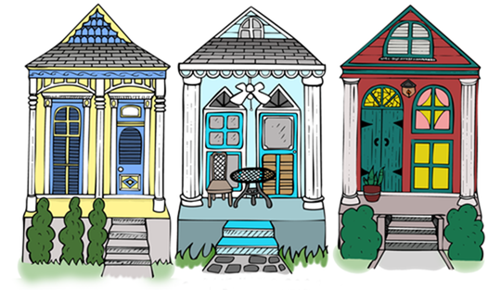
Housing & Resilience
Session 4: Before and After Disasters

Slide 2
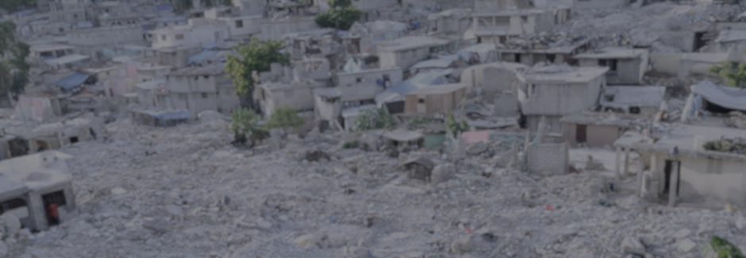
If half the population of an urban area lived in inadequate and unsafe housing before a disaster, it follows that housing is an acute and overwhelming need after a disaster.
Disaster recovery simply overlays new, urgent issues on the long-term problems of inadequate housing.
Habitat for Humanity – Shelter Report 2012

Slide 3
Disaster Preparedness and Housing: What is housing preparedness?
Infrastructural Preparedness: examples include roofing maintenance, insulation and shuttering, lifting, etc.,
Financial Preparedness: personal insurance (flood, homeowners, rental),personal planning, government assistance (NFIP)
Systems / Resource Preparedness: short and long-term sheltering, emergency housing, community
Social Preparedness: cohesion and neighborhood planning, neighborhood norms
These categories are intersectional!

Slide 4
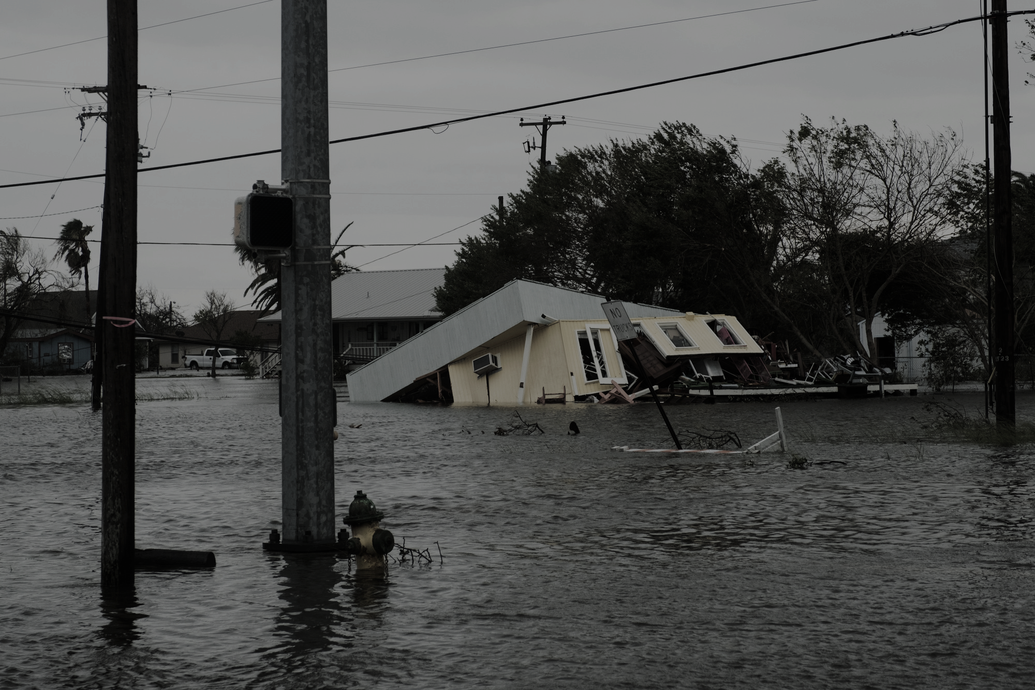
In Louisiana 42% of homes in high risk areas are flood insured. Only 12.5% of homes in mid-low risk areas are insured.
FEMA; 2016

Slide 5
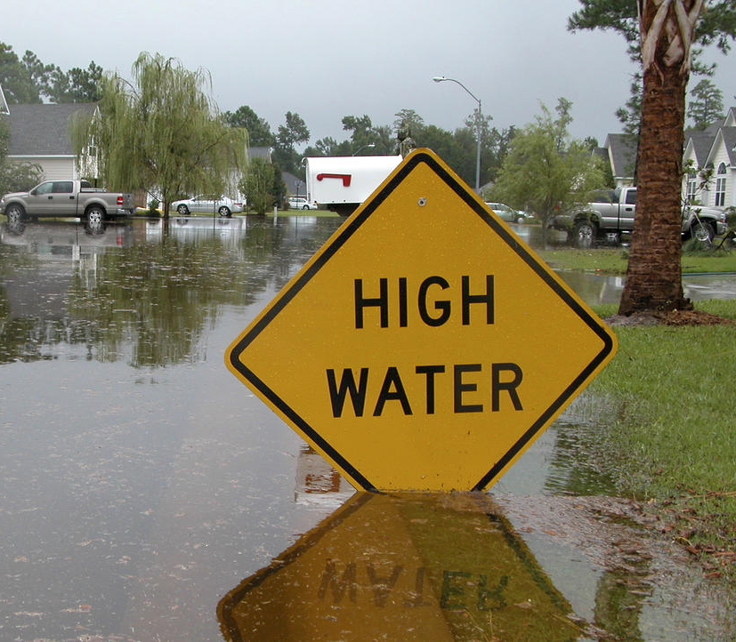
Understanding Flood Insurance in Louisiana
Homeowners and renter’s insurance does not typically cover flood damage.
Flood insurance 1) may be required by mortgage lenders, 2) goes into effect 30 days after policy purchase
Flood insurance is separate from FEMA’s National Flood Insurance Program (NFIP)
Requires State of Emergency (SOE) and subsequent Presidential Declaration of Disaster (PDOD)
SOE is often declared in anticipation of requesting FEMA funds
no SOE, no FEMA

Slide 6
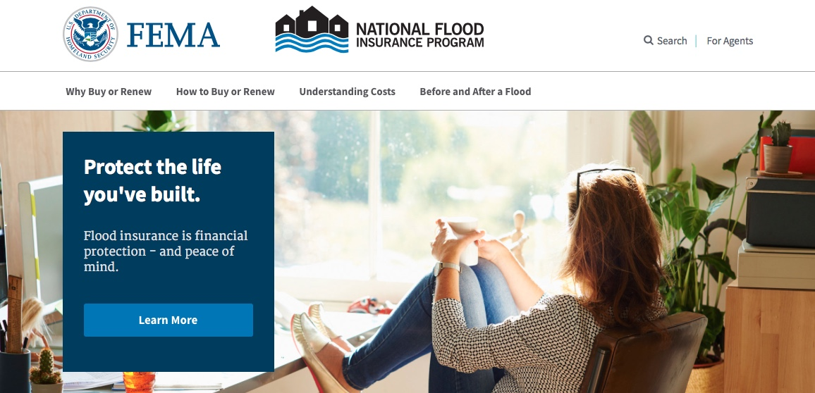
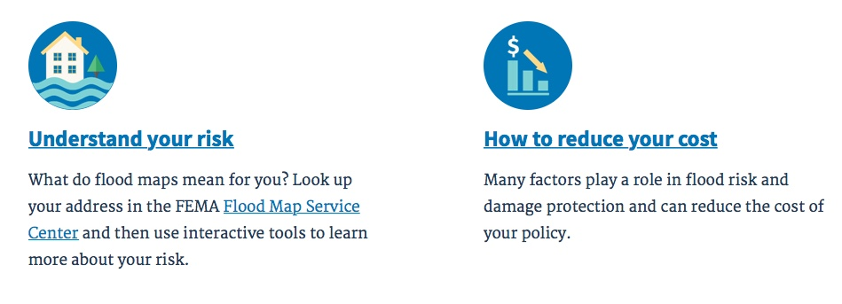
Resource: Helping Clients Understand & Seek Flood Insurance
www.floodsmart.gov
Research: help your client understand and research their area, requirements, community discounts etc.,
Connect: clients to and insurance agent or get a referral from the NFIP Referral Call Center: 1-800-427-4661
Maintain and follow up: help clients create a housing maintenance plan and follow up with resources like LA Department of Insurance: 1-800-259-5300

Slide 7
Consider keeping paper copies of this information on file, or encouraging clients to maintain this information in their files / go kit. Internet may be inaccessible during and/or after the event.

Slide 8
Toolkits for Preparedness: HUD Housing Counseling Disaster Planning, Response and Recovery Toolkit
Available via HUD’s official website
English only
Access here: https://www.hudexchange.info/programs/housing-counseling/housing-counseling-disaster-recovery-toolkit/preparing/

Slide 9
Toolkits for Preparedness: HUD Housing Counseling Disaster Planning, Response and Recovery Toolkit
Who should use this toolkit? HCAs, Intermediaries, State Housing Finance Agencies, and Multi-State Organizations that want to be prepared to play an active and effective role in local disaster recovery.
What is in this toolkit? This guide provides concrete guidance on how to prepare your agency and clients for a disaster. This includes:
Implementing disaster counseling programs
Implementing group education focused on housing
Post-disaster procedures related to housing issues
Planning for disasters and maintaining/seeking housing

Slide 10
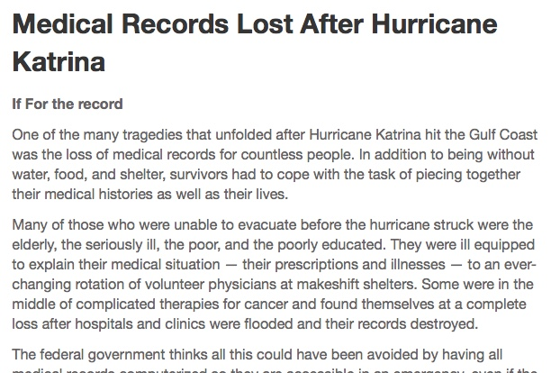

Slide 11
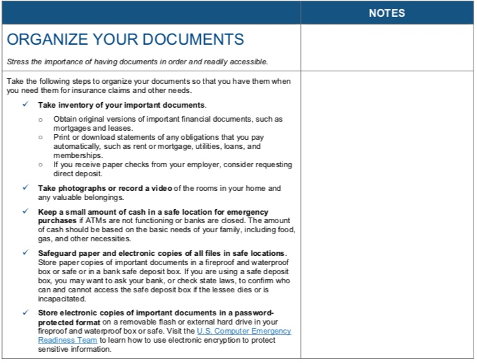
Toolkits for Preparedness & Organizing: Documents and Templates
HUD focuses on 1) maintaining your property, 2) preparing your property, and 3) preparing to leave your property
One of the greatest barriers to accessing post-disaster funds for relief / housing repairs is lack of documentation.

Slide 12
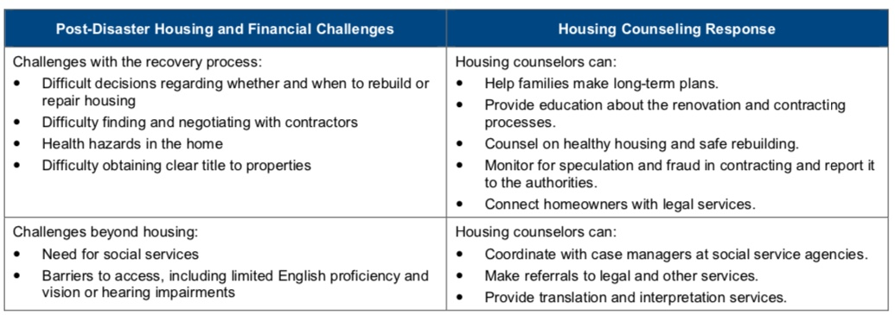
Toolkits for Preparedness & Organizing: Counseling Post-Disaster
Provides scenario-based counseling guides and recommendations with resources and links for homeowners, homeless, and renters.

Slide 13
Toolkits for Preparedness & Organizing: Counseling Post-Disaster
Also offers resources for agencies and counselors who: 1) do not have capacity to offer services after or during event, 2) do not offer the services and 3) do not specialize or have knowledge in disaster housing

Slide 14
Toolkits for Preparedness & Organizing: Housing Preparation Timelines
prepare
respond
react
STAY OR LEAVE

Slide 15
Toolkits for Preparedness & Organizing: Housing Preparation Timelines
prepare
HUD recognizes that agencies (especially those that directly or primarily deal with housing issues) need to balance preparedness of clients, agency operations, facilities, and staff.
This toolkit offers guidance and materials the manage various needs across various stages of disaster.
respond
Considers ultimate goal to be coalition building
react
STAY OR LEAVE

Slide 16
Coalition building offers the opportunity to holistically address housing issues post disaster.

Slide 17
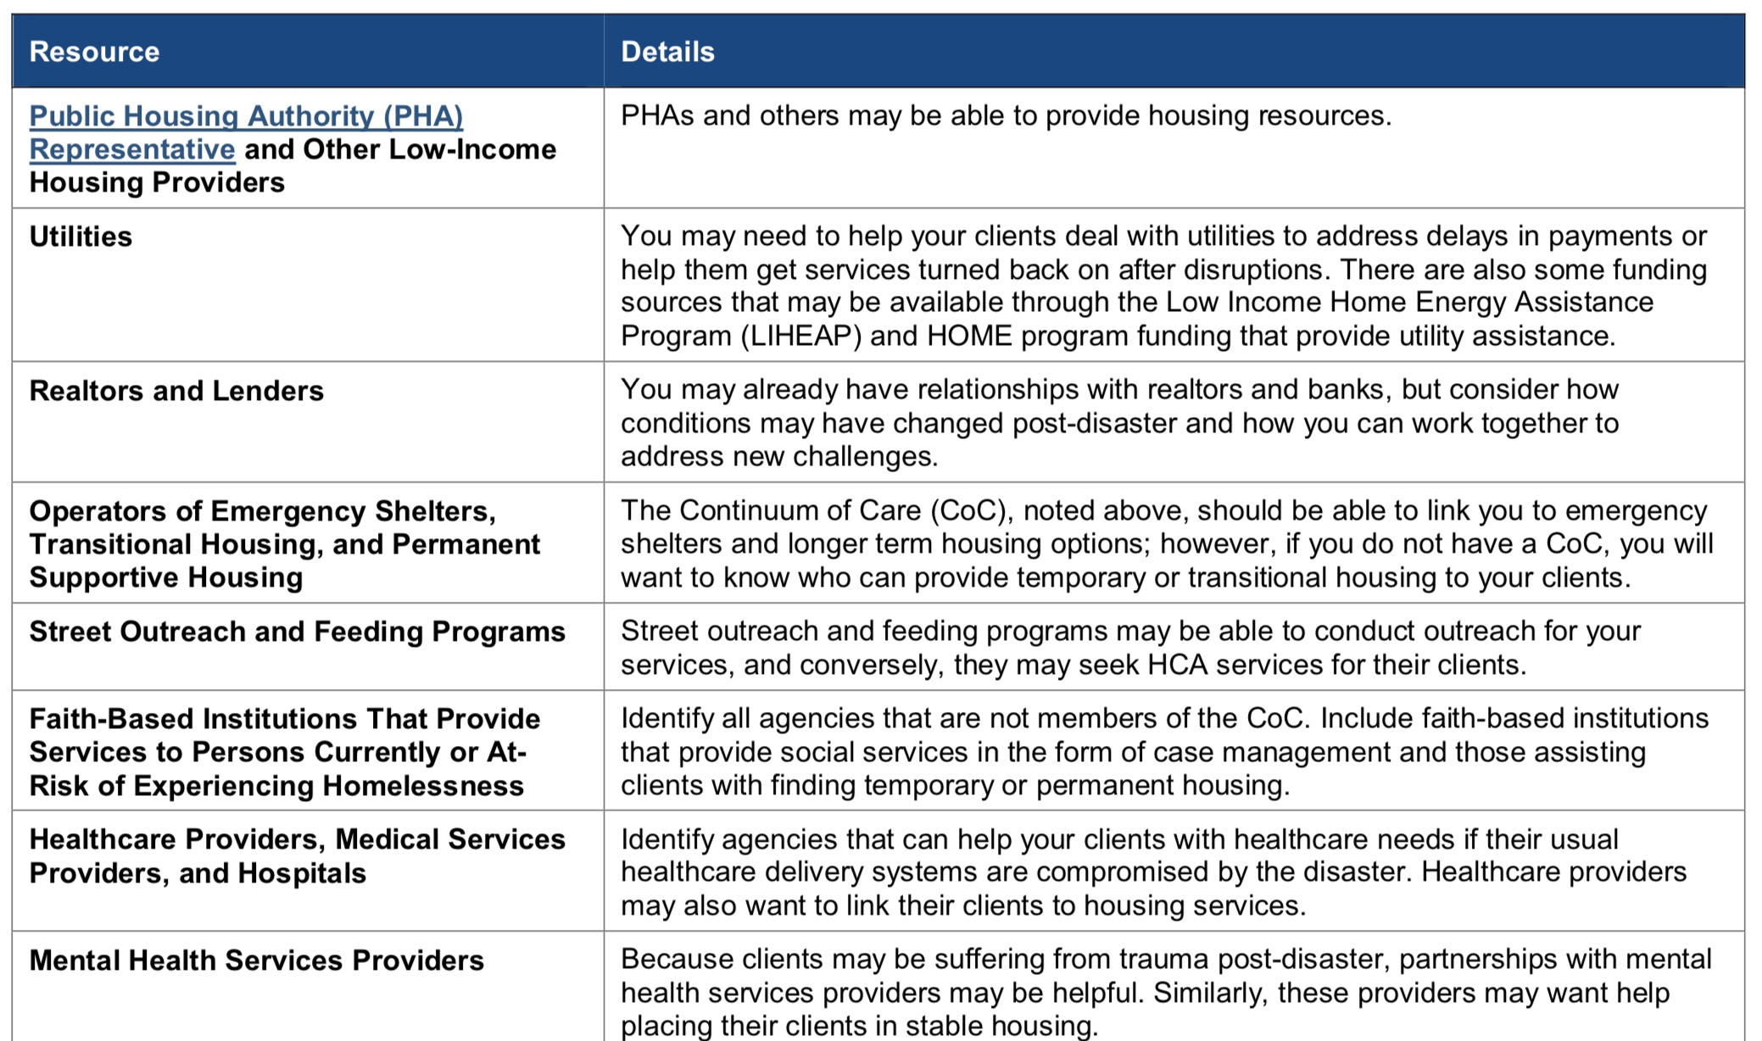

Slide 18
How Do I Make Use of This Toolkit?
Holistic preparedness, response and recovery is the primary focus of this toolkit
Before: Analyze and develop understanding of agency capacity to address housing
After: Develop relationships and partnerships with agencies that manage housing with coalition building as goal.
Materials focus on agency development and client outreach
Before: Research local agencies active in disaster (VOAD), and those that support housing services.
After: Create and disseminate information across disaster continuum.

Slide 19
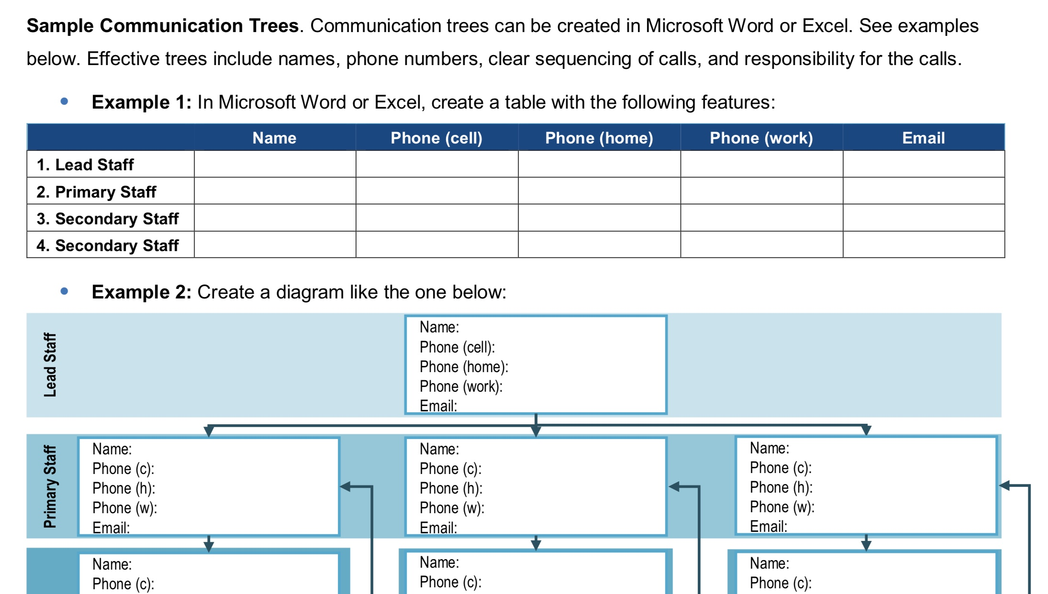

Slide 20
THANK YOU!

