Slide 1
Disaster Resilience & Coalition Building
Session 1: Introduction to Disaster Resilience & Risk Communication

Slide 2
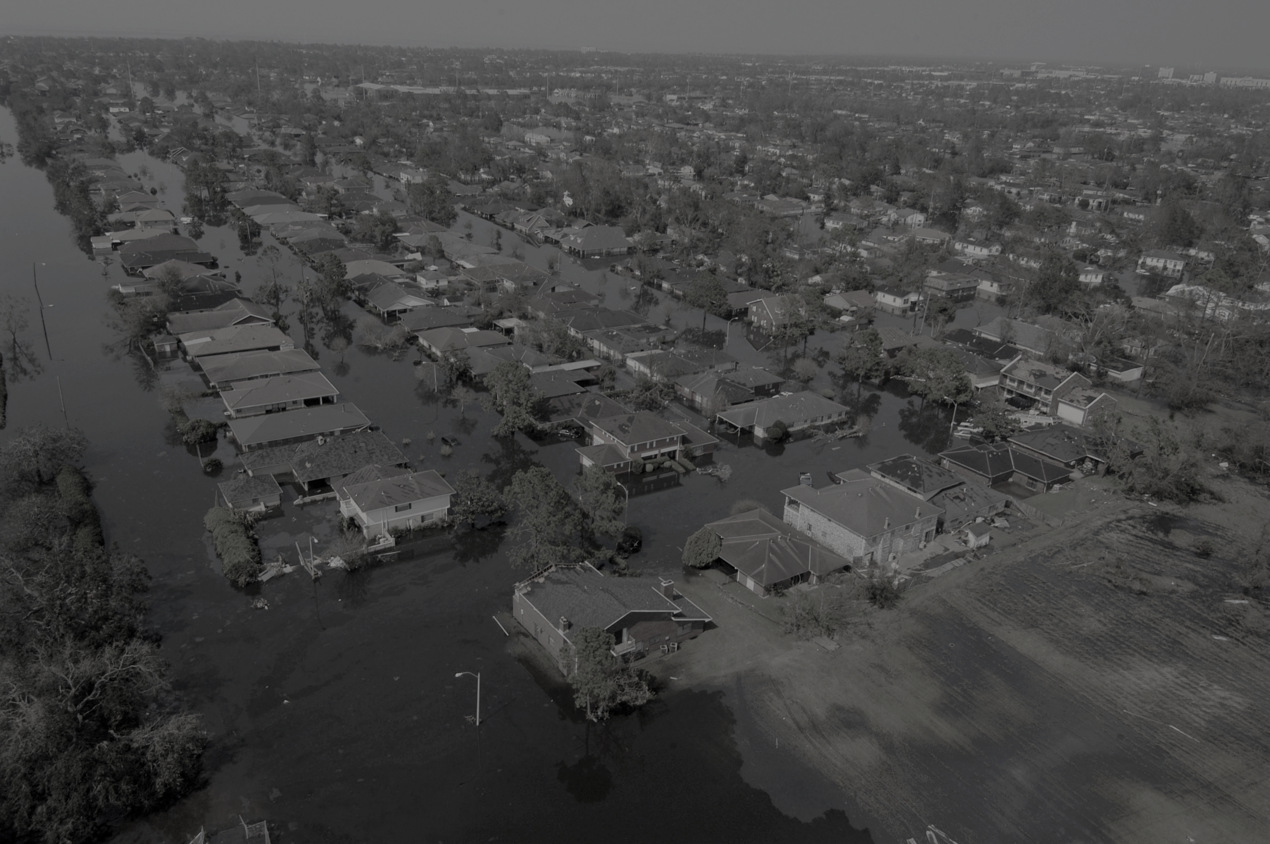
2017/2018 are the costliest years on record for natural disaster*
How can we help improve disaster outcomes and prepare our clients, agencies, and selves as we continue to face natural disaster events?
*https://www.ncdc.noaa.gov/billions/overview

Slide 3
Introduction to Concepts in Disaster Resilience
There are 5 recognized stages of disaster: Preparation, Prevention, Response, Recovery, and Mitigation.
85% of the population of Louisiana is in what is considered active recovery from disasters.
New Orleans has experienced Hurricanes, Flooding, Flash Flooding, Unexpected Rain Events, Heat Waves, High Risk Freeze Events and Tornadoes; six of these types of events have occurred in the past two years.
State hazards also include storm surge, subsidence, wildfire/marsh fire, dam failure, levee failure, and hazardous materials incidents.
New Orleans is considered a city of high risk and of low resilience* based on an analysis of 1) natural environment, 2) built environment, 3) societal environment, 4) generalized risk, and 5) governance.
*(EPA; 2017)https://cfpub.epa.gov/si/si_public_record_report.cfm?dirEntryId=337914

Slide 4
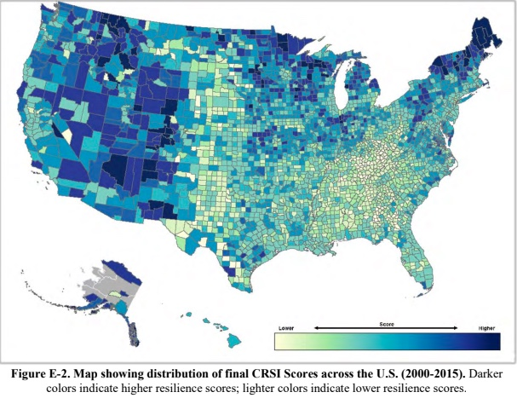
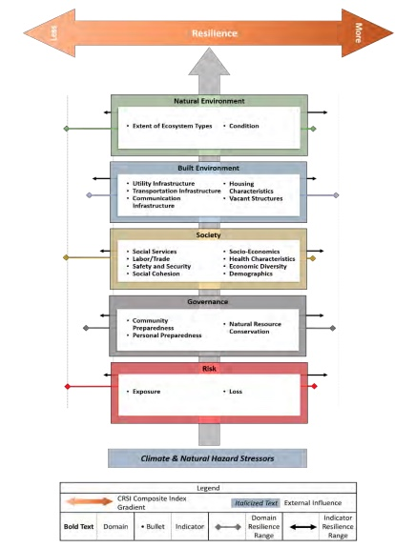
Louisiana is located in EPA Region 6 which received a score of 2.77 / 10.00 on the Climate Resilience Scale Index.

Slide 5
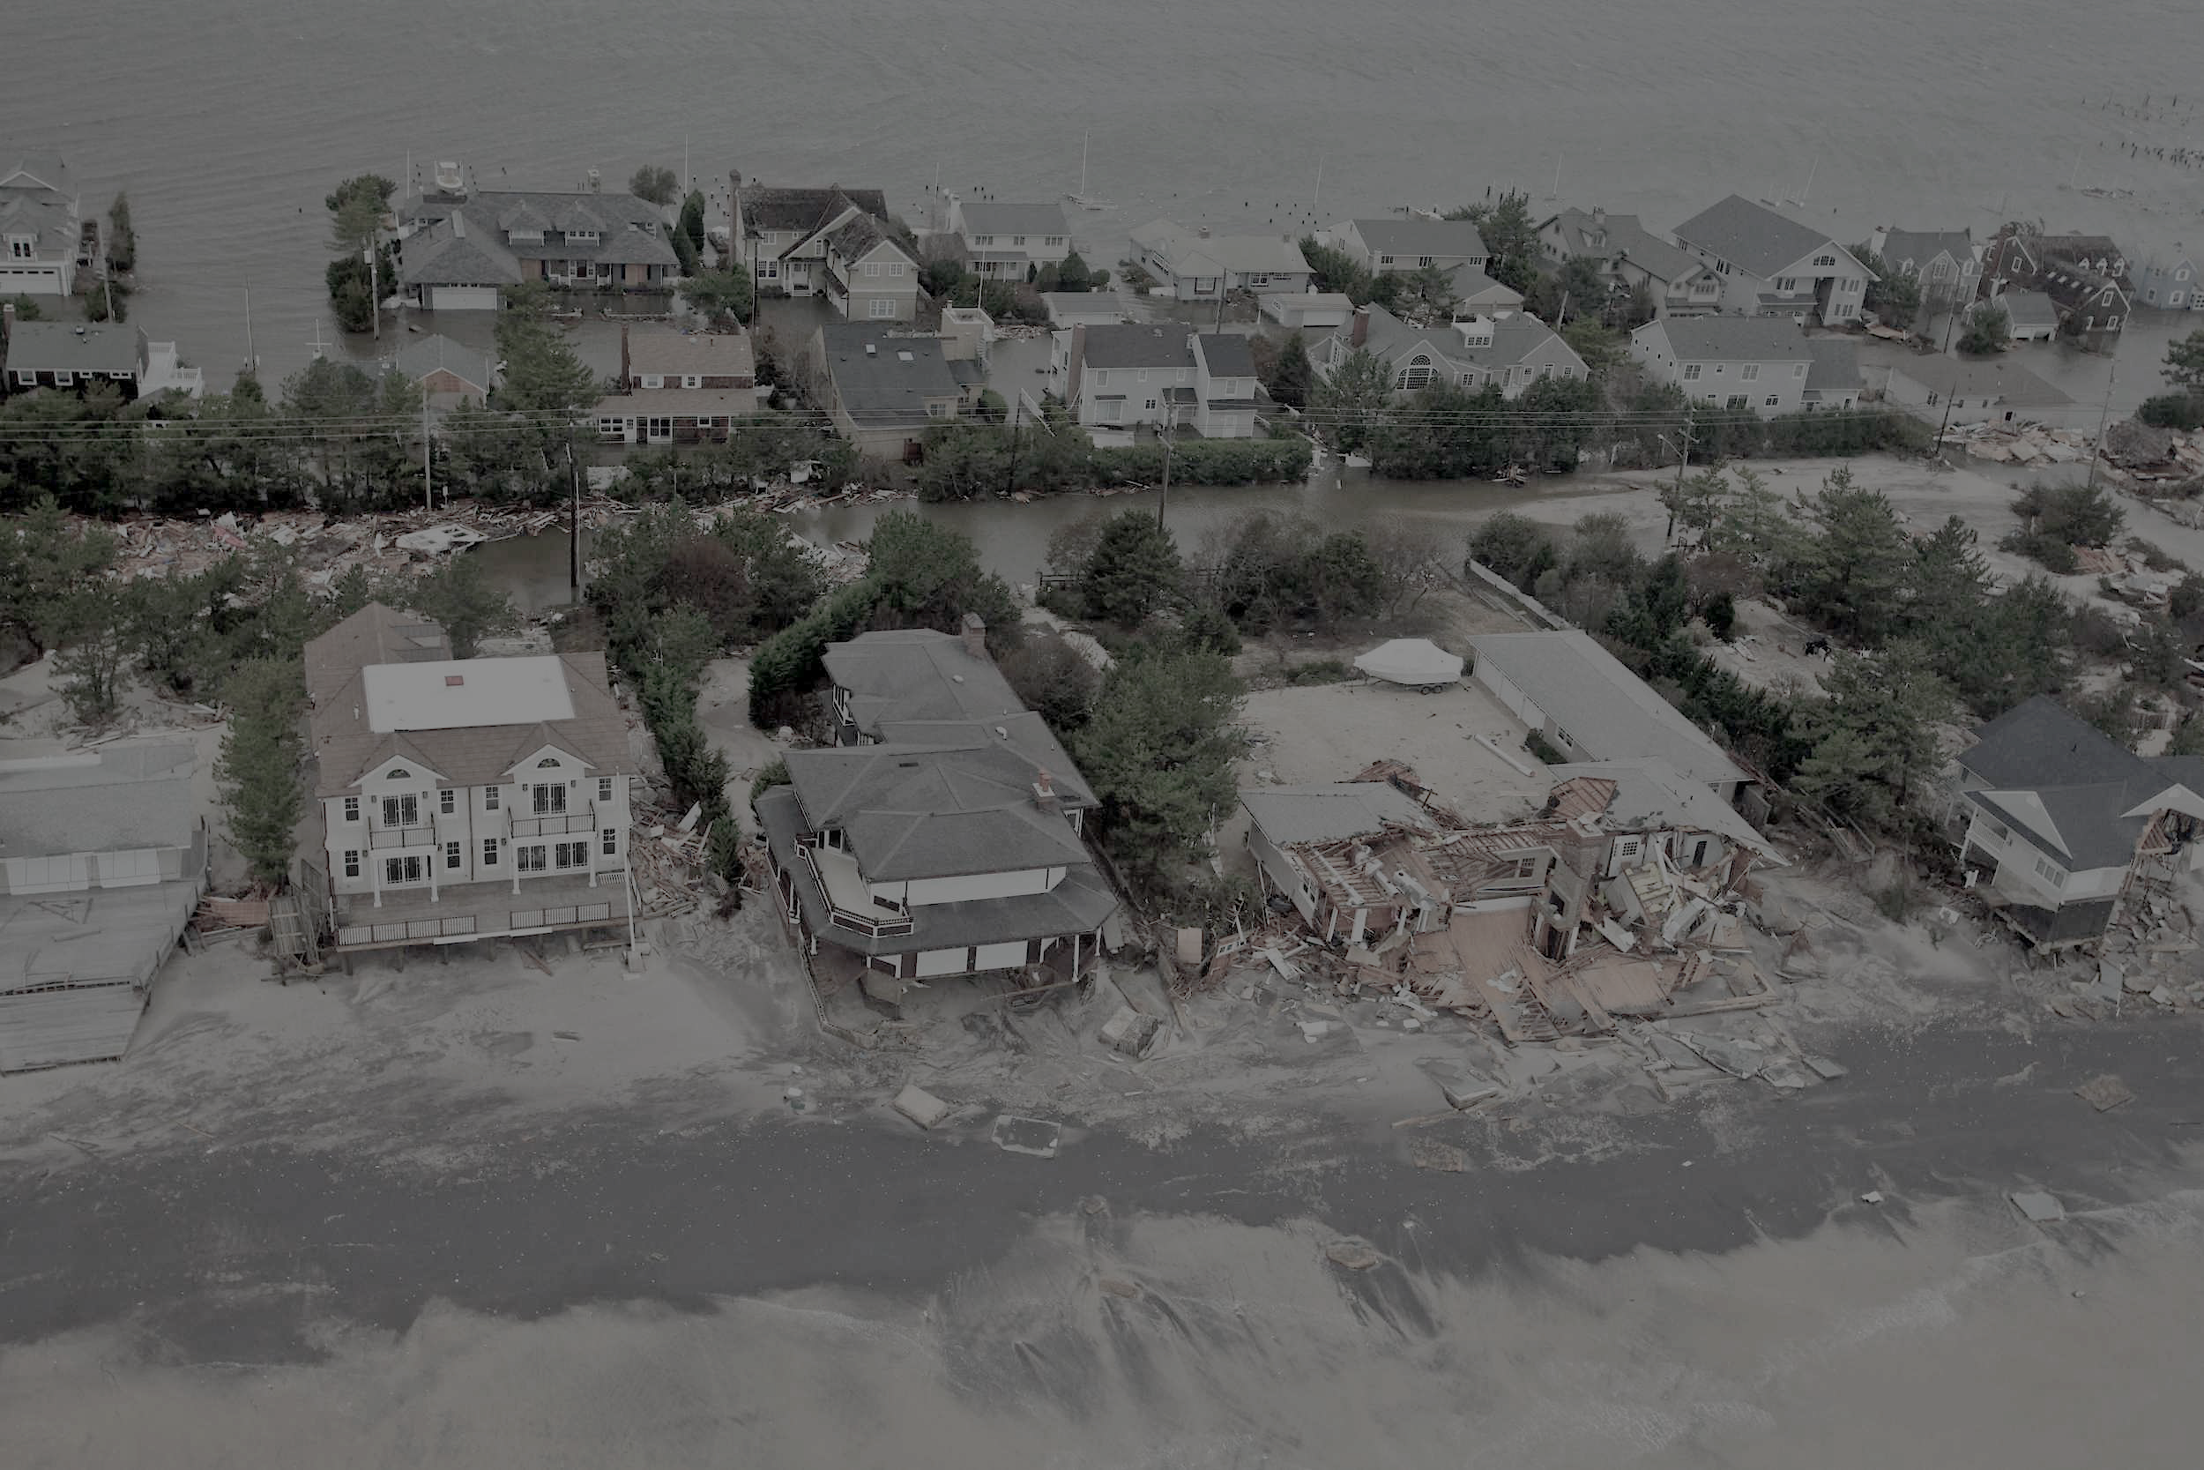
Communicating and understanding risk is the first step towards building resilience
This is called Disaster
Risk
Reduction
DRR

Slide 6
When Communicating Risk with Clients …
Communicating risk is an important part of developing and improving resilience.
No two communities, agencies, or individuals are perfectly alike in their chosen risk assessment methods or results.
A client’s assessment of risk and that of the city, state or government may differ.
Consider accessibility of information, language, individual and community needs, and safety when communicating risk:
Can my client access these resources?
Can my client understand this information?
Does my client need this information / need more than what is available?
Is it safe and moral to share this information with my client / will it cause more harm than good to share or discuss this information at this time?

Slide 7
Building a Picture of Personal and Community Risk: Mapping
It is important to understand how you, your agency, your geographic area, and your clients are “seen” or “categorized” by the city in the event of a disaster or evacuation.
LSU Flood Map (http://maps.lsuagcenter.com/floodmaps/)
Tip: Many people in New Orleans and Louisiana have already experienced flooding; build off of these lived experiences by connecting them to these resources while acknowledging the narrative.
Ready NOLA Evacuation Map (http://ready.nola.gov/plan/hurricane/)
NOLA District Maps (http://www.nolacitycouncil.com/maps/maps.asp)
Tip: Residents may not ‘adhere to’ or prefer these distinctions; it is important to understand both the city’s understanding of neighborhood geography and that of your client’s.
Louisiana falls under: 1) FEMA Region 6, and 2) EPA Region 6; Orleans and Jefferson Parish fall under GOHSEP* Region 1.
*Governor’s Office of Homeland Security and Emergency Preparedness

Slide 8
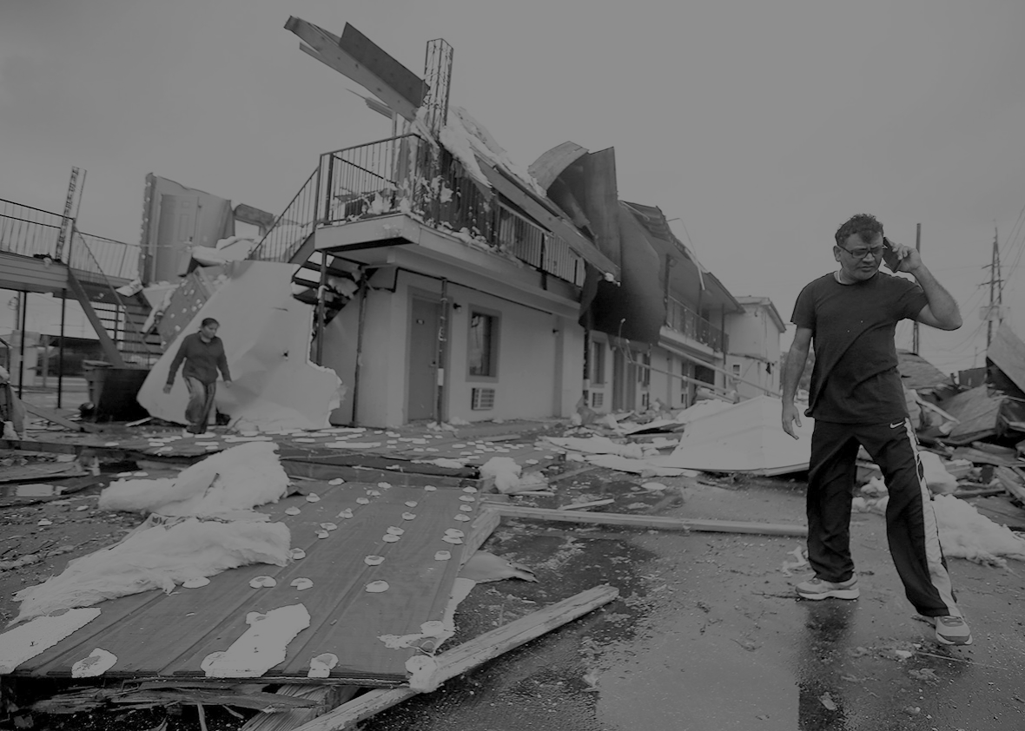
The Golden Rule of Disaster Risk Communication:
“Be First.
Be Right.
Be Credible.”

Slide 9
Toolkit for Client Communication: CDC Crisis & Emergency Risk Communication
“Be First. Be Right. Be Credible .” Regardless of when you are communicating risk, consider the golden rule of disaster communication.
Agencies and Providers can leverage relationship by ensuring that the information disseminated follows the above rules.
Acts as a checklist of due-diligence

Slide 10
Toolkit for Client Communication: CDC Crisis & Emergency Risk Communication
This toolkit was developed to:
Introduce Topics in Disaster Communication
Help agencies determine their audience and to assess best methods of communication
Educate leaders on managing conflict and dismantling rumors around subjects in disaster, as well as practice non-violent communication
Help improve internal communications around risk and disaster communication
Offer scorecards, tools, and rubrics to measure client communication preferences, agency credibility, agency morality, and communication plan effectiveness
Assess and weigh the risk of planned or intended communications with clients

Slide 11
Accessing the CDC CERC Toolkit
You may also request free hardcopies of manuals and workbooks by filling out this request form: https://emergency.cdc.gov/cerc/resources/pdf/cercmaterialsrequestform.pdf
You can access the toolkit series online at the Center for Disease Control’s (CDC) website: https://emergency.cdc.gov/cerc/resources/index.asp

Slide 12
CERC Toolkit
The CERC Toolkit has four domains:
Trainings
Manuals & Toolkits
Newsletter
Publications & Recording

Slide 13
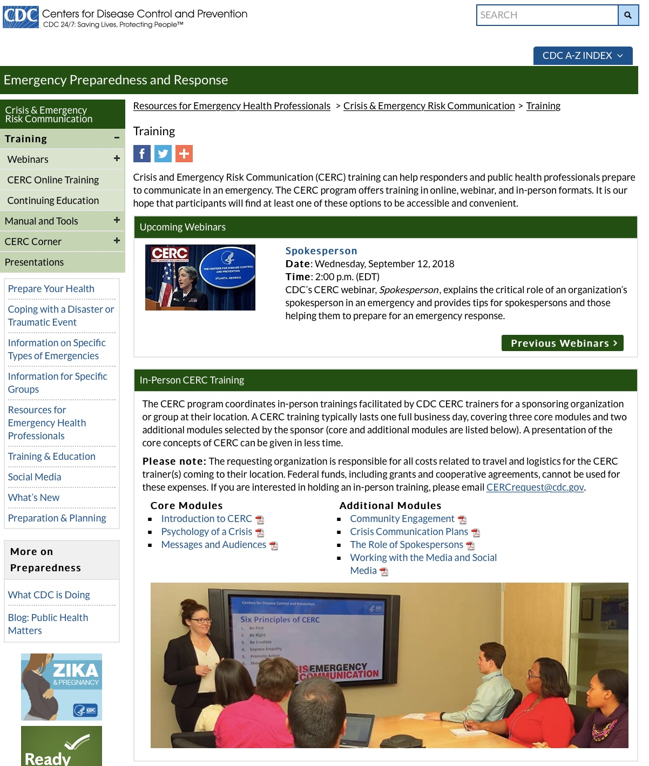

Slide 14
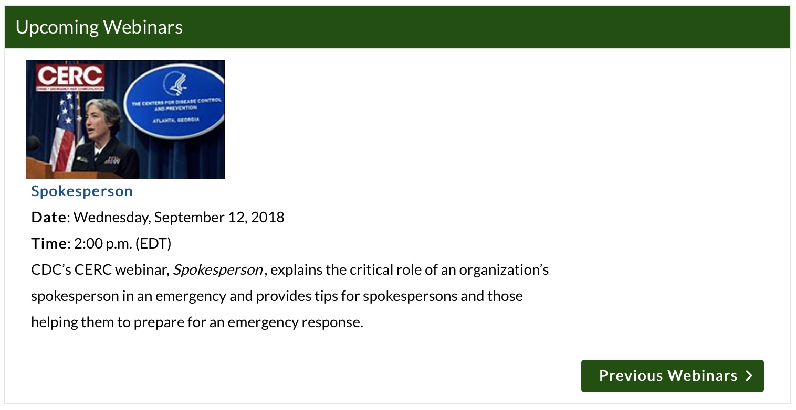
CERC Trainings: Webinars, Online, and Offline
Tailored t0 professionals and agencies that
Work with or represent clients at risk for crisis or disaster
Professionals or agencies that are highly visible in their communities and wish to pursue best disaster communication practices
Spokespersons and/or communications managers

Slide 15
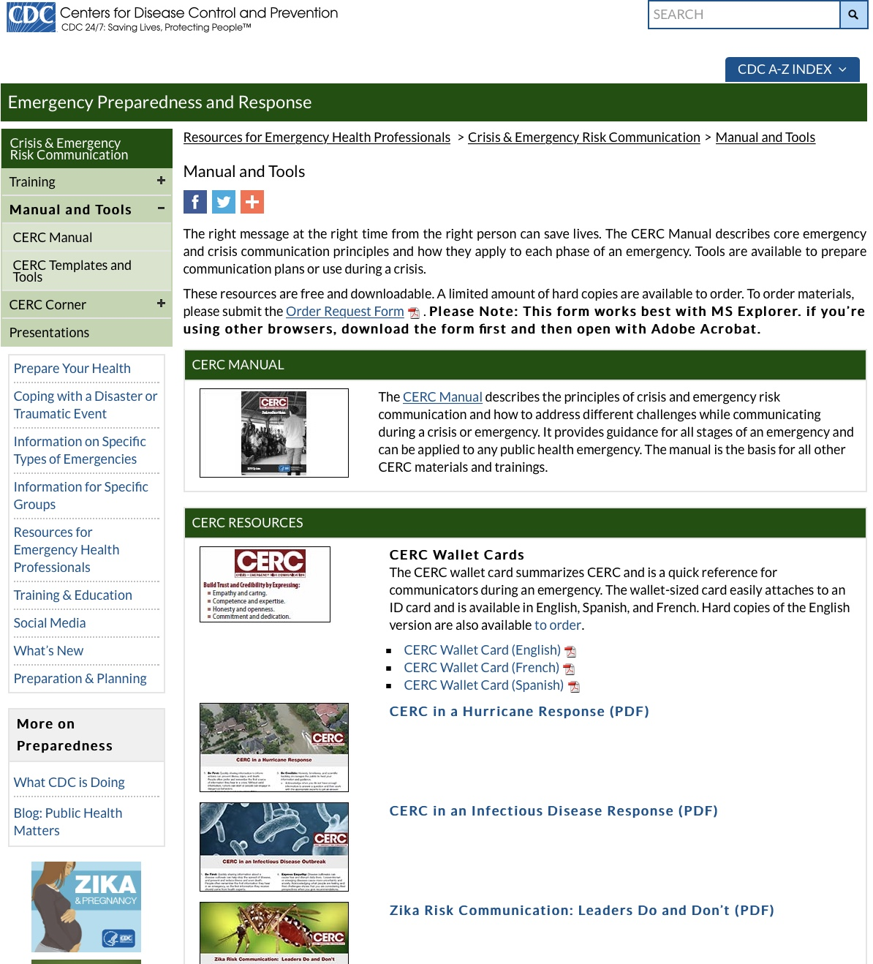

Slide 16
CERC Manual Chapters & Indicated Use
Published in English, French, and Spanish
Updated Annually
Self Guided or Paired with Trainings
Additional Resources Address: Disaster Resilience, Hurricane Response, Infectious Diseases, Zika, and Risk Assessment
CDC Risk-Smart Assessment

Slide 17
Disaster Risk Communication always starts with self assessment.

Slide 18
How Do I Make Use of This Toolkit?
It is recommended that you perform a ‘needs assessment’ before working with this toolkit; ask yourself / agency:
What is our current communication model?
Does it differ from our crisis/emergency communication model?
What are our strengths and weaknesses?
WHO speaks for our agency?
What do I need to know about my clients and context to communicate effectively?
What materials are we lacking / Do we know HOW to communicate what we need to, and what resources do we need to do so?
What else might you need to ask yourself or your agency to better assess your communication needs or readiness?

Slide 19
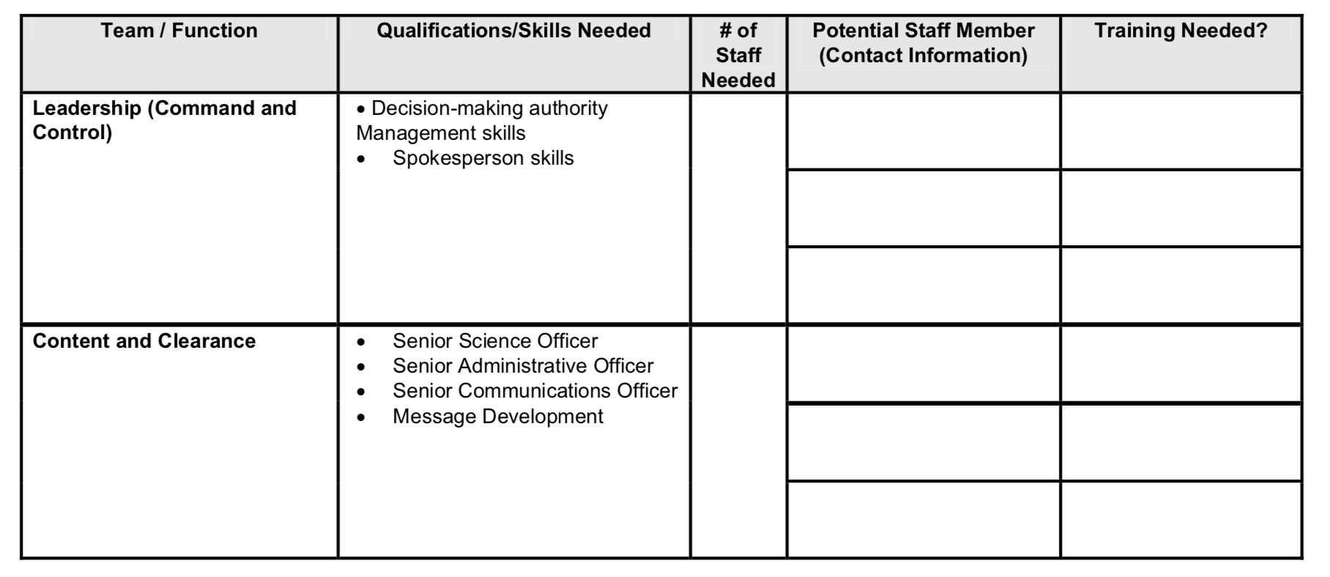
How Do I Make Use of This Toolkit? Self Assessments Worksheets

Slide 20
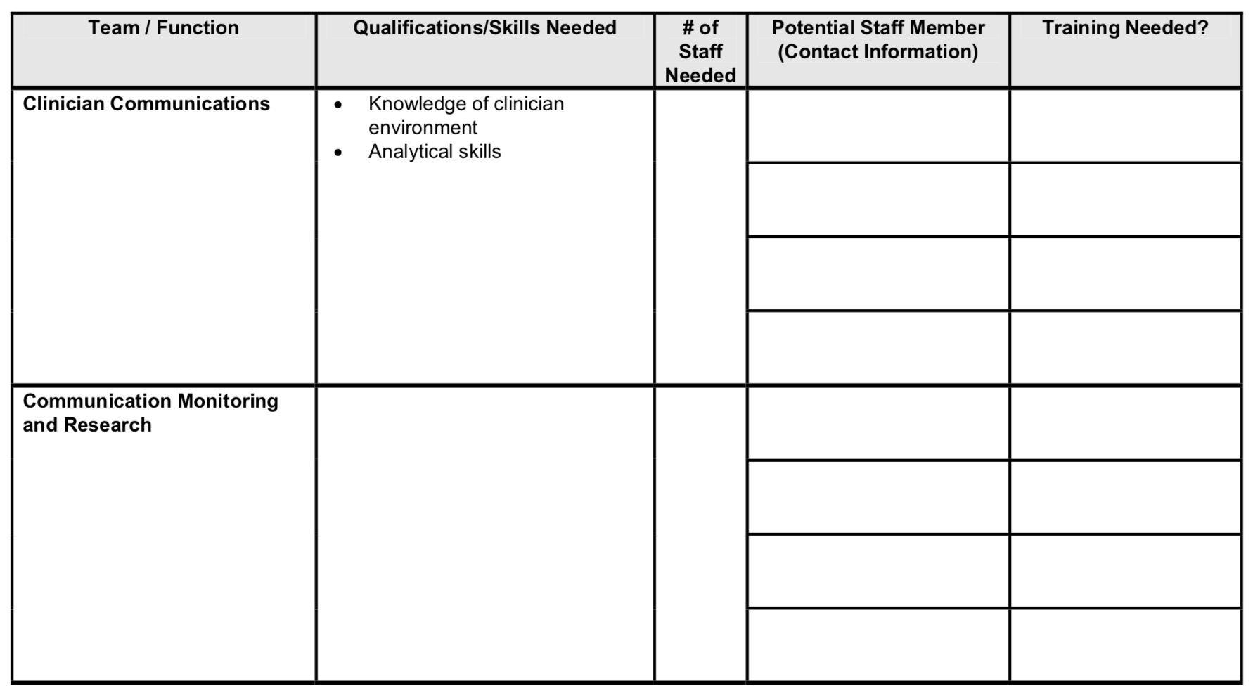
How Do I Make Use of This Toolkit? Self Assessments Worksheets

Slide 21
Good Disaster Risk Communication is not just a matter of content.
It is a matter of the purveyor.*

Slide 22
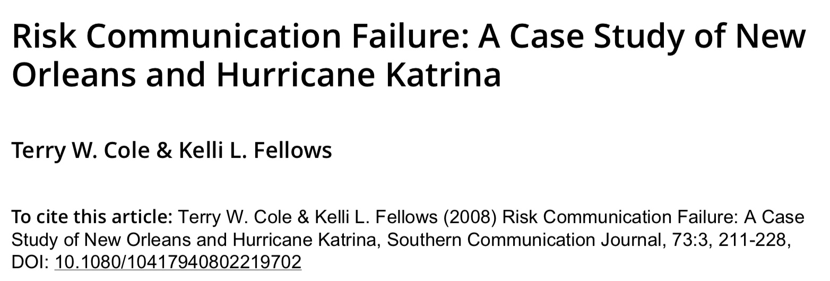
*

Slide 23
Tool for Risk Reduction: CDC-Risk Smart
A system to detect, assess and help the organization respond to the opportunities and threats inherent in credibility/reputational risk.
Organizations may have more or less risk tolerance but no organization will ever be free from risk nor should it pursue that as its goal.
Regardless of where a risk is generated, most risks can be anticipated, its threats mitigated, and opportunities enhanced.

Slide 24
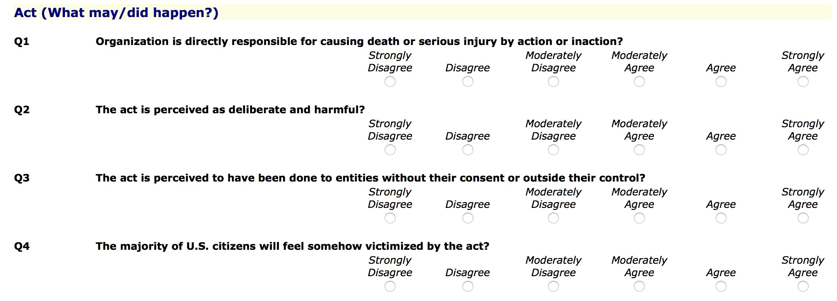

Slide 25
How Does This Connect to Coalition Building? Filling in the Gaps
Discussing Risk: Having an open conversations about risk serves as a good opportunity to not only ‘break the ice’, but to reveal blind-spots and asses them critically. Mapping services, coverage, etc., helps to visualize this important information.
Filling the Gaps: There are several activities that may help your coalition assess risk.
‘Community Talent Survey’ & Agency Assets Inventory
CERC Core Principles Rubric
CDC Risk-Smart: Consider sharing your CDC Risk-Smart Score, OR, develop a scenario to score and analyze as a team. The pursuant discussion may reveal differences in communication and leadership styles and may assist in working towards eliminating bias.
Recruitment: Analyze and assess your results. Are there blind-spots or areas in which you lack coverage? Is there someone else you can invite to the table that may fill these gaps?

Slide 26
THANK YOU!
Next Week:
Session 2: Disaster Preparedness

