Slide 1





Session 1: Introduction to Collaborative Care & Care/Case Management for Depression
C-LEARN
Mental Health & Resilience

Slide 2

Introduction
Speaker: Wayne Bentham, MD
Presentation:
  Overview of the Collaborative Care Model
  Approach to implementation of Collaborative Care Model based on organization/agency resources
  Collaborative care tools available in C-LEARN

Slide 3




The Collaborative Care Model- Overview
PRIMARY CARE CLINIC TREATMENT OF DEPRESSION
Care Coordinator
Screen for depression
Make initial appointment
Contact patient between appts
Provide counseling
Track outcomes of treatment
Coordinate Care with psychiatrist
Communicate recommendations
from psychiatrist to PCP
Consulting Psychiatrist
Review information
Make recommendations

Slide 4







The Collaborative Care Model-Overview
Consulting Psychiatrist
Care Coordinator
Registry
“Make sure NO ONE falls through the cracks”

Slide 5


The Collaborative Care Model-Overview
PRIMARY CARE MANAGMENT OF BEHAVIORAL HEALTH
Consulting Psychiatrist
Care Coordinator
Home Health Giver
Case Manager
AODA
Therapist

Slide 6
The Collaborative Care Model- Overview
COLLABORATIVE CARE FOR DISEASE MANAGEMENT
Proactively:
Coordinate care
Track clients
Consulting Psychiatrist
Care Coordinator
Settings
Primary Care
Cancer Care
Cardiovascular Care
Diabetes Care
Chronic Pain
Post Disaster
Chronic Illnesses
Depression
Anxiety
PTSD
Bipolar Disorder
Chronic Pain
Diabetes

Slide 7
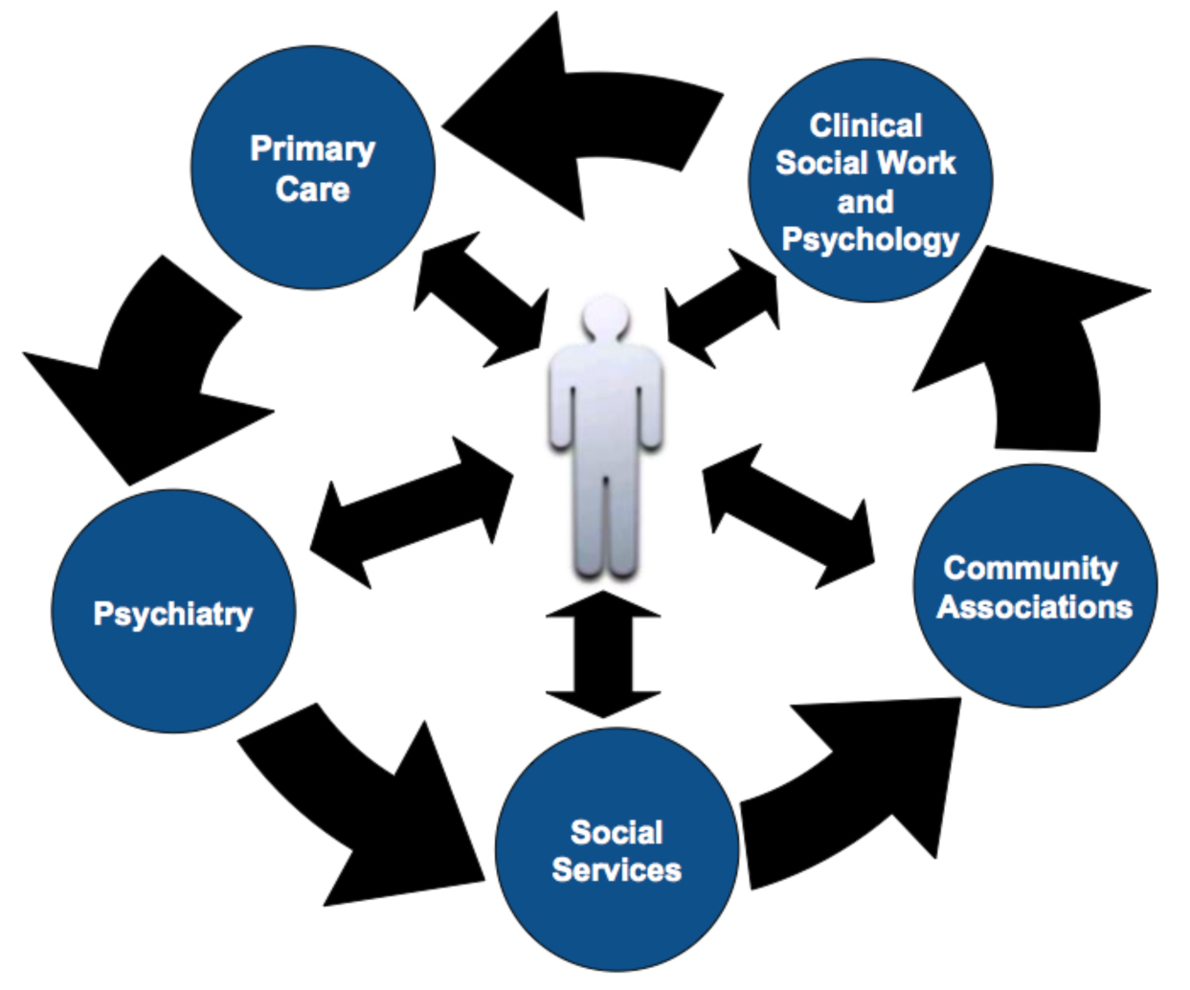
The Collaborative Care Model- Overview

Slide 8
Transformed Chronic Illness Care
Health System Organization
Leadership commitment to quality
Aligned incentives
Self-Management
Support
Skilled clinical educators
Psychosocial (group visits)
Change plans
Clinical Information
Systems
Registry with key clinical data
Reminders
Measurement
Delivery System
Design
Nurse case manager
Guideline roles clear
Planned follow-up
Decision
Support
CME
Feedback
Guidelines
Consultation
+ Links to Community Resources
Informed,
Activated
Patient
Productive
Interactions
Prepared
Practice
Team
Better Functional and Clinical Outcomes
8 2-2006

Slide 9

The Collaborative Care Model
Clinic
Admin
Comm
Outreach
Co-ordinators
Community
PCP
Outreach
Workers
Case/Care
Managers

Slide 10
Roles for Administrators
Clinic
Admin
Comm
Outreach
Co-ordinators
Community
PCP
Outreach
Workers
Case/Care
Managers

Slide 11



Roles for Administrators
“Collaborative Care Champions”
Developing collaborative care infrastructure
Align collaborative care tasks with people
Support quality improvement
Foster growth in knowledge, attitudes, skills at all levels to support collaborative care
Develop sustainability plans & partnership agreements
Promote a culture of hope

Slide 12
Goals for Case Managers and Outreach Workers
Clinic
Admin
Comm
Outreach
Co-ordinators
Community
PCP
Outreach
Workers
Case/Care
Managers

Slide 13

Goals for Case Managers and Outreach Workers
Promote health and wellness
Reduce stigma
Referral & Education
Assist those who are suffering
Be culturally competent/sensitive

Slide 14

Activities for Case Managers and Outreach Workers
Screening – a tool to identify people with health conditions (e.g., depression) and stress
Education – provide and explain materials on health/stress
Referrals – help make and follow up on referrals using resource guides
Client Support – provided through behavioral activation (return to pleasant activities) and problem solving skills
Advocacy – promote and encourage positive health behaviors and access to care
Follow-up – check client progress and provide assistance to connect to services if needed, within the scope outlined by your organization

Slide 15
Roles for Community Outreach Coordinators
Clinic
Admin
Comm
Outreach
Co-ordinators
Community
PCP
Outreach
Workers
Case/Care
Managers

Slide 16

Roles for Community Outreach Coordinator
Responsible for leading organization’s outreach efforts
Organize and/or participate in task forces, coalitions, self-help groups, community support networks, councils
Help identify community health and social needs, locate resources and initiate problem-solving actions for agencies
Provide education and/or consultation to individuals and communities regarding services and programs
Possibly work with care managers to track outcomes and coordinate care for patients
Expand or enhance abilities of agencies and groups to respond to health and social needs of the community

Slide 17
Roles for Primary Care Providers
PRIMARY CARE CLINIC MANAGEMENT OF BEHAVIORAL HEALTH
Primary Care Provider
Assessment
Treatment
Referrals
Culturally competent care
Track for poor treatment
response
Support effective follow-up
adherence, reinforcement
Consulting Psychiatrist
Care Coordinator/Manager

Slide 18
Roles for Consulting Psychiatrists
PRIMARY CARE CLINIC MANAGEMENT OF BEHAVIORAL HEALTH
Primary Care Provider
Consulting Psychiatrist
Medication management
Respond to mental health emergencies
Provide prescriptions
Support treatment plans
Provide education and consultation
to other team members
Support and participate in quality improvement
Care Coordinator/Manager

Slide 19

Roles for Therapists
PRIMARY CARE CLINIC TREATMENT OF DEPRESSION
Consulting Psychiatrist
Care Coordinator/Manager
Therapist
Reduce Stigma
Psychotherapy & Education
Referrals
Cultural competency
Monitor outcomes
Work & supervision with
care managers
Support QI efforts

Slide 20
Trust Building Strategies
These strategies are applicable to all providers:
  This is a critical first step!!!
  Reinforce with each interaction
  Develop a relationship
  Understand your client and the situation
  Understand your community
  Be honest with what you offer and can do; acknowledge limitations
  Be reliable and show up
  Acknowledge client’s strengths

Slide 21
Implementation: Tailoring Activities to Programs and Providers
The scope or job description should be tailored to the needs, capacities, and limitations for each organization.
In some organizations “follow-up” may include on-going record keeping of appointments and scoring of outcome measures;
In others it may involve simply asking general questions such as “Were you able to see the therapist I recommended?” and taking note of the response.

Slide 22
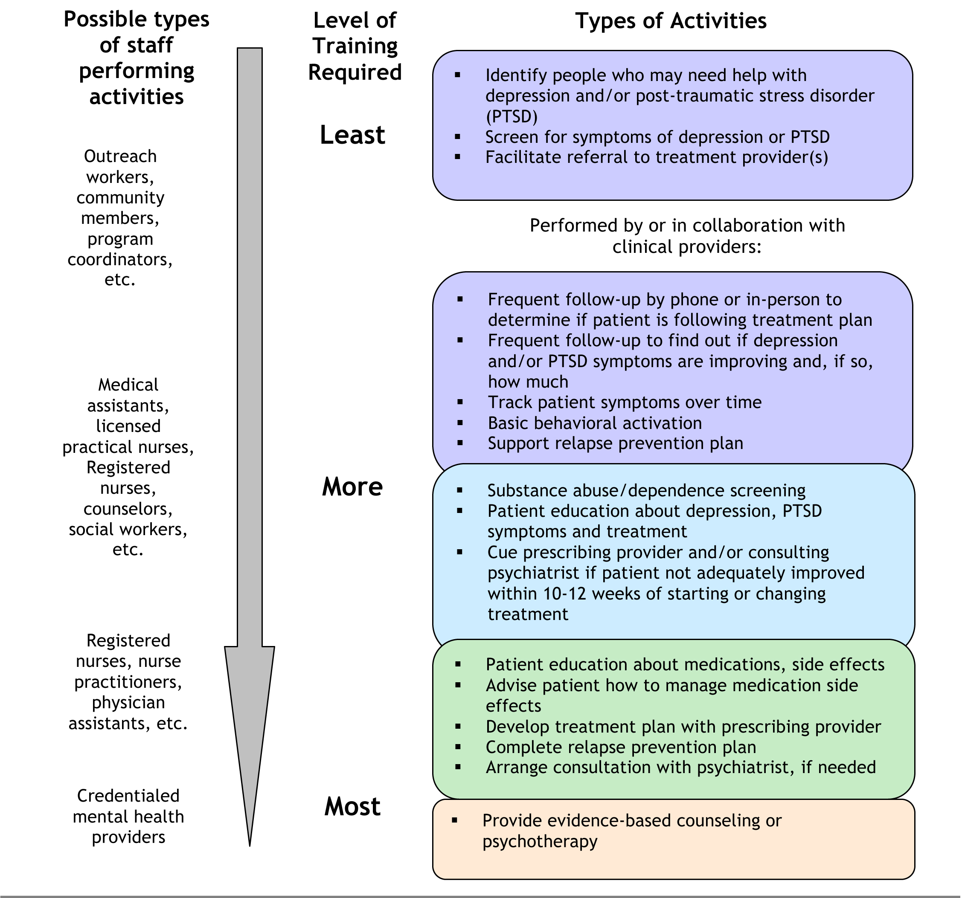
, post-traumatic stress disorder (PTSD),
and anxiety
, PTSD, and anxiety
, anxiety,
, anxiety
, psychotherapy, or
medication management

Slide 23

Patient Education
C-LEARN Tools: Client Education Materials

Slide 24
Client Steps from Depression to Recovery (1 - 5)¹
Q.1 Do I have depressive symptoms?
Book Chapter
Resources/Tools
Step 1 (Ch. 1)
Learn the
common symptoms
Q.2 Do I have clinical depression?
Brochures and DVDs
Brochure
Step 2 (Ch. 2)
Learn about
the disorder
PHQ-2
depression
screening
Step 3 (Ch. 3)
Learn the treatment
options and think
about preferences
Confidentiality
Q.3 How do I get diagnosed and get the best care?
Step 4 (Ch. 4)
Evaluate my
resources and
barriers to
getting care
New Orleans Community
Resource Guide
Problem solving
approach
Step 5 (Ch. 4)
Getting the clinical
evaluation and
starting treatment
Client consent and
release of health
information templates
Collaborations with
clinical partners
1. Beating Depression: The Journey to Hope by Maga Jackson-Triche, Kenneth B. Wells, Katherine Minnium; Figure 8.1, p. 145

Slide 25
Client Steps from Depression to Recovery (6 - 9)¹
Q.4 What can I do to help myself?
Book Chapter
Resources
Step 6 (Ch. 5)
Doing the things
that help improve
my symptoms
Behavioral Activation
Step 7 (Ch. 6)
Determine whether
I have special
issues
PTSD, Alcohol,
substance
abuse screenings
Q.5 Do I have any special
problems that can affect my
treatment and recovery?
Physical Illness
Step 8 (Ch. 7)
Learn the stages
Of recovery
Q.6 I’ve started treatment.
How do I live with depression while I heal?
PHQ-9
Step 9 (Ch. 8)
Develop my plan
for staying well
Registry
Personal Plan
for Recovery
Q.7 How do I stay well?

Slide 26


C-LEARN Tools: Resources for Care/Case Management
Telephone Scripts
Contact Information and Initial Visit - Worksheet
Telephone Call Notes - Worksheet
PHQ-9 Screener
"Getting to Know You" Worksheet
Vital Sign Worksheet
Follow-up Log - Worksheet
Personal Wellness Plan - Worksheet
"Your Personal Treatment Plan" Worksheet

Slide 27

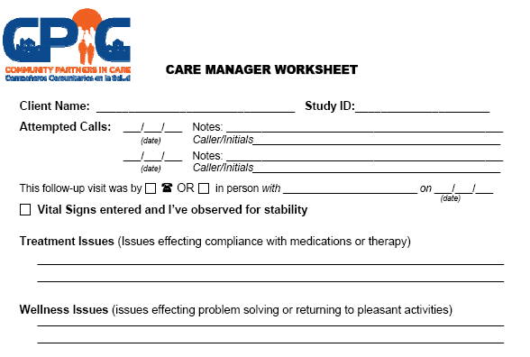

Slide 28
Screening for Depression

Slide 30
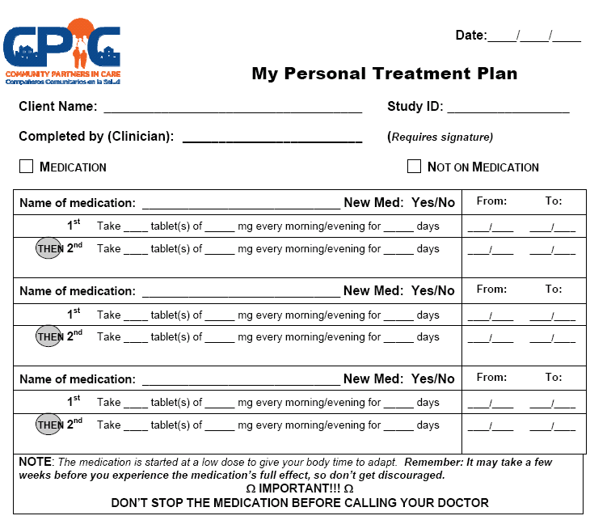

Slide 31
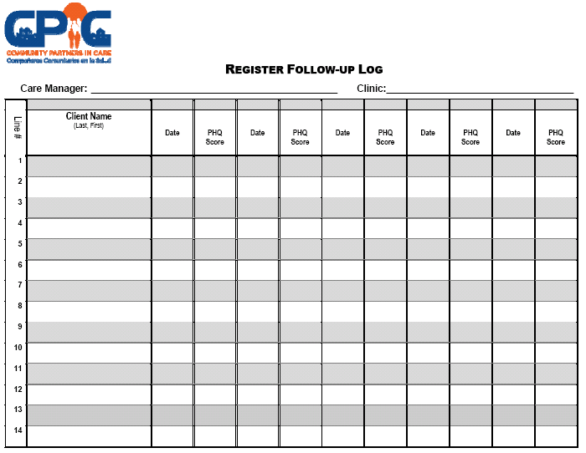

Slide 32
Tailoring Forms and Roles to Your Organization

Slide 33



Self-Care for the Case Manager

Slide 34

Accessing Depression Toolkits
Visit the C-LEARN website to check out the depression toolkits:
www.C-LEARN.org

Slide 35
Next Week - Session 2: Introduction to Depression and Problem Solving Therapy
Thank You!

