Slide 1
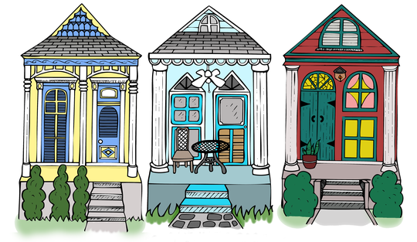
C-LEARN
Housing & Resilience
Session 1: Housing as a Social Determinant of Health
https://nola-lettering.com/collections/new-orleans-houses/shotgun-houses

Slide 2
The links between housing and health are clear: individuals struggling with unsafe or unstable housing experience worse health outcomes and higher health care costs.
- American Hospital Association

Slide 3
OVERVIEW
Historical Policies and Practices that Impacted Housing in New Orleans
Housing & Health
Resources and Toolkits

Slide 4
Policies & Practices that Impact Housing in New Orleans
Inequity in Access to High Ground
Racial Zoning and Redlining
Discrimination in Mortgages
Restrictive Covenants
Segregated Public Housing
Urban Renewal
Notes:
https://s3.amazonaws.com/gnocdc/reports/TDC-prosperity-brief-stacy-seicshnaydre-et-al-FINAL.pdf

Slide 5
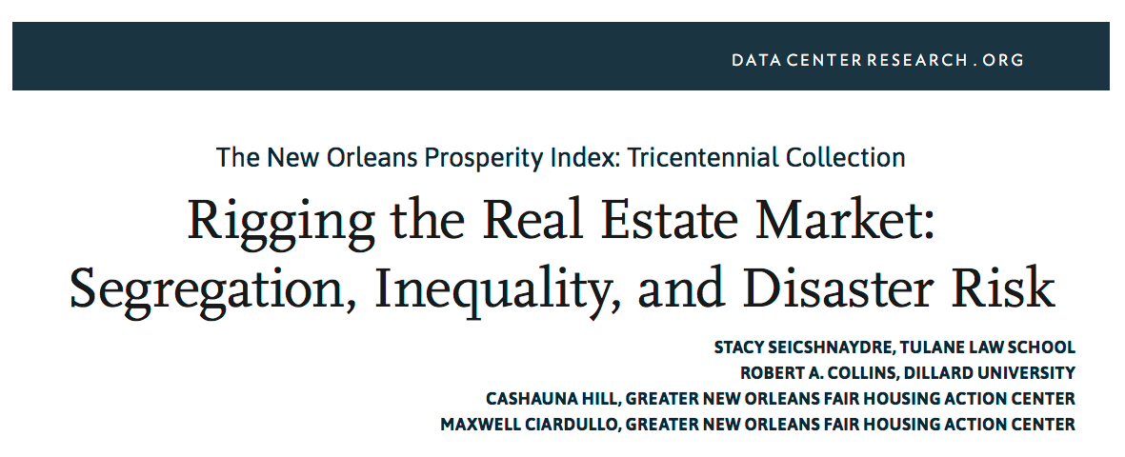

Slide 6
Historical Policies & Practices that Impacted Housing in New Orleans
According to the 2016 HANO Report
Neighborhoods that were mostly African American before the storm and were on lower ground — such as New Orleans East and parts of Gentilly — became even more heavily African American after Katrina; and
Areas that were mostly African American pre-Katrina but were on high ground — such as Bywater, parts of Treme, St. Roch and St. Claude — “are now majority white or moving in that direction”.
Inequity in Access to High Ground
Early wealthy settlers bought up the land above sea level, leaving the the lower income residents to settle on “low-lying flood-prone mosquito-infested back swamp” in the early 1700’s.

Slide 7
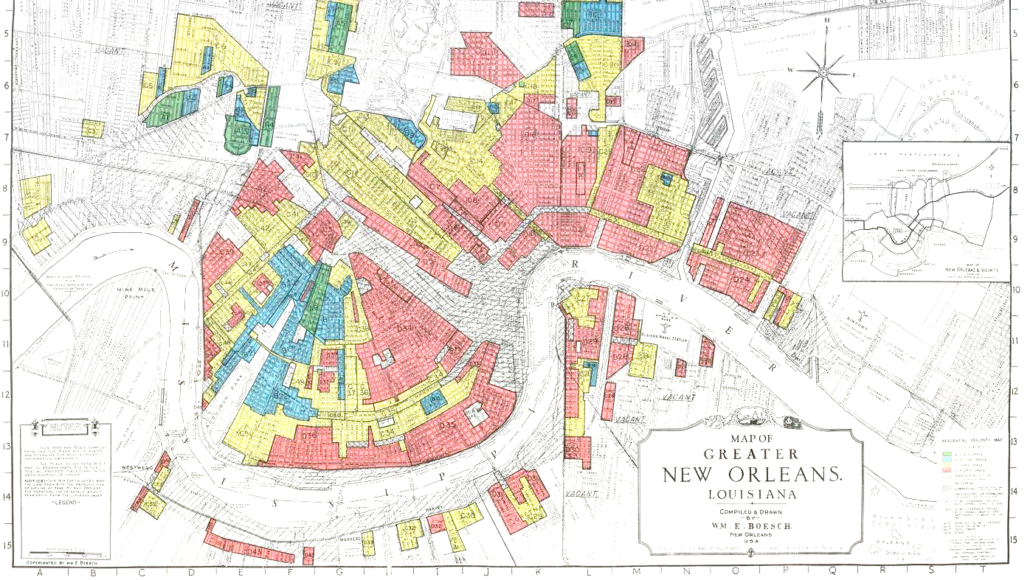
Historical Policies & Practices that Impacted Housing in New Orleans
Racial Zoning and Redlining
Racial zoning ordinances prevented all classes of Blacks from entering neighborhoods predominated by Whites.
Discrimination in Mortgages
Federal housing policy prevented Blacks from getting real estate capital while offering Whites the opportunity to accumulate wealth in segregated suburbs.
Restrictive Covenants and State Enforced Exclusion
Property deed restrictions prohibiting an owner from selling or renting to African Americans.
Notes:
Discrimination in Mortgages
Federal housing policy prevented Blacks from getting real estate capital while offering Whites the opportunity to accumulate wealth in segregated suburbs.
An exception to this policy occurred in 1954 when New Orleans Mayor DeLesseps Morrison mandated a subdivision for middle-class African American professionals in Pontchartrain Park with a promise that it would not be integrated.
Later, other black neighborhoods within areas such as the Lower Ninth Ward developed, but African Americans who owned homes at the time often built them without the help of a commercial loan.
Restrictive Covenants and State Enforced Exclusion
Property deed restrictions prohibiting an owner from selling or renting to African Americans.
The Lakeview neighborhood required the purchaser to agree “that no lots are to be sold to negroes or colored people.” back in 1913 and is still largely white to this day. 53
The staying power of covenants might be that they “sent a signal to buyers about the racial preference of their neighbors.”57
“By the mid-twentieth century, white and black New Orleanians were moving away from each other en masse (largely to low-lying suburbs)”58

Slide 8
Historical Policies & Practices that Impacted Housing in New Orleans
Segregated Public Housing
The federally subsidized public housing program that emerged with the New Deal in the late 1930s systematically replaced integrated neighborhoods with segregated ones, and contributed to the residential isolation of African Americans.
Urban Renewal
The Housing Acts of 1949 (slum clearance) and 1954 (urban renewal) authorized the displacement of African Americans from urban neighborhoods in close proximity to downtown business districts, or otherwise deemed desirable for development, and forced relocation to more economically isolated and racially segregated residential areas.
Notes:
Segregated Public Housing
The federally subsidized public housing program that emerged with the New Deal in the late 1930s systematically replaced integrated neighborhoods with segregated ones, and contributed to the residential isolation of African Americans.
Eventually, the Civil Rights era resulted in the desegregation of housing developments in New Orleans, but “lower-income whites simply stopped viewing the projects as housing they were willing to accept. It was a decision they could afford to make.” 71
Higher vacancy rates in white complexes allowed for more housing choices outside the city in newly built suburbs. By contrast, blacks faced exclusion and discrimination in both the employment and housing markets, which led to limited supply and mortgage capital, higher rents and overcrowding, and longer waiting lists for public housing.72
Urban Renewal and Gentrification
The Housing Acts of 1949 (slum clearance) and 1954 (urban renewal) authorized the displacement of African Americans from urban neighborhoods in close proximity to downtown business districts, or otherwise deemed desirable for development, and forced relocation to more economically isolated and racially segregated residential areas.
The program earned the nickname of “Negro clearance” because nearly nine out of every ten displaced families that were compelled to move into low-rent public housing were non-white
The construction of Louis Armstrong Park and Cultural Center, Greater New Orleans Bridge, and the Parkchester Apartments in Gentilly removed large tracts of low-income housing units from the market.74
the construction of interstate highways to achieve “the elimination of [so-called] unsightly and unsanitary districts.”75 Federal administrators of the highway program deferred to industry leaders and local government officials who made plain their racial motivations to displace large numbers of blacks from low-income housing and middle-class residential areas.76 A prominent example of this was the Claiborne Avenue highway construction that bulldozed a mixed-income black community in the mid-1960s.77

Slide 9
The rebuilding of post-Katrina New Orleans could have reversed residential patterns of racial segregation given the sheer magnitude of the destruction and the billions in recovery dollars that followed. Unfortunately, many policy decisions made during the recovery repeated or amplified existing patterns of separation and inequality

Slide 10
Housing Policies & Health
How do these housing policies and practices impact physical and mental health?
Notes:
Evidence on housing and health can be stated as supporting a pathway from housing to good health. The pathway is one “word”, and that word is “AFFORDABLE”. Affordable housing can lead to good health. Affordable housing is not available to low income families, because there is such a large gap between minimum wages and the cost of living.

Slide 11
“Housing segregation contributes to unequal exposure to crime and violence, environmental health hazards, and threats to physical and mental health.”

Slide 12
Housing & Health
Neighborhood conditions make a significant impact to mental and physical health
Violence
Access to fresh foods
Green space for physical activity
Public transportation access
Housing instability disrupts routine obligations such as work, school, social networks, access to services.
Worries about housing conditions and/or instability can cause distress and subsequent mental disorders
Notes:
https://www.rwjf.org/en/library/research/2011/05/housing-and-health.html
https://healthequity.globalpolicysolutions.org/wp-content/uploads/2016/12/Housing2.pdf
https://healthequity.globalpolicysolutions.org/wp-content/uploads/2016/12/Housing2.pdf

Slide 13
Housing & Health
There is also an issue of housing quality within the home. Common hazards include:
Mold
Vermin infestation (e.g. mice, cockroaches, etc.)
Lead paint/pipes
Poor indoor air quality
Unsafe wiring
Poor quality housing can play a part in:
Chronic diseases
Physical injuries
Asthma
Poor child development
Notes:
https://www.rwjf.org/en/library/research/2011/05/housing-and-health.html

Slide 14
RESOURCES & TOOLKITS
These can be utilized by your clients to help them get the most out of their current situation—and plan for the future.

Slide 15
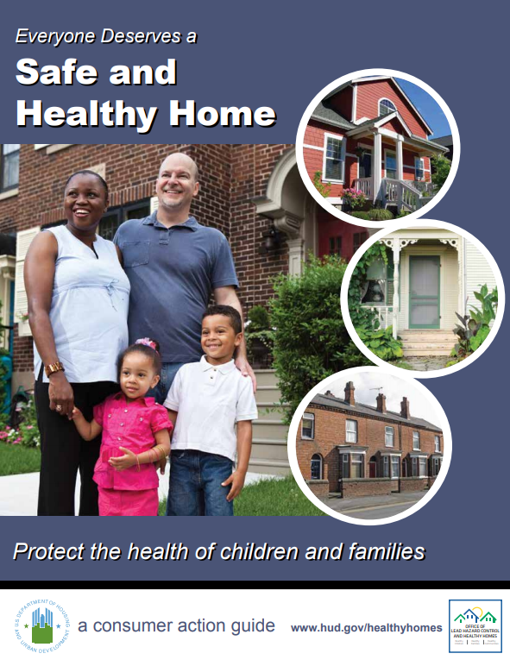
Ensure that your client’s living conditions support optimal health outcomes.
The Healthy Housing Toolkit for Housing Counselors provides information about maintaining safe and healthy homes.
Everyone Deserves a Safe and Healthy Home is an easy to use checklist and guide to be used by clients.
1

Slide 16
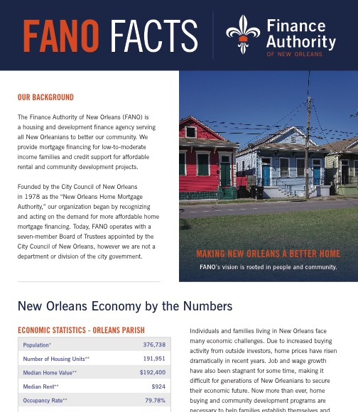
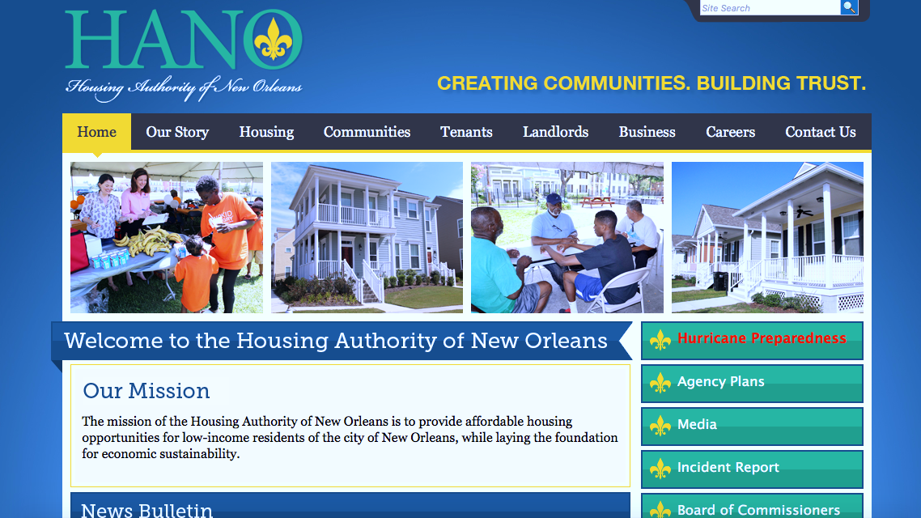
Help clients access affordable housing options in New Orleans
Finance Authority of New Orleans (FANO)
Provide mortgage financing for low-to-moderate income families and credit support for affordable rental and community development projects.
Housing Authority of New Orleans (HANO) manages:
Housing Choice Voucher Program: Assists low-income families with rental payments through the Section 8 Program
Project Based Voucher Program: Subsidizes units in HANO-owned and privately owned properties throughout New Orleans. Tenants residing in Project-Based Voucher Units pay 30% of their income for rent and utilities.
Public Housing: Available to seniors, families and persons with disabilities.
Homeownership Program: Assists public housing and Housing Choice Voucher Program (HCVP) Section 8 residents to become first-time homebuyers.
2

Slide 17
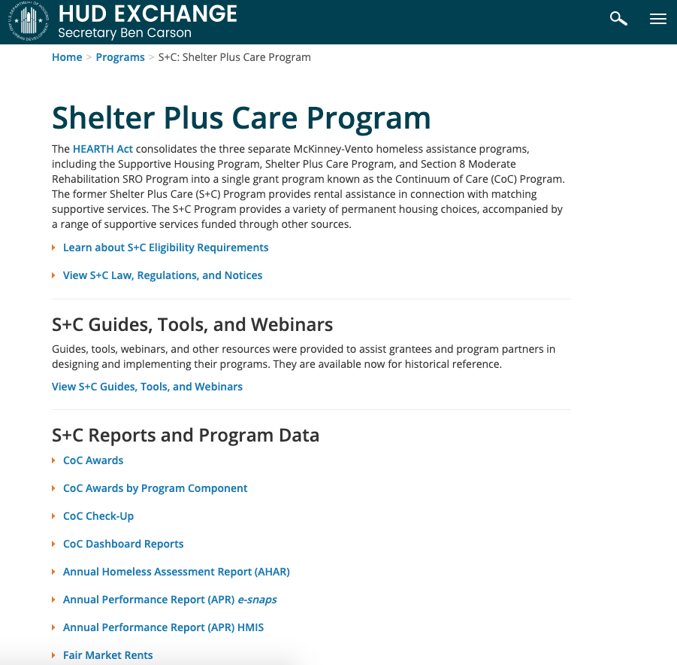
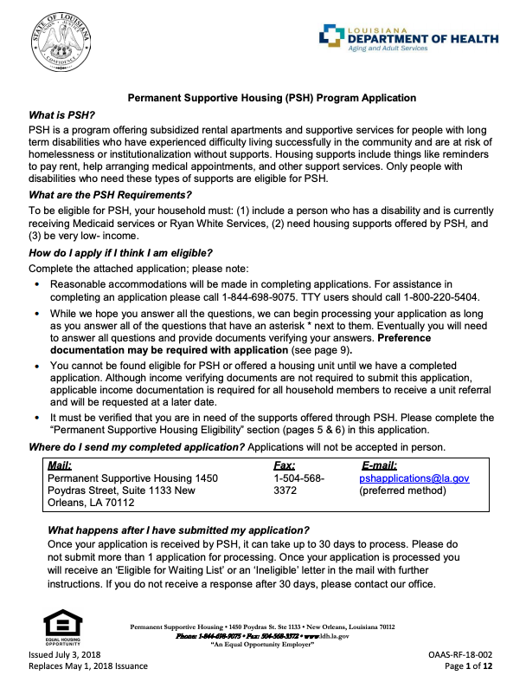
Additional homeless prevention options in New Orleans
Permanent Supportive Housing (PSH) Program:
Offers subsidized rental apartments and supportive services for people with long term disabilities who have experienced difficulty living successfully in the community and are at risk of homelessness or institutionalization without supports. Housing supports include things like reminders to pay rent, help arranging medical appointments, and other support services.
Rapid Re-housing Program
Assists families with the identification of available housing. Assistance is also offered with move-in, short-term rental assistance, case management and linkages to community-based services. To be eligible, families must be living in an emergency shelter, on the streets or in a place not meant for human habitation
Shelter Plus Care Program
Assists hard to serve homeless individuals with disabilities and their families. These individuals primarily include those with serious mental illness, chronic problems with alcohol and/or drugs, and HIV/AIDS or related diseases.
2

Slide 18
For clients who are interested in purchasing a home for the first time, have them plan out the process using the Consumer Financial Protection Bureau Toolkit
3
Notes:
https://files.consumerfinance.gov/f/201503_cfpb_your-home-loan-toolkit-web.pdf

Slide 19
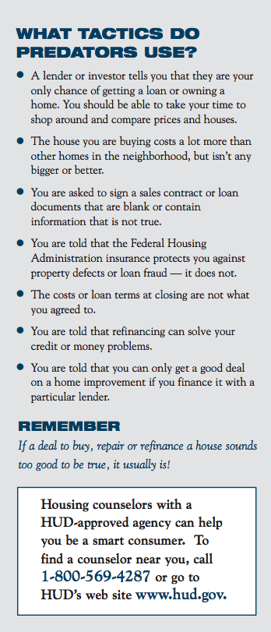
Use these guidelines to help clients avoid predatory lending
1
Attend a homeownership education course offered by a HUD-approved, non-profit counseling agency
2
Interview several real estate agents. Be sure to ask for and check references
3
Get information about the prices of other homes in the neighborhood
4
Hire a properly qualified and licensed home inspector to carefully inspect the property then decide who will make repairs
5
Shop for a lender and compare costs. Be suspicious if anyone tries to steer you to just one lender.
6
Do not make false statements on a loan application. Lying is fraud and may result in criminal penalties
7
Do not let anyone convince you to borrow more money than you know you can afford to repay
8
Never sign a blank document or a document containing blanks. Insert “N/A” (i.e., not applicable) or cross through any blanks
9
Read everything carefully and ask questions. Do not sign anything that you don’t understand and have your contract and loan agreement reviewed
Notes:
https://www.hud.gov/sites/documents/2003-01H.PDF

Slide 20
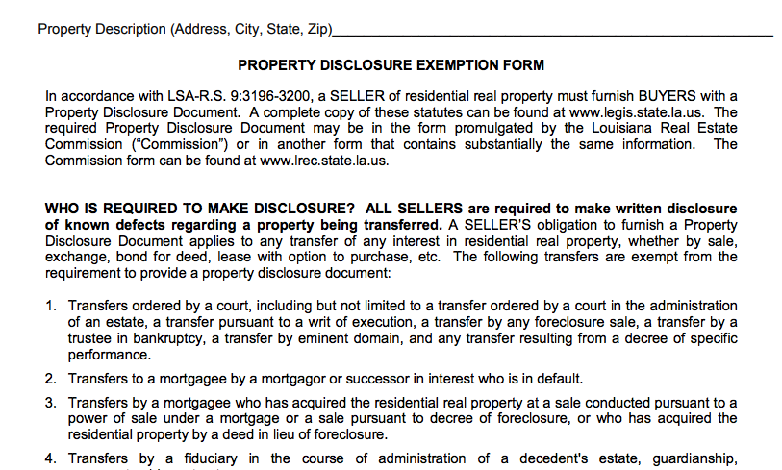
…and make sure they know their rights when purchasing their home
Sellers by law must tell buyers about some defects
Louisiana Real Estate Commission provides an official document that entails all rules and regulations sellers must abide by.
Notes:
https://www.lrec.state.la.us/files/01-01-2018%20Property%20Disclosure.pdf
https://lrec.gov/wp-content/uploads/2018/09/Real-Estate-Rules-and-Regs-Updated-through-4-2018.pdf

Slide 21
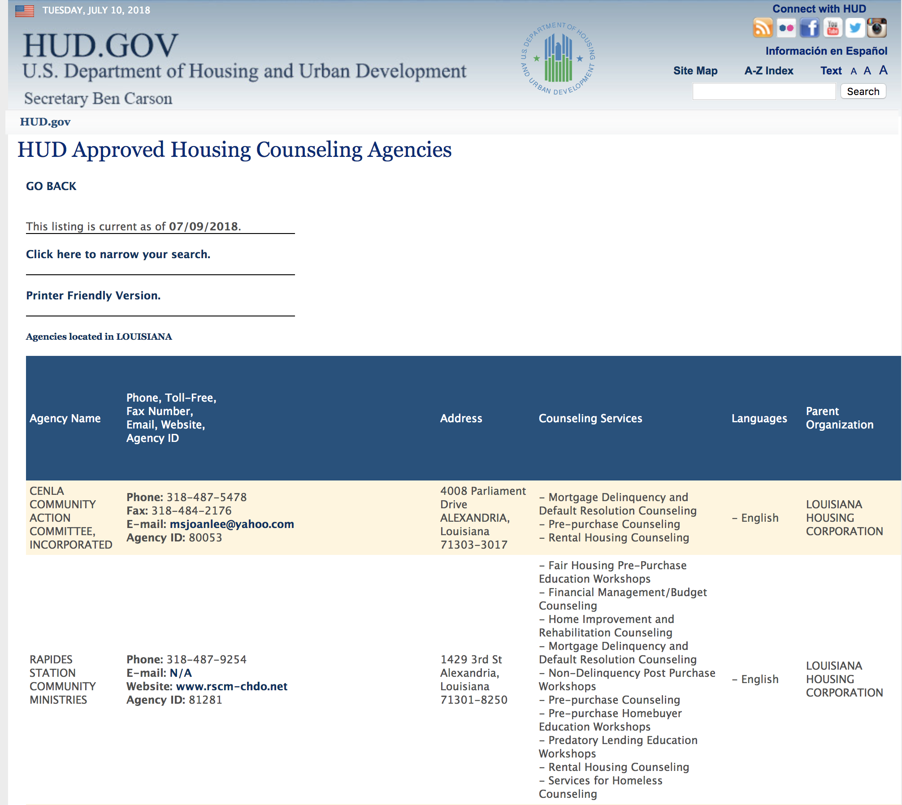
Have your clients contact an approved housing counseling agency if they need specific advice about housing related issues
HUD sponsors housing counseling agencies throughout the country that can provide advice on buying a home, renting, defaults, foreclosures, and credit issues.
Search for an agency online
4

Slide 22
Inform clients about “heir property”
When necessary legal work isn’t done after a property owner dies, the right to live on the property goes to an “heir.”
Related to the deceased property owner by blood or marriage, or
named in a will and alive when the property owner dies.
The heir legally owns the property. But, the property’s title does not automatically pass to the heir. Without legal paperwork, the title is unclear and “unmarketable.”
Even if the property owner had a valid will, the heir still must take the original will to court in order to get clear title.
5
Notes:
https://louisianaappleseed.org/wp-content/uploads/2016/03/Protect-Your-Property-2017-web.pdf

Slide 23
Other ways to help clients protect their property
Make sure property taxes are paid.
Visit your parish tax office to make sure your property taxes are paid up and that the office has the correct name and address of the person responsible for the taxes.
Some offices have this information on their web pages.
Have a valid will to ensure that your property will be legally passed down according to your wishes.
Create a family tree to help all family members know who their relatives are.
Notes:
https://louisianaappleseed.org/wp-content/uploads/2016/03/Protect-Your-Property-2017-web.pdf

Slide 24
Check with your clients about their home insurance policies, including flood insurance
There are organizations like Flood Proof LA that help provide free legal services for properties damaged by the 2016 flood and title issues.
6

Slide 25
Refer any clients that may have experienced housing discrimination to Louisiana Fair Housing
Call Attorney General Jeff Landry’s Fair Housing Hotline: 800-273-5718
Southeast Louisiana Legal Services is another source for free legal aid
Services low-income populations
SLLS has offices in Baton Rouge, Covington, Hammond, Harvey, Houma, and New Orleans
7

Slide 26
Agencies and organizations in New Orleans that are centered around housing
Greater New Orleans Housing Alliance (GNOHA)
Community Resource Drop-In
Grace House
Hagar’s House
NAMI Women’s Shelter
Ozanam Inn
Pathways Program
The Mission
Travelers Aid Society of Greater New Orleans
Hotel Hope for Women and Children
Louisiana Housing Corporation
The Rebuild Center
Greater New Orleans Fair Housing Action Center
Habitat for Humanity
Jane Plane Neighborhood Sustainability Initiative
Jericho Road Housing Initiative
Salvation Army
Unity
New Orleans Women Space

Slide 27
Regional agencies and organizations that are centered around housing
Baton Rouge
Office of Community Development
Coastal Louisiana
Community Housing Development Organization
Tenant Based Rental Assistance
Notes:
http://www.tpcg.org/index.php?f=community_development&p=investment_partnership
https://www.brla.gov/855/Office-of-Community-Development

Slide 28
Thank You!
Next Week:
Session 2: Renter’s Rights, Disaster Opportunism
& Advocating for Clients

