Slide 1
C-LEARN
Housing & Resilience
Session 3: Low-Income Housing
https://nola-lettering.com/collections/new-orleans-houses/shotgun-houses

Slide 2
“We need a culture of preparedness that becomes a part of our everyday existence”
Leslie Chapman-Henderson,
Chief Executive of the Federal Alliance for Safe Homes

Slide 3
OVERVIEW
Public Housing and Homeownership Programs
Resources for Homelessness
Additional Resources

Slide 4
What is Public Housing?
Public housing is a federal program to provide decent and safe rental housing for eligible low-income families, the elderly, and persons with disabilities. Public housing comes in all sizes and types, from scattered single family houses to high-rise apartments for elderly families.
The U.S. Department of Housing and Urban Development (HUD) administers federal aid to local housing agencies (HAs) that manage the housing for low-income residents at rents they can afford.
Housing Authority of New Orleans (HANO) is the local organization that handles affordable housing in New Orleans.

Slide 5
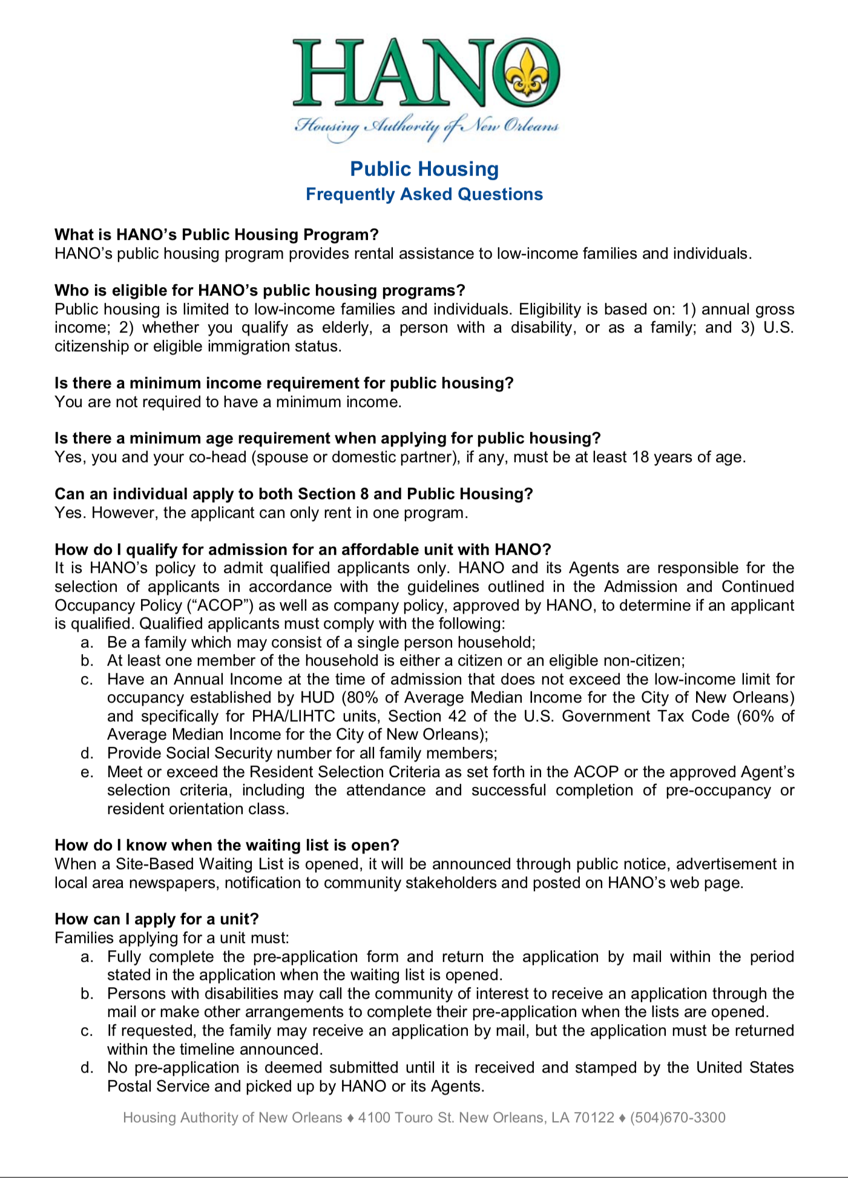
Eligibility for Public Housing
HANO determines eligibility based on:
Annual gross income;
Whether you qualify as elderly, a person with a disability, or as a family; and
U.S. citizenship or eligible immigration status
Note: People with a history of incarceration are eligible for assistance through HANO

Slide 6
Housing Choice Voucher Program (Section 8)
The participant is free to choose any housing that meets the requirements of the program and is not limited to units located in subsidized housing projects.
A housing subsidy is paid to the landlord directly by the PHA on behalf of the participating family. The family then pays the difference between the actual rent charged by the landlord and the amount subsidized by the program.

Slide 7
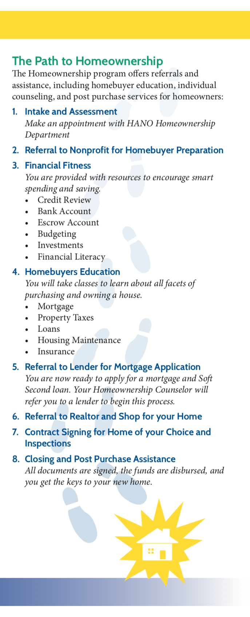
HANO Homeownership Program
Created to assist public housing and Housing Choice Voucher residents to become first-time homebuyers.
The program includes homebuyer preparation; homebuyer assistance; and marketing and sales.
The primary role of the program is to provide technical and financial assistance directly and through referrals to assist HANO families transition from public housing and HCVP tenants to homeowners. Public housing and HCVP clients earning 80% of the Area Median Income (AMI) or less are eligible for program participation.
Contact: www.hano.org |504-670-3300

Slide 8
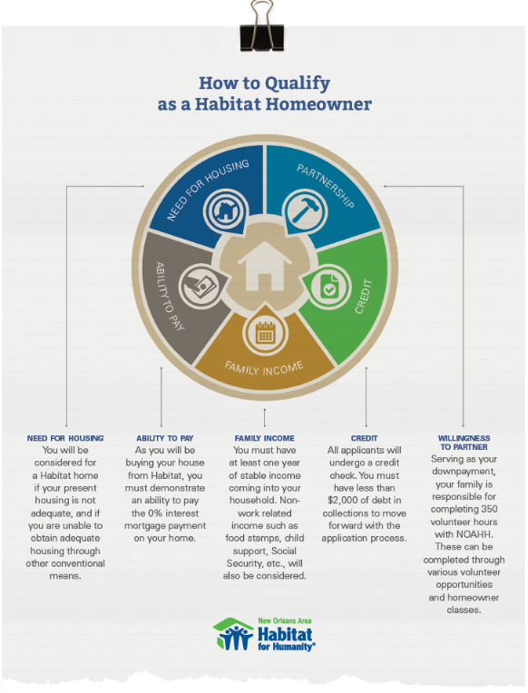
Habitat for Humanity Homeownership Program
If your client meets the criteria and would like more information, have them:
Complete an Online Family Services Application or complete one at the intake meeting.
Schedule an intake meeting with a Family Services Case Manager by calling the Homeowner Hotline at (504) 609-3340.
The Family Selection Committee will review your application and conduct a home visit to determine approval for the homeownership program.
Once approved, a Partnership Agreement will need to be signed. Clients are then eligible to start earning sweat equity.
Once the client’s family complete 50 sweat equity hours, they will be eligible to see the list of lots available for construction of their home.
Notes:
http://habitat-nola.org/homes-and-services/how-to-qualify/

Slide 9
Refer any clients that may have experienced housing discrimination to Louisiana Fair Housing
Call Attorney General Jeff Landry’s Fair Housing Hotline: 800-273-5718
Southeast Louisiana Legal Services is another source for free legal aid
Services low-income populations
SLLS has offices in Baton Rouge, Covington, Hammond, Harvey, Houma, and New Orleans

Slide 10
RESOURCES FOR HOMELESS POPULATIONS
State of Louisiana
New Orleans
Coastal Region

Slide 11
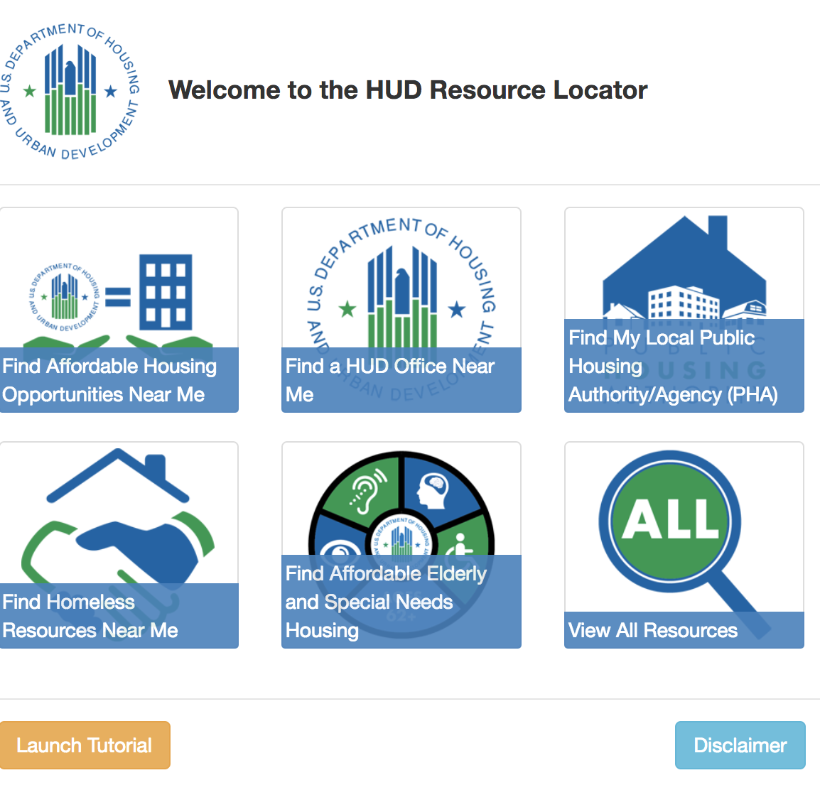
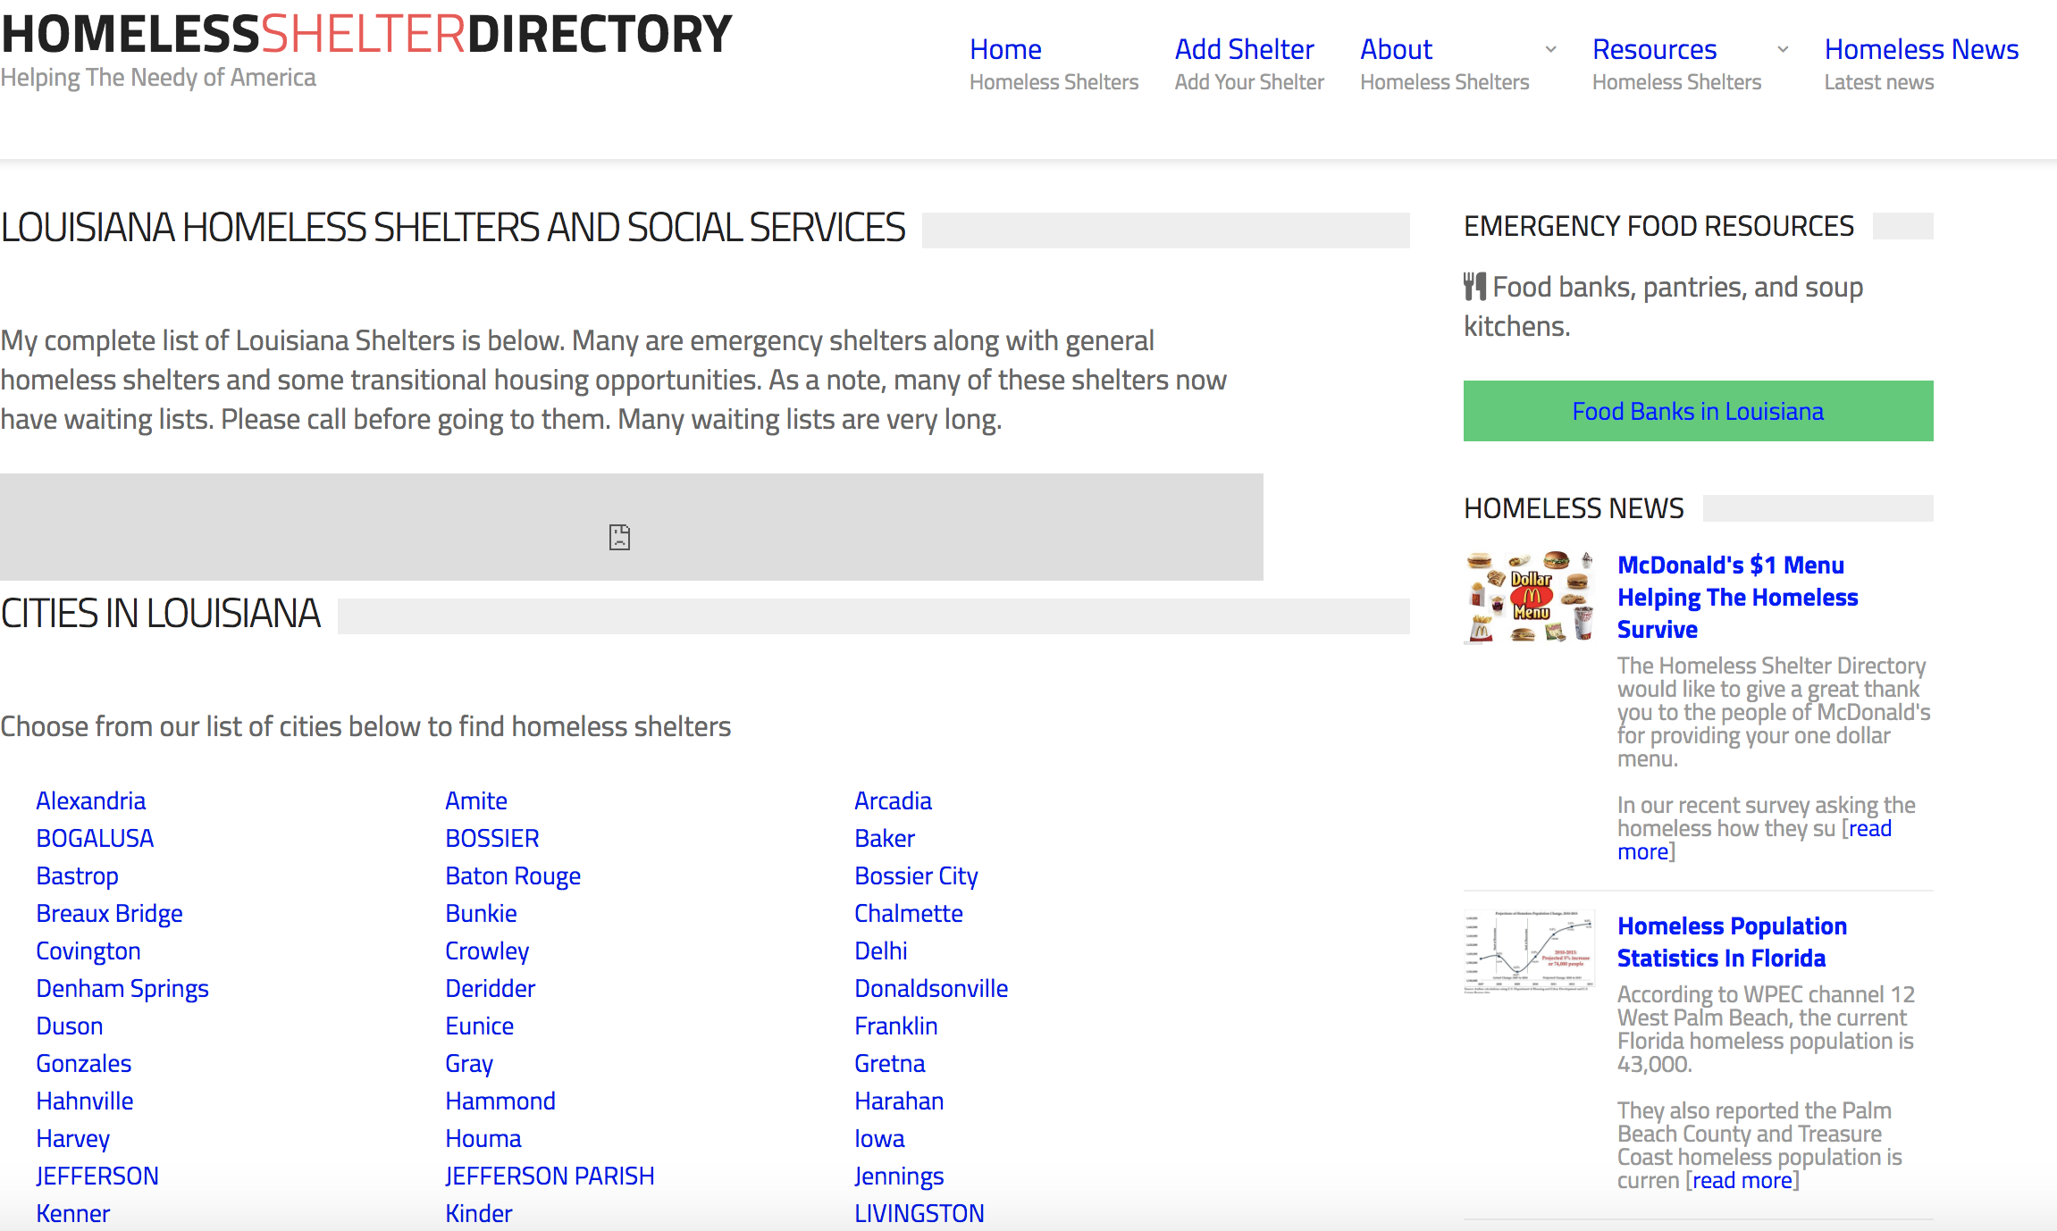
Louisiana Resources for Homeless Clients
Department of Housing and Urban Development Resource Locator
Homeless Shelter Directory
Day Shelters
Notes:
Day Shelters in New Orleans

Slide 12
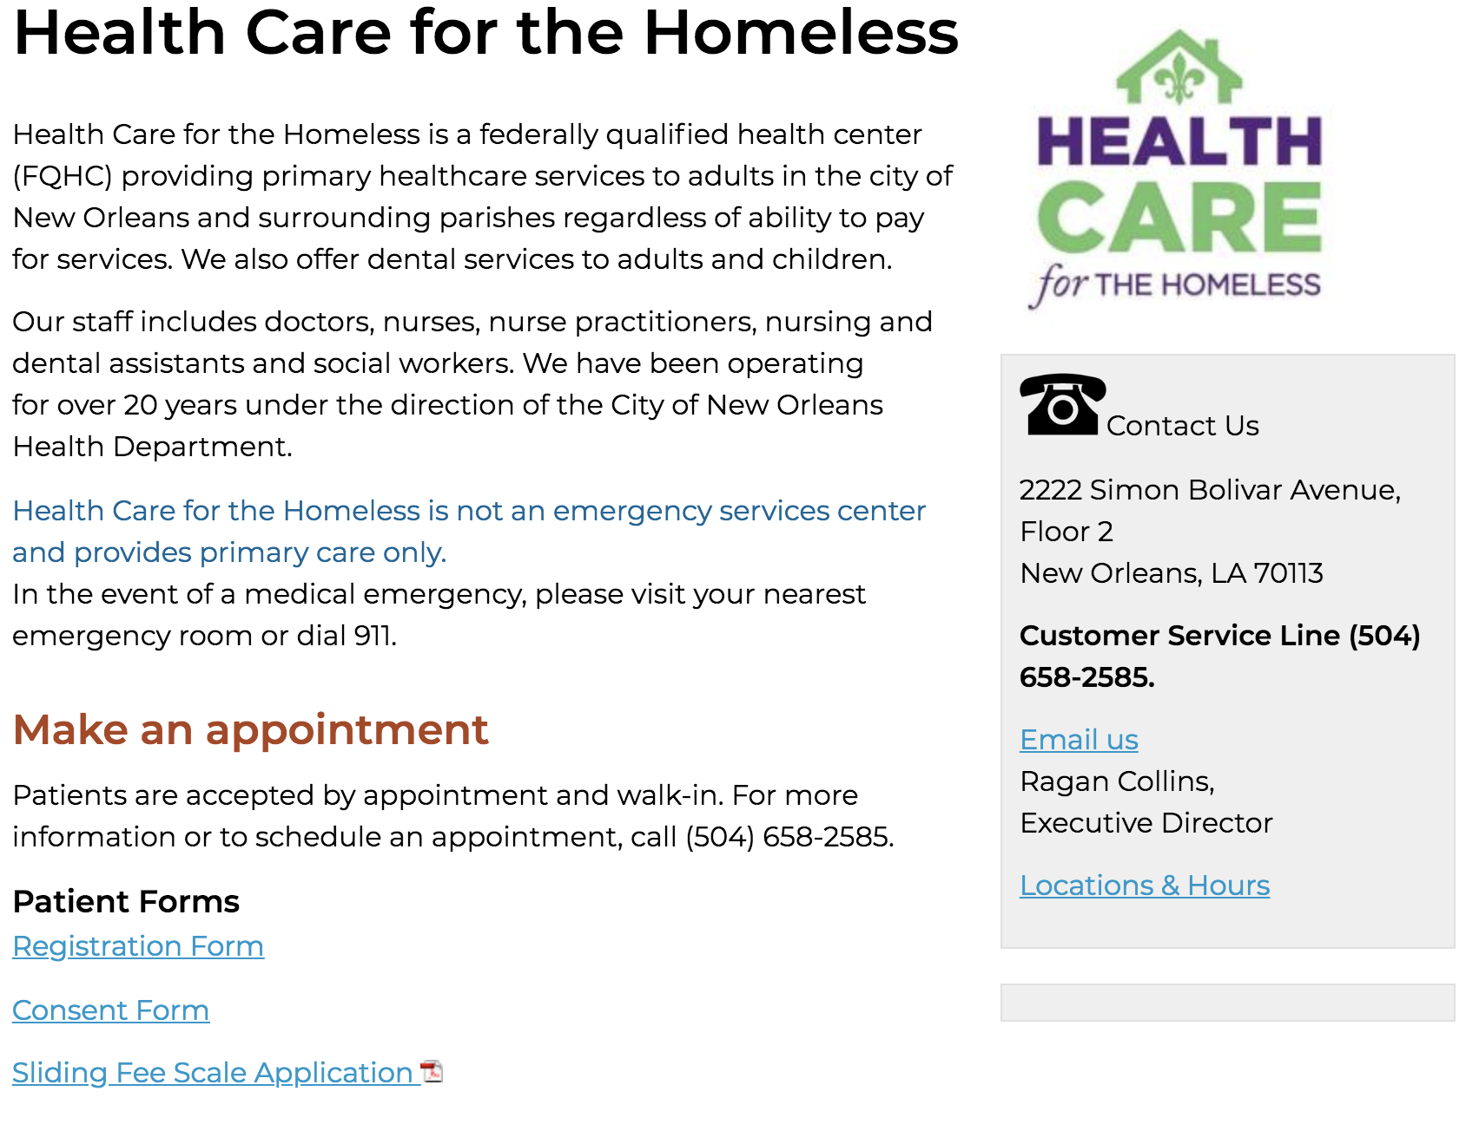
New Orleans Resources for Homeless Clients
UNITY of Greater New Orleans Directory has a comprehensive list of emergency shelters, outreach services, day programs, mental health services, employment services, and more.
Healthcare for the Homeless provides primary care services, including dental, on a sliding scale.
The Rebuild Center at St. Joseph’s Church provides services for the homeless and those in need—such as haircuts, meals, access to showers, access to computers and much more.
Notes:
http://unitygno.org/wp-content/uploads/2011/07/UnityDirectory_web.pdf

Slide 13
New Orleans Resources for Homeless Clients
Covenant House is more than “just a shelter,” they provide supportive counseling and the tools needed to help youth become independent, productive members of our community.
Space for homeless and runaway youth.
Onsite 24/7 Crisis Center
Hagar’s House for Women is a long-term transitional housing facility and 24 hour emergency shelter for single women
Transgender inclusive
Programs include art and yoga, capacity building partnership empowerment model.
Ozanam Inn offers supportive services FREE to anyone in need, male and female.
Humanitarian Services, Counseling Services, Medical Services (through partnerships with LSU and Tulane Medical Schools and Crescent City Vision), Medications/Pharmacy, Employment Skills Training, Spiritual Services (Optional), Legal Counsel/Basic Needs, Housing Programs.
Notes:
https://www.covenanthousenola.org/shelter-documentary/

Slide 14
Coastal Resources for Homeless Clients
Louisiana Coastal Homeless Coalition is a private non-profit organization that coordinates and supports housing services and resources within the parishes of Terrebonne, Lafourche, Assumption, St. John the Baptist, St. James, and St. Charles.
If homeless upon prison release:
Alpha Daughters of Zion: 985-308-0819 | 13201 River Road, Luling LA (women only)
If homeless in Lafourche Parish:
Beautiful Beginnings Homeless Shelter: 580-8105
Gulf Coast Social Services: 851-4488
Lafourche Community Action Agency: 537-7603
Salvation Army: 262-1871
If homeless in St. Mary Parish:
St. Mary Community Action Agency: 1-337-828-5703
If homeless in Terrebonne Parish:
Beautiful Beginnings Homeless Shelter: 580-8105 (Families with children only)
Bunkhouse Shelter: 876-9976 or 637-6088 : (men only) there is a small charge per night to stay
Gulf Coast Social Services: 851-4488
Salvation Army: 262-1871
Terrebonne Parish Consolidated Government: 873-6817

Slide 15
ADDITIONAL RESOURCES
Here are a list of helpful services for low-income clients

Slide 16
If your clients are experiencing housing problems, it may be beneficial to mention the following services and programs:
Medicare
Medicaid
Louisiana Children’s Health Insurance Program (LaCHIP)
Louisiana Low Income Home Energy Assistance (LIHEAP)
Family Independence Temporary Assistance Program (FITAP)
Louisiana Supplemental Nutrition Assistance Program (SNAP)
Louisiana Special Supplemental Nutrition Program for Women, Infants, and Children (WIC)
Head Start

Slide 17
Medicaid
LaCHIP
Medicare
Medicaid provides medical benefits to low-income individuals and families. Although the federal government establishes the general rules for Medicaid, specific requirements are established by each state.
In Louisiana, over a million residents receive health care coverage through Medicaid, most of whom are children under 19.
The Louisiana Medicaid Program operates within the Louisiana Department of Health.
The Louisiana Children’s Health Insurance Program (LaCHIP) provides health coverage to uninsured children up to age 19. It is a no-cost health program that pays for hospital care, doctor visits, prescription drugs, shots and more.
Medicare is a federal health insurance program for people 65 and older and for eligible people who are under 65 and disabled.
Medicare was never intended to pay 100% of medical bills. Its purpose is to help pay a portion of medical expenses. Medicare beneficiaries also pay a portion of their medical expenses, which includes deductibles, copayments, and services not covered by Medicare.
Medicare is run by the Centers of Medicare and Medicaid Services, an agency of the U.S. Department of Health and Human Services. It is controlled by Congress.

Slide 18
Louisiana Low Income Home Energy Assistance (LIHEAP)
The Low-Income Home Energy Assistance Program (LIHEAP) is a federally funded program that helps low-income households with their home energy bills. The LIHEAP program may provide bill payment assistance and/or energy crisis assistance.
Household income determines the minimum requirements for energy assistance. Availability to LIHEAP is not guaranteed. There may be other eligibility requirements.
Contact: energyawebinfo@lhc.la.gov | 888-454-2001

Slide 19
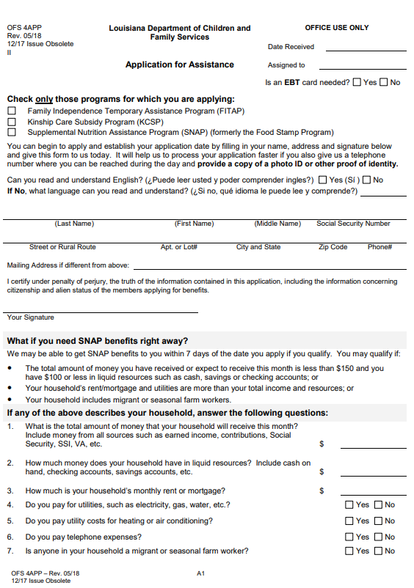
Family Independence
Temporary Assistance (FITAP)
Supplemental Nutrition
Assistance Program (SNAP)
The Family Independence Temporary Assistance Program (FITAP) provides cash assistance to families with children when the financial resources of the family are insufficient to meet subsistence needs.
The goal of FITAP is to decrease the long-term dependency on welfare assistance by promoting job preparation and work. Public assistance is no longer a lifetime benefit but an opportunity to become independent after a financial crisis.
The Supplemental Nutrition Assistance Program (SNAP) provides monthly benefits that help eligible low-income households buy the food they need for good health.
For most households, SNAP funds account for only a portion of their food budgets; they must also use their own funds to buy enough food to last throughout the month.
Eligible households can receive food assistance through regular SNAP or through the Louisiana Combined Application Project (LaCAP).

Slide 20
Special Supplemental Nutrition Program for Women, Infants, and Children (WIC)
Head Start
The Special Supplemental Nutrition Program for Women, Infants, and Children (WIC) provides supplemental foods, nutrition education and referrals to health care, at no cost, to low-income pregnant, breastfeeding and postpartum women, infants, and children up to age 5 who are determined to be at nutritional risk.
In order to qualify for this benefit program, you must be a resident of the state of Louisiana; a pregnant, breastfeeding and/or postpartum woman; an infant or child up to 5 years of age; and individually determined by a health professional to be at nutrition risk.
Head Start is a federal program that promotes the school readiness of children from birth to age five from low-income families by enhancing their cognitive, social, and emotional development.
Head Start programs provide a learning environment that supports children's growth in many areas such as language, literacy, and social and emotional development.
Head Start emphasizes the role of parents as their child's first and most important teacher. These programs help build relationships with families that support family well-being and many other important areas.

Slide 21
C-LEARN
Thank You!
Next Week:
Session 4: Before and After Disaster

