Slide 1





Session 2: Introduction to Depression and Problem Solving Therapy
C-LEARN
Mental Health & Resilience

Slide 2

Introduction
Speaker: Wayne Bentham, MD
Review of Session 1:
  The Collaborative Care Model

Slide 3







The Collaborative Care Model-Overview
PRIMARY CARE MANAGMENT OF BEHAVIORAL HEALTH
Consulting Psychiatrist
Care Coordinator
Home Health Giver
Case Manager
AODA
Therapist

Slide 4






The Collaborative Care Model-Overview
Consulting Psychiatrist
Care Coordinator
Registry
“Make sure NO ONE falls through the cracks”

Slide 5
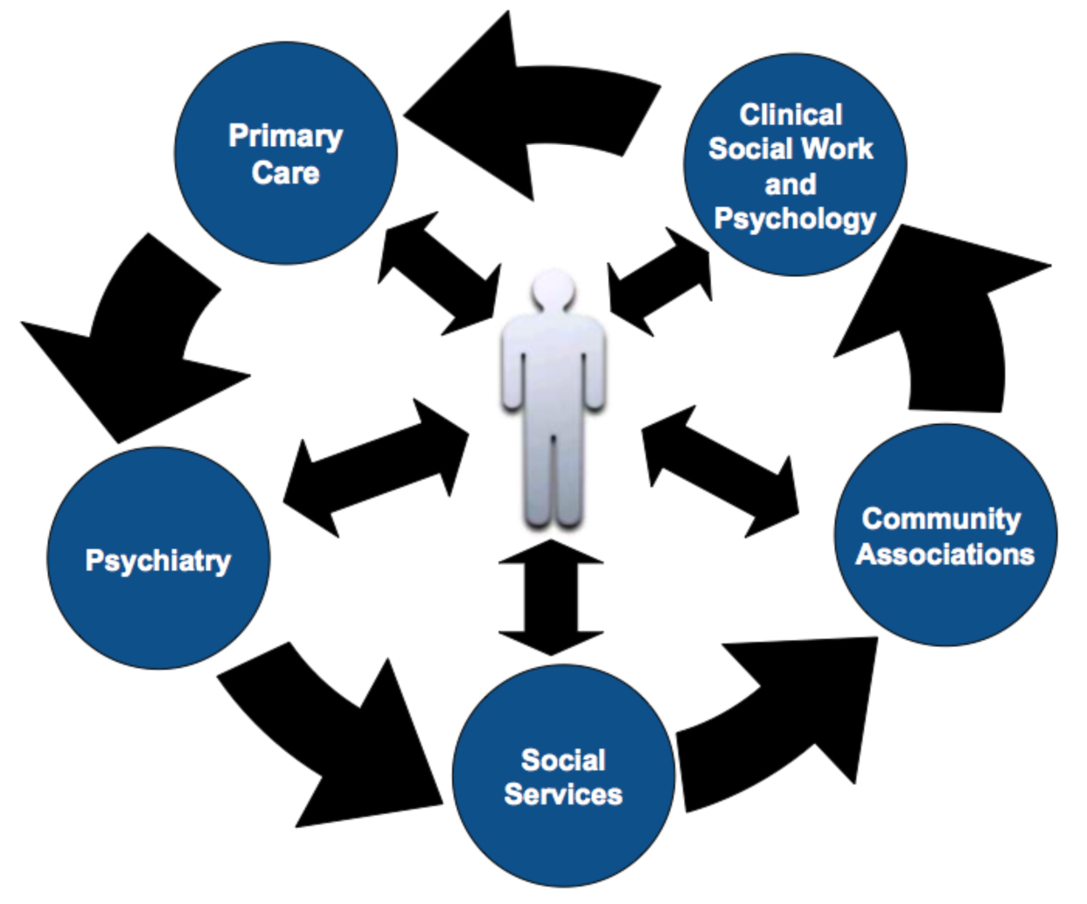
The Collaborative Care Model- Overview

Slide 6

The Collaborative Care Model
Clinic
Admin
Comm
Outreach
Co-ordinators
Community
PCP
Outreach
Workers
Case/Care
Managers

Slide 7

Overview
What is Depression?
  Prevalence, Symptoms and Impact
  Overview of Treatment
Problem Solving Therapy (PST) and the Seven Steps
Applying PST to Social Determinants of Health

Slide 8
Depression & Stress

Slide 9
What is Depression?
Depression is a mood disorder characterized by low mood, poor concentration, inability to enjoy things, and impaired sleep and appetite. While everyone experiences these symptoms occasionally, people with clinical depression experience these symptoms for a prolonged time period, and are unable to function at their usual level.
Sometimes people develop depression after a stressful event, and other times it can occur without an apparent trigger. Some people experience depression many times throughout their lives. Some people have depression that runs in their families.
Depression is present in 5-10% of patients seen in primary care settings
It causes more severe disability than any other chronic illness besides heart disease
Source: CPIC Clinician Resources

Slide 10


Symptoms of Depression
Feeling sad or “empty”
Losing interest in things
Trouble concentrating, thinking, remembering
Trouble sleeping or sleeping too much
Loss of energy or feeling tired
Loss of appetite or eating too much
Losing or gaining weight without trying
Crying or feeling like crying
Feeling irritable
Feeling worthless or guilty
Feeling hopeless or negative
Thinking about death or suicide
Headaches, body aches, pains
Stomach and bowel problems

Slide 11
Symptoms of Depression
Feeling sad or “empty”
Feeling irritable
Feeling worthless or guilty
Feeling hopeless or negative
Crying or feeling like crying
Thinking about death or suicide
Losing interest in things
Trouble concentrating, thinking, remembering
Loss of appetite or eating too much
Losing or gaining weight without trying
Trouble sleeping or sleeping too much
Loss of energy or feeling tired
Headaches, body aches, pains
Stomach and bowel problems

Slide 12
Screening for Depression

Slide 13
Symptoms of Depression
Cognitive
Emotional
Physical
Significant or Severe
Change in Function
Or Behavior

Slide 14
It’s never “just depression”
Depression
Anxiety
??
Alcohol
PTSD

Slide 15
How does stress impact depression?
Problematic drinking; drug use; and
medical illness such as chronic pain, endocrine disorders, neurologic disorders, and autoimmune disorders can also impact mood
Many social and interpersonal stressors can trigger or worsen depression:
  Loss in the family
  Serious arguments
  Family or marital problems
  Work problems or trouble finding work
  Serious injury or illness (regarding self and/or family)
  Financial problems
  Discrimination
  Housing problems
Recovering from a natural disaster

Slide 16
Impact of Social Determinants on Mental Health
Social determinants are the conditions in which people live and grow. These can impact mood and mental illness
They include physical factors in the environment, like proximity to schools and employment, availability of affordable housing, proximity to violence, and availability of clean water and air
They also include social factors, such as discrimination and social support.
“About social determinants of health.” World Health Organization. http://www.who.int/social_determinants/sdh_definition/en/

Slide 17
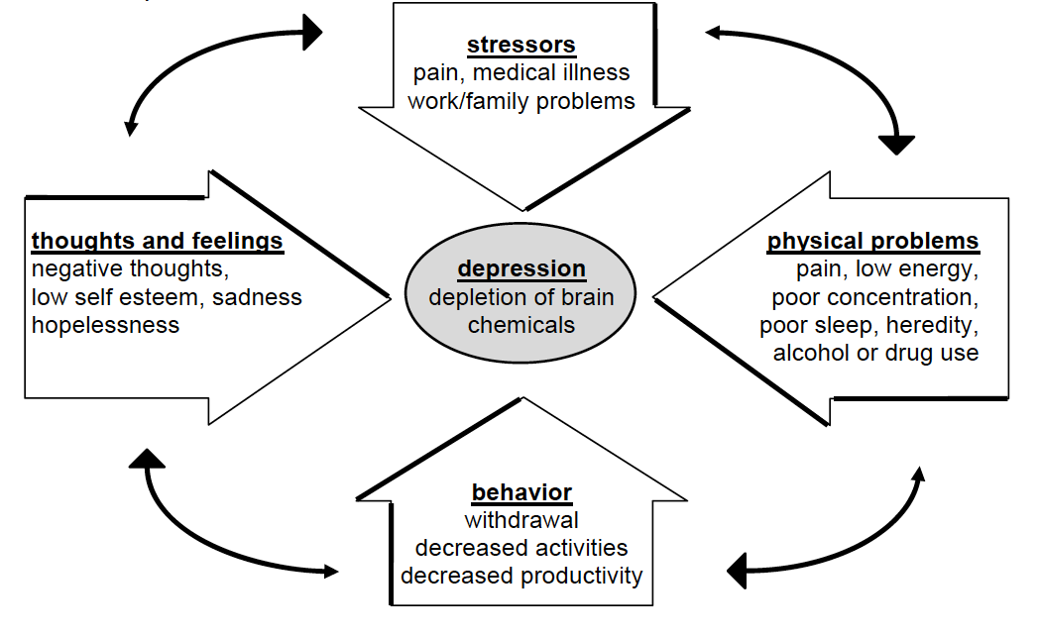
Cycle of Depression

Slide 18


Who can help with depression?
Primary care doctors
Local mental health clinic
Case workers or outreach workers
A family member, friend, or spiritual advisor

Slide 19
Who can help with depression?

Slide 20


What are the clinical treatment options?
Talk Therapy (psychotherapy or counseling)
  Requires a trained and licensed therapist
  Weekly sessions for 2-12 months
Medication (antidepressants)
  Requires a physician or nurse practitioner
  Visits weekly or monthly
  Medication daily for 6-12 months

Slide 21
Problem Solving Therapy (PST)

Slide 22
Problem Solving Therapy (PST)
Everyone has problems. Having too many problems, or feeling stuck in a very difficult problem, can make people feel hopeless and helpless. This can lead to worsening depression.
The goal of problem-solving therapy is to break this cycle by targeting one problem at a time. The more we do, the better we feel.
PST typically occurs with a therapist and lasts 4-12 sessions
      First, the therapist gets to know the patient, explains therapy, answers questions.
      Next, the patient and therapist set the agenda with achievable problems.
      After this, the patient learns PST skills.

Slide 23
Better Problem Solving
Developed for REACH NOLA
Steven Vannoy | Steven.Vannoy@umb.edu
Problem Solving Process
UNIVERSE OF PROBLEMS
Problem Definition
Goal
Brainstorming
Pros and Cons
Choosing a Solution
Action Plan
Outcome
Evaluation
Notes:
REACH NOLA Oct 2008 better problem solving

Slide 24







Seven Steps of PST for Primacy Care
1. Clarify and Define the Problem
2. Set Realistic/Achievable Goal
3. Generate Multiple Solutions
4. Evaluate and Compare Solutions
5. Select a Feasible Solution
6. Implement the Solution
7. Evaluate the Outcome

Slide 25
1
Clarify & Define the Problem
Explore and Clarify:
  Who, What, Where, When, Why?
  “What have you already tried?”
Break down Complex Problems into Objective & Possible
  Must be objective: observable and measurable:
    “Low self-esteem” is not objective.
    Ask self: “Can I picture this?”
    Think “Function”
    “I stay home alone” is objective.
  Must be possible:
    Patient must have some degree of control
    Life problems are potentially controllable
    Symptoms are not directly controllable

Slide 26
2
Set Realistic and Achievable Goals
Follows directly from the Problem definition
  “What do you want to change about ____?”
  “How would things be different?”
Goal must be objective (i.e., measurable).
  Either it happened or it didn’t happen.
    Improved self-esteem is not objective.
    Going out with friends is objective.
Must be stated in behavioral terms.
  “Weight loss” is objective, but it is not behavioral.
  Changing eating habits is both objective and behavioral.
Goal must be Achievable (i.e., by next visit)

Slide 27
3
Generate Multiple Solutions
Solutions come from the patient
Withhold Judgment
  It’s all about Attitude
  Throw caution to the wind!
  Number over Quality
Combine and Modify Ideas
  “What Else?” then be quiet
Write them down

Slide 28
4
Evaluate and Compare Solutions
Evaluate the Pros & Cons
Pros – Look for unique quality:
  What is unique about this solution?
  What makes this solution so good?
  “It solves my problem” is not unique. Look for “it is quick”, “social”, “solves two problems in one”
Cons – How much does this solution “cost” in terms of time, effort, cost, independence, emotional impact compared to other solutions?
Cons (-) | A Little | Medium | A Lot
Effort
Time
Money
Emotional Impact
Involving Others

Slide 29
5
Select a Feasible Solution
Systematic Evaluation of Pros and Cons
Solution Satisfies the Goal
Negative Impact is Limited
Review the Rationale for Choice
  Especially if it does not seem to reflect preceding decision analysis
  This helps to empowers the client
Notes:
REACH NOLA Oct 2008 better problem solving
29

Slide 30
6
Implement the Solution
The action plan should
  Specify tasks: Where, When, How, Who…
  Anticipate obstacles
  Be realistic
Role Play to Improve Confidence
7
Evaluate the Outcome
Review all Tasks
Acknowledge Success
Explore Undesirable Outcome
  Problem definition
  Goal definition
  Unforeseen Obstacles

Slide 31
Road Blocks to Effective Problem Solving
ROAD BLOCK | OPTION
Avoiding problems | Create a list and prioritize
Getting discouraged and giving up. | Be persistent
Getting frustrated and unable to concentrate | Be patient, break it down into small steps
Getting anxious and jumping at the first idea that comes to mind | Attend to details, weigh the consequences of each option and compare them against each other.

Slide 32
Applying PST to Social Determinants of Health

Slide 33
PST and Social Determinants of Health (SDOH)
Social Determinants of health intersect with economic inequality, patient self-efficacy and social connectedness to expose patients to peril.
One approach to helping patients address SDOH and build self-efficacy is through the use of Problem Solving Therapy (PST).
PST is a “positive approach” that trains clients in constructive problem solving skills. It emphasizes self-efficacy and teaching skills that can be generalized to future problems.
It has been used in a variety of mental illnesses, including depression.
Center for Community Health and Development. (2017). Chapter 17, Section 5: Addressing Social Determinants of Health and Development. Lawrence, KS: University of Kansas. Retrieved April 30, 2018, from the Community Tool Box: http://ctb.ku.edu/en/table-of-contents/assessment/assessing-community-needs-and-resources/conduct-concerns-surveys/main.
D’Zurilla TJ and Nezu AM. Chapter 7: Problem Solving Therapy. Handbook: Cognitive Behavioral Therapies. Ed. Keith Dobson.

Slide 34
Example of Applying PST to a Social Determinants of Health
We will explore the process of applying PST to poor nutrition.
Selecting and defining the problem
  Most urgent problems first
  Least complex problems first
  Define problem clearly and objectively
Example: “It is too difficult for me to eat healthy” → “It is difficult for me to afford vegetables, and much cheaper to buy fast food.”
Establishing realistic and achievable goals
  The goal should also be achievable with a reasonable amount of effort and time.
  Longer term goals can be broken down into smaller goals
Example: “I will eat two dinners per week that are cooked at home, not packaged or fast foods.”

Slide 35
Example of Applying PST to a Social Determinants of Health
Generating alternative solutions
  Have patient brainstorm and list at least 5 possible solutions to problem. The first idea is not always the best idea. Therapists withhold judgment during this phase.
Example:
  “I could try to cut back on other expenses to save money for healthier food”
  “I could buy healthier food but cook enough to have leftovers”
  “I could wait for healthy food to be on sale”
  “I could start buying and cooking frozen food”
  “I could pick up donated canned foods for part of meals”

Slide 36
Example of Applying PST to a Social Determinants of Health
Implementing decision making guidelines,
  Have patients list pros and cons for each solution. Have them think about pros and cons related to whether solution is feasible, what impact the solution will have on patient and other people, and whether the solution meets the patients long and short-term goals
Example: “I could buy healthy foods when they are on sale”
  pros – I would be saving money
  cons – it takes a lot of planning to find foods on sale and then figure out how to cook them, there may not be anything I like on sale, everyone in my family likes to eat different things. Fresh foods go bad quickly, sometimes in one day. It takes a while to get to the grocery store and it’s hard to carry a lot of groceries home. An apple costs $1.50, while Doritos cost $.75 and last longer.

Slide 37
Example of Applying PST to a Social Determinants of Health
Evaluating and choosing solutions
  Examine and compare solutions. Therapist can help guide by asking questions.
Example: “I will start by shopping once per week for healthy frozen foods and cooking with them once per week.”
Implementing the preferred solution
  Make an action plan and list all potential obstacles.
Example: “I will go to the grocery store on Sunday and with my shopping list. I will cook Sunday night.”
Obstacles: “I will be too tired, I won’t feel like going, my family will not want to eat what I make, my family will want fast food, and then I will eat it too.”

Slide 38
Example of Applying PST to a Social Determinants of Health
Evaluating the outcome
  Patient and therapist should attempt to answer these questions: Were you satisfied with the outcome? Did you learn anything new about the problem? Is there anything you would have done differently?
Example: ”I would cook on a different night because my family was not around on Sunday night, and they ate what they wanted and not what I cooked.”
The next step is to try another solution if the first did not work adequately, or to tackle another goal. Part of problem-solving is learning new things and attempting new strategies to meet our goals. These skills can be applied over and over until the patient feels better and feels that goals have been accomplished.

Slide 39
Next Week - Session 3: Cognitive Behavioral Therapy for Depression (BRICH)
Thank You!

