Slide 1



Session 4: Medication Management for Depression Care
C-LEARN
Mental Health and Resilience

Slide 2

Introduction
Speaker: Wayne Bentham, MD
Review of Session 1 - 3:
  The Collaborative Care Model
  Models of Depression
  Problem Solving Therapy
  Cognitive Behavioral Therapy

Slide 3









The Collaborative Care Model-Overview
PRIMARY CARE MANAGMENT OF BEHAVIORAL HEALTH
“Make sure NO ONE falls through the cracks”
Registry
Consulting Psychiatrist
Care Coordinator
Home Health Giver
Case Manager
AODA
Therapist

Slide 4
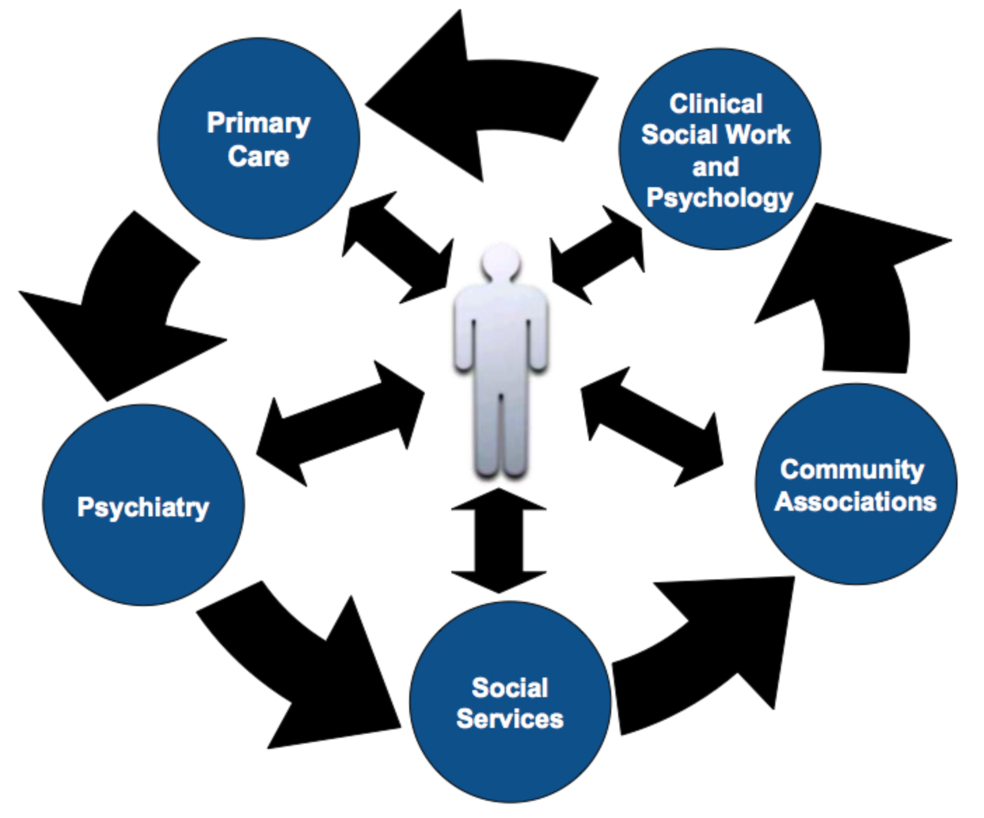
The Collaborative Care Model- Overview

Slide 5
Symptoms of Depression
Cognitive
Emotional
Physical
Significant or Severe
Change in Function
Or Behavior

Slide 6
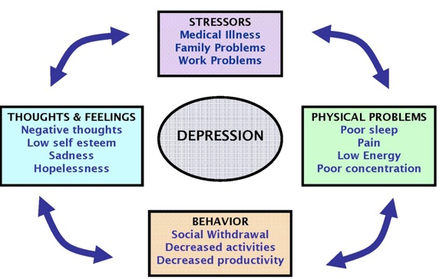
Cycle of Depression

Slide 7
Main Ideas of CBT
THOUGHTS
EMOTIONS
BEHAVIOR
Significant Improvement
In & Recovery From
Depression

Slide 8







Seven Steps of PST for Primacy Care
1. Clarify and Define the Problem
2. Set Realistic/Achievable Goal
3. Generate Multiple Solutions
4. Evaluate and Compare Solutions
5. Select a Feasible Solution
6. Implement the Solution
7. Evaluate the Outcome

Slide 9

The power of thoughts is in how they make you feel and act.
You can CHOOSE the manner in which you think.

Slide 10
Main Ideas of CBT
AWARENESS
ACTION
CHANGE
Thoughts
Emotions
Actions
Improvement
In Symptoms

Slide 11
Main Ideas of CBT
Techniques and Processes
Problem Solving Therapy
Progressive Muscle Relaxation
Exposure & Response Prevention
Pleasant Events Scheduling

Slide 12
CBT for Depression
Over 75 clinical trials since 1977
Meta-analyses show CBT superior to:
  Wait list control
  Placebo control
  Psychodynamic therapy
CBT equal to:
  Behavior therapy
  Medications for all but most severely depressed
Combined CBT and medications:
  May be superior to only one in severely depressed.
CBT may help prevent relapse
  30% of CBT treated versus 60% of medication treated relapse at 1 year

Slide 13
Initial Visit
Assessment
Education
Discuss treatment options
Start initial treatment plan
Arrange follow-up contact
In person or by phone
In one week or earlier
Document initial visit

Slide 14
Cycle of Depression

Slide 15

Patient Education
Depression affects the body, behavior, and thinking
  Physical symptoms may be the most apparent
The ‘cycle of depression model’
Depression can almost always be treated with antidepressant medication or psychotherapy
Recovery from depression is the rule, not the exception
  . . . But relapse is common if treatment is discontinued
Minor tranquilizers, drugs and alcohol can make depression worse, not better

Slide 16
Patient Education
Goals of Antidepressant Treatment
Improve Symptoms
Improve Function

Slide 17

Talking with Caregivers about Depression
Patient education materials (booklets, videos) can aid caregivers in recognizing depression symptoms
Caregivers may have a better view of the patient’s mood and behavior changes over time
  Irritability / anger is a common symptom of depression in men

Slide 18
Patient Education
Reassurance
No Zombie
No Sedation
Not like yourself
If any of this happens, LET ME KNOW

Slide 19
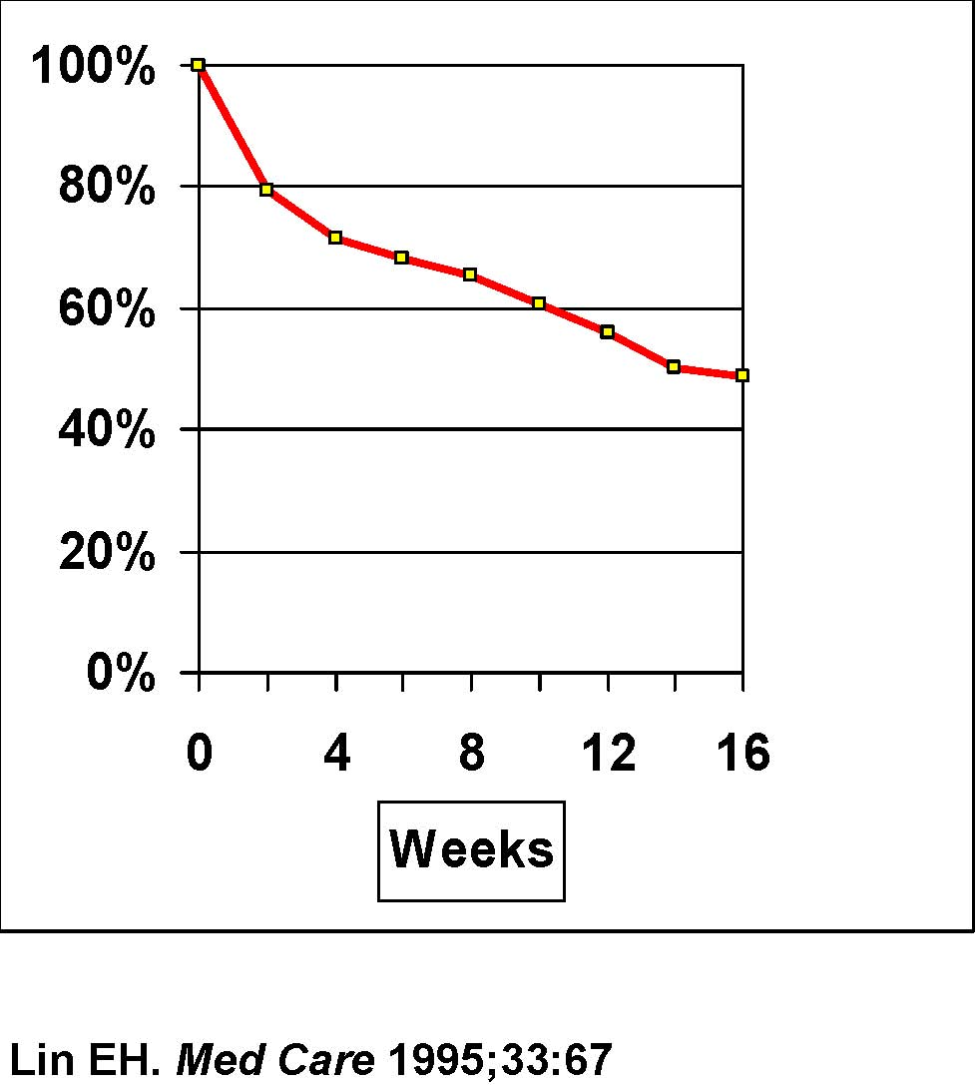
Antidepressant Adherence
Key Messages:
Take medication daily
Wait 2-4 weeks for effect
Side effect can occur, but often resolve in 1-2 weeks
Keep taking medication even if better
Check with MD before stopping
Not addictive

Slide 20
Anticipate Non-Adherence
What things are going to get in the way of taking this medication as prescribed?
Fear of side effects
Cost
Family
Getting to drug store
Etc.

Slide 21

Supporting Antidepressant Management
Become familiar with commonly used antidepressant medication dosages
Provide basic patient education about antidepressants
Support antidepressant medication adherence
Know when treatment is ‘not working’

Slide 22

Supporting Antidepressant Management
Help patients and providers identify
  Potentially inadequate doses
  Ineffective treatment (e.g. persistent depression after adequate duration of antidepressant trial)
  Side effects
Facilitate patient-provider communication about antidepressant medication
Consult with team psychiatrist about medication questions

Slide 23
Using Antidepressants
Key principles
  Use antidepressants, not minor tranquilizers
  Use adequate doses for an adequate amount of time
  Start slow and work with side effects but titrate to an effective dose as needed
  Change medication if not effective
    Usually after 8-10 weeks

Slide 24

Medications to Avoid
If possible, avoid the following medications:
Benzodiazepines:
  Xanax (alprazolam)
  Klonipin (clonazepam)
  Valium (diazepam),
  Temazepam (restoril)
Hypnotics
  Ambien (zolpidem)
  Lunesta (eszopiclone)
Why?
Tachyphylaxis - rapidly diminishing response to successive doses of a drug making them less effective.

Slide 25

Effectiveness
All antidepressants have similar
  Effectiveness (30-40% response)
  Time to response (6-8 weeks)
  Discontinuation rates

Slide 26

FDA Approved Antidepressants
Serotonin Reuptake Inhibitors (SSRIs)
Fluoxetine (Prozac), Paroxetine (Paxil), Citalopram (Celexa), Escitalopram (Lexapro), Sertraline (Zoloft), Fluvoxamine (Luvox), Vilazodone (Viibryd)
Serotonin-norepnephrine reuptake inhibitors (SNRI)
venlafaxine XR (Effexor), desvenlafaxine (Pristiq), duloxetine (Cymbalta), vortioxetine (Trintellix), Levomilnacipran (Fetzima)
Other Antidepressants
Bupropion SR (Wellbutrin, Forfivo, Aplenzin), mirtazapine (Remeron), venlafaxine XR (Effexor), dsvenlafaxine (Pristiq), duloxetine (Cymbalta), vortioxetine (Trintellix), Levomilnacipran (Fetzima)
Tricyclics (TCAs)
Secondary amines: nortriptyline, desipramine
Tertiary amines: imipramine, doxepin, amitriptyline
not recommended for older adults

Slide 27
Serotonin Specific Reuptake Inhibitors (SSRIs)
Common side effects in all SSRIs (>10%): insomnia, restlessness, agitation, fine tremor, GI distress (nausea, diarrhea), headache, dizziness, sexual dysfunction. *mg
Drug name | Unit doses available* | Therapeutic dose* | Usual dose* | Starting dose* | Comments
Fluoxetine (Prozac) | 10,20 | 10-60 | 20 | 10qd | Long half-life. Available as generic
Paroxetine (Paxil) | 10,20,30,40 | 10-50 | 20-30 | 10qd | Dry mouth, constipation, weight gain. Available as generic
Escitalopram (Lexapro) | 5,10,20 | 10-20 | 10 | 10qd | Few drug interactions.
Citalopram (Celexa) | 20,40 | 10-40 | 20 | 10qd | Few drug interactions. Available as generic.
Sertraline (Zoloft) | 50,100 | 25-200 | 50-100 | 25qd | Dry mouth. Available as generic.

Slide 28
Newer Antidepressants: NSRIs
Drug name | Unit doses available (mg) | Therapeutic dose (mg) | Usual dose (mg) | Starting dose (mg)
Venlafaxine (Effexor, Effexor XR) | 25, 37.5, 50, 75, 100 37.5 XR, 75 XR, 150XR | 12.5-150 bid 37.5-225 qd (XR) | 25-100 bid 75-225 qd (XR) | 25 qd 37.5 qd (XR)
Side-effects / Comments | Once daily dosing with XR preparation. Nausea, agitation / insomnia. Elevations in BP at higher doses. Available as generic.
Duloxetine (Cymbalta) | 20, 30, 60 | 40-60 qd | 40-60 qd | 30 qd
Side effects / comments | Nausea, dry mouth, constipation, decreased appetite, fatigue, sweating, sexual dysfunction. Enteric coated. DO NOT break tablets!

Slide 29
Other Antidepressants
Drug name | Unit doses available (mg) | Therapeutic dose (mg) | Usual dose (mg) | Starting dose (mg)
Bupropion (Wellbutrin) | 75, 100 100SR, 150SR | 75-150bid-tid 100-200bid (SR) | 75-150bid 100-200qd (SR) | 75 qd 100 qd (SR)
Side-effects / Comments | Twice daily dosing with SR preparation. Insomnia / agitation. Risk of seizures at high doses. Minimal sexual side effects. Available as generic.
Mirtazapine (Remeron) | 15, 30 | 15-45 qhs | 15-30 qhs | 7.5 qhs
Side effects / comments | Sedation, weight gain. Minimal sexual side effects.

Slide 30
Secondary Amine Tricyclics
(TCAs)
Drug name | Unit doses available (mg) | Therapeutic dose (mg) | Usual dose (mg) | Starting dose (mg) | Side effects
Nortriptyline | 10, 25, 50, 75 | 40-150 | 50-100 | 10 | Weakness / fatigue
Desipramine | 10, 25, 50, 75, 100,150 | 75-200 | 100-200 | 25 | Tachycardia, insomnia, agitation

Slide 31
Choosing Antidepressants
Prior treatment history in patients / family members
Patient preference
Expertise of prescribing provider
Side effect profile (sedating or activating)
Safety in overdose (10 days of a TCA can be lethal overdose)
Availability and costs
Drug-drug interactions

Slide 32
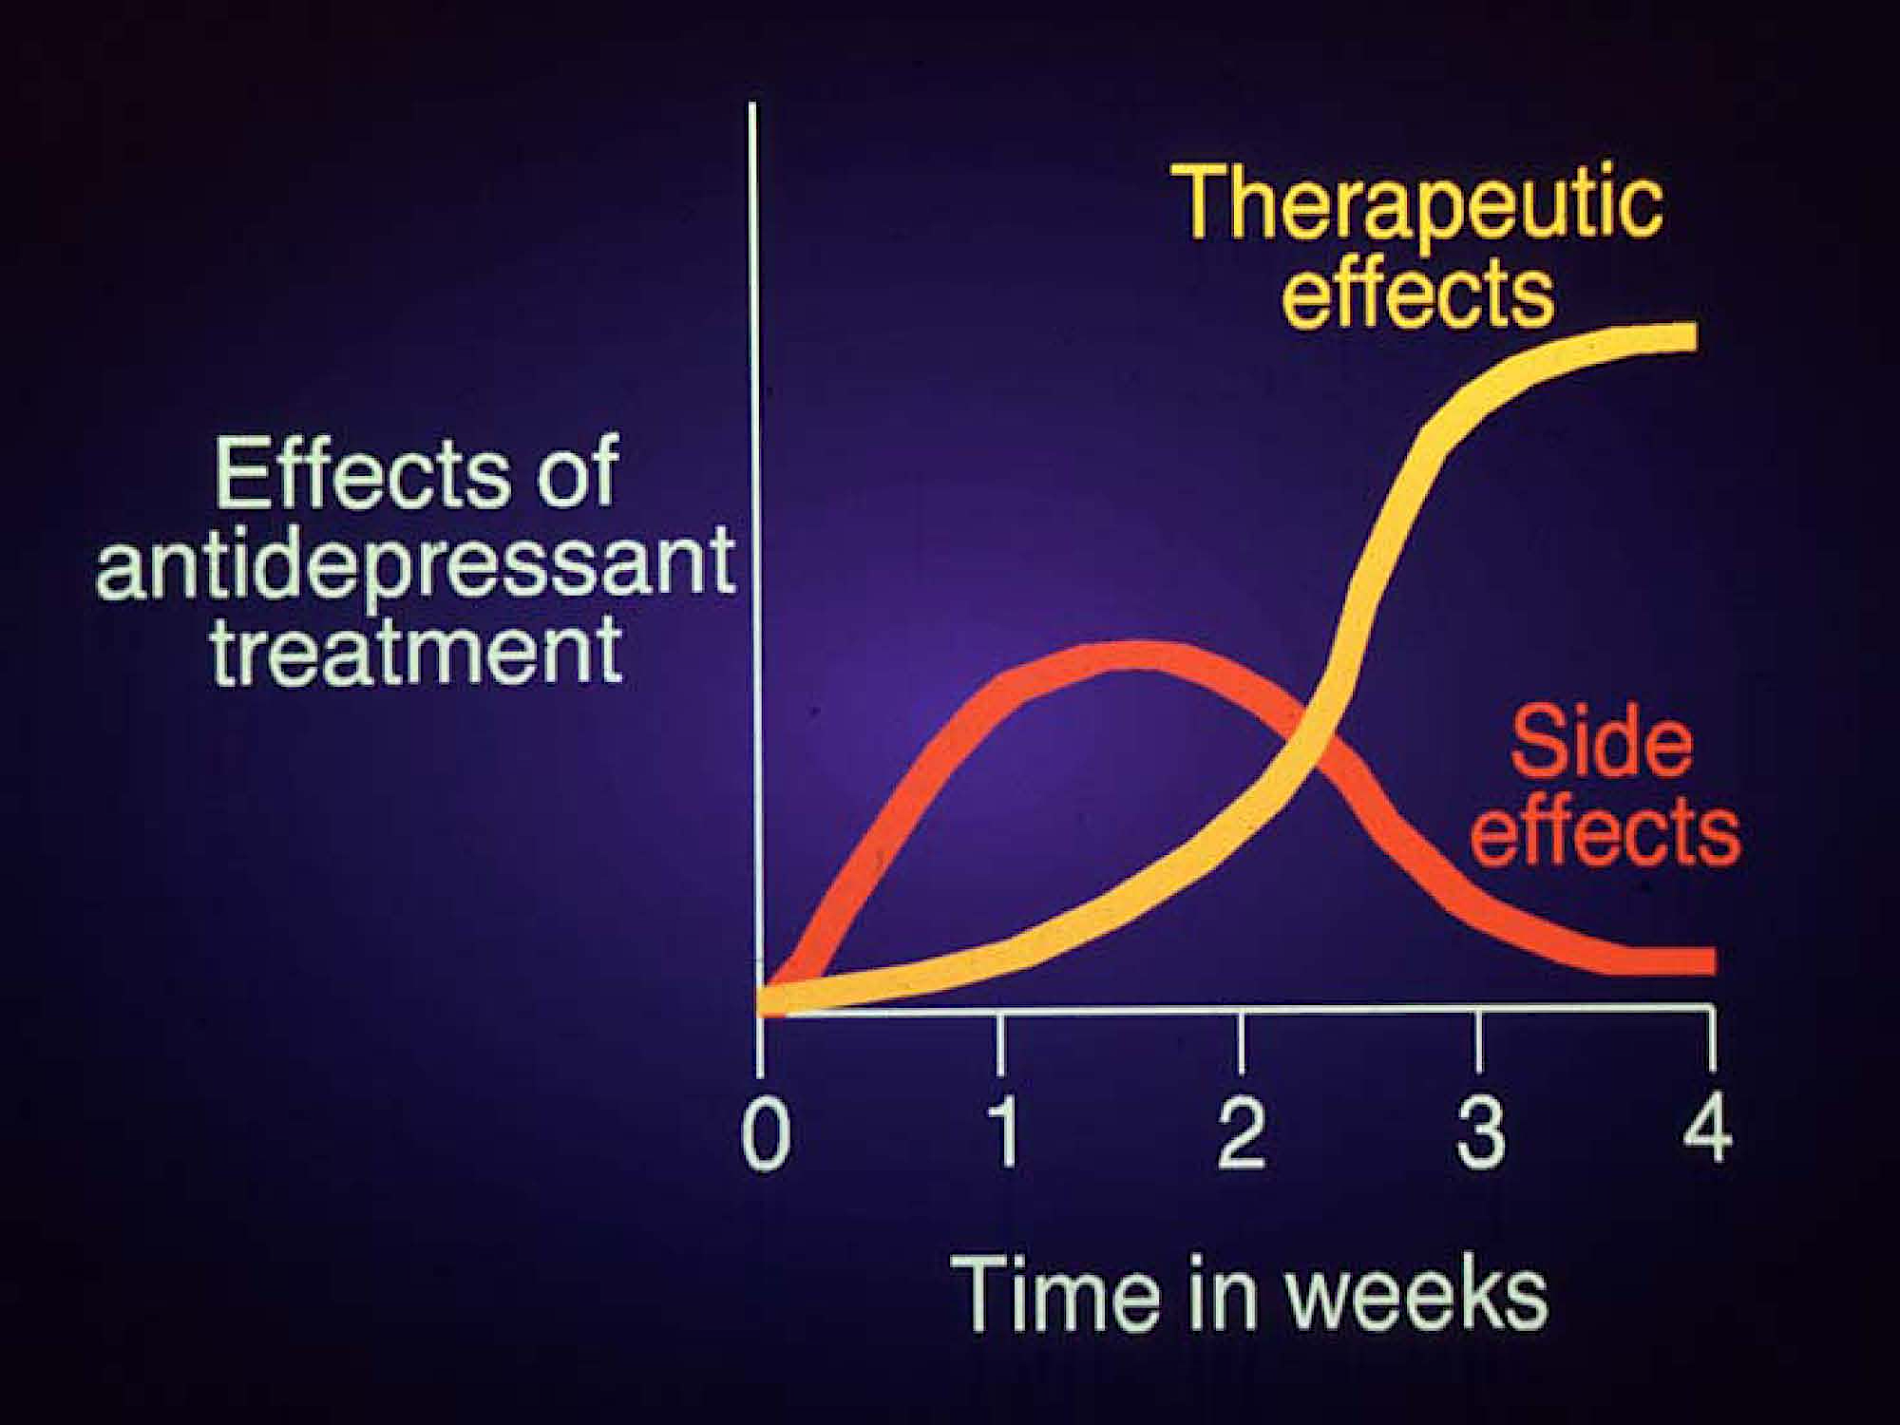

Slide 33
Managing Side Effects
Consult with prescribing provider / team psychiatrist
  Are side effects ‘physical’ or ‘psychological’
Short term strategies
  Wait and support (e.g. GI side effects)
  Adjust medication timing (e.g., take sedating meds at bedtime)
  Consider temporary dose reduction
  Treat side effects (see intervention manual)
Change to a different antidepressant
Change to or add counseling / psychotherapy

Slide 34
Antidepressants & Suicide
Black box warning for all SSRI’s
Risk of SI / Suicidal behaviors
  Slightly increased in adolescents & adults <25
  Decreased in older adults
Close follow-up (care management)

Slide 35
Example: Decision Points in Antidepressant Rx (I)
Proactive Tracking | PHQ Score | Problem | Solution
Week 1-4 -Patient stops meds | 18 | Non-adherence Discouragement Side effects | Patient education Adjust dose Address side effects
Week 4 - Fluoxetine 20mg | 16 | Minimal response | Increase dosage
Week 8 - Fluoxeinte 40mg | 15 | No response | Switch classes of antidepressant

Slide 36
Response & Remission
Black box warning for all SSRI’s
Risk of SI / Suicidal behaviors
  Slightly increased in adolescents & adults <25
  Decreased in older adults
Close follow-up (care management)

Slide 37
Example: Decision Points in
Antidepressant Rx (II)
Proactive Tracking | PHQ Score | Problem | Solution
Week 8 - Fluoxetine 40mg | 4 | Sexual side effect -anorgasmia | Switch to bupropion or add mirtazapine or add buspirone (15 BID)
Week 8 - Fluoxetine 40mg | 10 | Partial response | Increase Fluoxetine to 60mg or add CBT and / or augment or switch antidepressant

Slide 38

Remember
Over 20 FDA approved antidepressants
  All are effective in about 50% of patients
  May take several trials until an effective medication is identified for a patient
  Patients need support during this time
If medications are not effective after 8-10 weeks at a therapeutic dose
  make sure patient is taking medication as prescribed
  consult with prescribing provider
  consult with a team psychiatrist
  a change in treatment plan is likely indicated e.g. change in medication augmentation of medication, switch to CBT or other depression treatment
Most patients will need treatment adjustments
  Only 30-50% of patients will have a complete response to initial treatment
  Remaining 50-70% will require at least one change in treatment to get better

Slide 39
What about a ‘Plan B’?
Treatment recommendations for partial or non responses (50-70% of patients)
  ‘augment initial treatment choice with psychotherapy (e.g. CBT) or medication
  switch to psychotherapy or another antidepressant (especially if NO response in Step 1)
Also consider:
  combination therapy (if not tried earlier)
  aerobic exercise and yoga
  augmentation with more than one medication
  referral to specialty mental health care for additional psychotherapy
  electroconvulsive therapy (ECT) OR Transcranial magnetic stimulation

Slide 40

Seek consultation with psychiatrist when patient . . .
Is severely depressed (PHQ-9 score ≥ 20)
Fails to respond to treatment
Has complicating mental health diagnosis, such as personality disorder or substance abuse
Is bipolar or psychotic
Is suicidal or homicidal

Slide 41

How long to treat with antidepressants?
Treat all adults for 4-9 months after initial response
Treat those at high risk for relapse for 2 years or longer
Some many need lifetime treatment
Maintenance treatment should be at full dose

Slide 42
Stopping Antidepressants
When to stop antidepressant treatment:
  Intolerable side effects
  Dangerous interactions with other medications
  Incorrect diagnosis (not depressed) or lack of indication for depression
  Maximum dosage for 4-8 weeks with no response
How to stop antidepressant treatment:
  Make a relapse prevention plan
  Taper slowly to avoid discontinuation syndrome
What are the relapse risks?
  50% if 1 prior episode
  75% if 2 prior episodes
  90% if 3 prior episodes
  Also increased with dysthymia and residual depressive symptoms

Slide 43

Patient Education about Antidepressants
Key messages
  How do these medications work?
    By restoring chemical imbalance in the brain
  There are several options (over 20 available medications)
Anticipate
  Patient concerns about medications
  Side effects (these can be managed)
  Problems with adherence
Reinforce
  Need for continuation or maintenance treatment to prevent relapse even after the patient feels better

Slide 44
The Collaborative Care Model- Overview

Slide 45
Cycle of Depression
PST
CBT
Community
Intervention
MEDICATIONS

Slide 46
THANK YOU!

