Slide 1
Financial Resilience
Session 2: Managing Finances

Slide 2
Training Purpose & Objectives
The purpose of this training is to provide you with:
An orientation to Your Money, Your Goals, a financial empowerment toolkit;
An overview of the training for service providers;
Strategies for using the toolkit, and
The tools, knowledge, and confidence to use the toolkit and provide training on the use of the toolkit to your staff or partners in your community or state.
By the end of the training, you will be able to:
Explain key financial empowerment concepts presented in Your Money, Your Goals.
Access and use tools and materials available at www.consumerfinance.gov.
Utilize and equip your organization's staff and volunteers with Your Money, Your Goals through your own trainings and one-on-one instruction.

Slide 3
The Bureau of Consumer Financial Protection (Bureau) created the Your Money, Your Goals toolkit for public use, as well as the training materials presented today. These materials are being presented to you by a representative of the Community Resilience Learning Collaborative and Research Network (C-LEARN) study.
The C-LEARN representative presenting these materials is not an agent or an employee of the Bureau.

Slide 4
Your Money, Your Goals
2
Discussing saving for emergencies, bills, and developing financial goals

Slide 5
The purpose of savings may differ per individual, family, or community.
Understanding Savings
Savings is money you set aside today from your income for use in the future
Emergencies & Disaster
Leisure & Enjoyment
Unexpected Costs

Slide 6
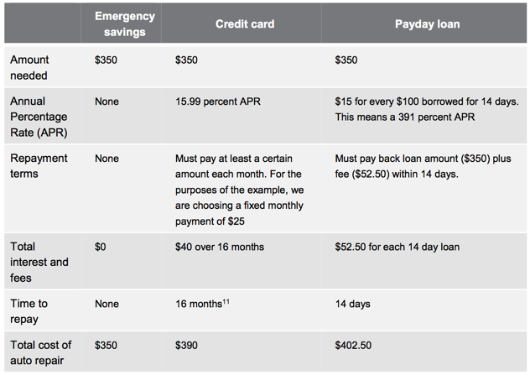
Savings: Planning for the Unexpected
It is important to identify a meaningful ‘unexpected’ scenario with clients in order to develop a savings plan
Mapping financing options increases awareness and knowledge
Acts as personal and community resource assessment
Assists in better understanding financial ability and values

Slide 7
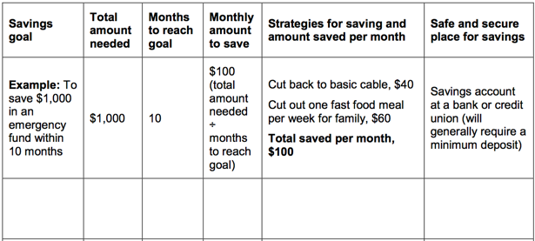
Savings: Developing and Defining Goals
What ‘type’ of goal does your client want to work towards?
Amount
Time
Outcome
Strategy
Client-developed definitions of feasibility, success, etc.,
How will we measure success?
How will we measure and acknowledge setbacks?

Slide 8
Reminder: Consider the SMART Goals Method
Specific
Measurable
Attainable
Relevant
Time-bound (deadline)
Setting goals helps you turn your needs, wants, hopes, and dreams for the future into something concrete that you can take steps to achieve. When you set goals, you can:
Work toward making your future better
Prioritize how you spend your money so that it goes toward things that really matter to you
Measure and track your progress toward getting the things you want out of life
Take pride in bettering your life and the life of your family
S
M
A
R
T

Slide 9
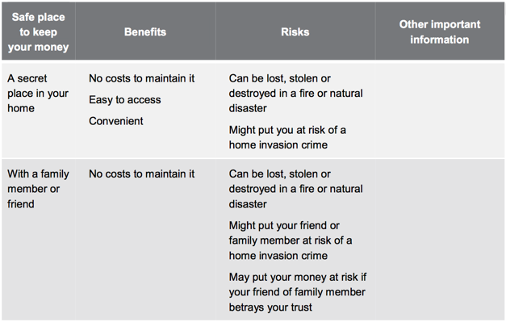
Finding Safe Places for Savings

Slide 10
Financial Planning Sessions with Clients
What can I work on with clients when I have …
Savings Planning
Goal Setting & Asset Limitations
Financial Management and Monies Diversification
10
30
Multiple
Sessions
minutes
minutes

Slide 11
Module 3
3
Tracking and Managing Income Benefits

Slide 12
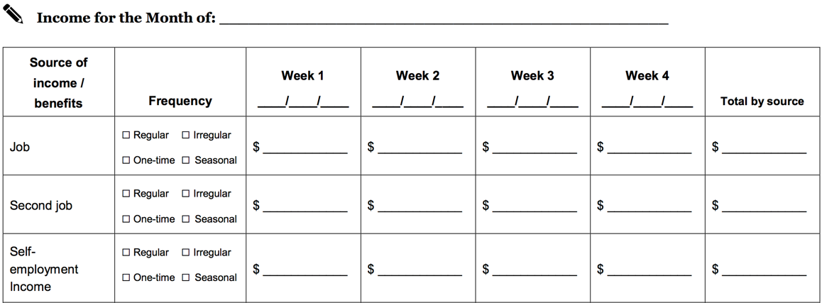
Tracking Income and Benefits
Income
Regular income
Irregular income
Seasonal
One-time occurrence
Benefits
Medical and Life Insurances
Retirement
Disability

Slide 13
Tracking Income and Benefits
Adding Additional Information:
HOW do I get this income? Direct Deposit, Checks, Etc.,
What benefits am I afforded per income? Life, Medical, Discount, etc.,
What risks come alone with this form of income? Liquid assets, no bank account
Other Comments What have I learned while tracking this information?

Slide 14
Increasing Income
$
Approaching income increases should be done by adopting strategies that address:
One-time Activities
Long-term, increased income

Slide 15
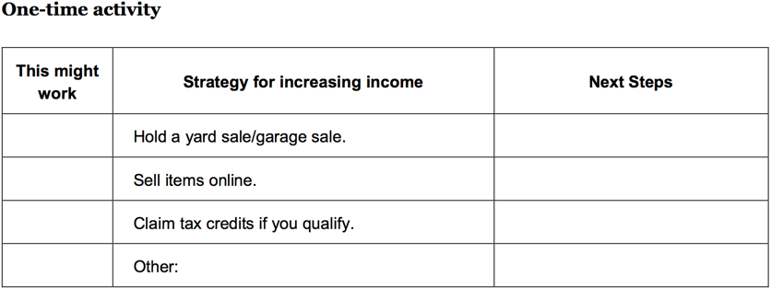
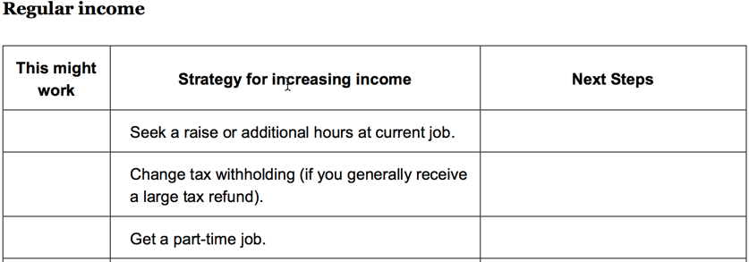
$
Increasing Income
What is possible?
What is timely?
What makes sense for the client?
What are the details that will make the strategy work?
What are the next steps?

Slide 16
Financial Planning Sessions with Clients
What can I work on with clients when I have …
Income Tracker
Tracking Income and Benefits
Increasing Income
All Three
10
30
Multiple
Sessions
minutes
minutes

Slide 17
Module 4
4
Bill Payment & Managing Other Expenses

Slide 18
$
$
Financial Planning Sessions with Clients
Spending
Money you use to pay for a wide range of basic needs, your financial obligations, and other things you may want.
Needs, Wants, and Obligations*
Needs are things you must have to live.
Wants are things you can survive without.
Obligations are things you must pay because you owe someone money (a car loan) or have been ordered to pay someone (child support).
*The perceived difference between a need and a want is extremely personal and should be approached with respect and non-judgement.

Slide 19
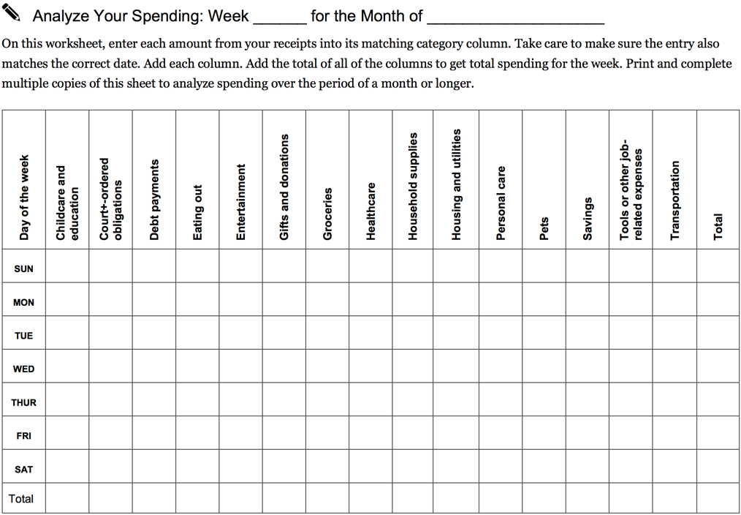
Performing Spending
Analyses
Helps to visualize habit as it relates to needs and wants*
Can be altered to suit daily, weekly or monthly tracking.
Categories should be created with the client, not for the client
Define analysis; what does a spending analysis mean to you and your client?
*Reminder: needs and wants are a sensitive subject and should always be approached with empathy

Slide 20
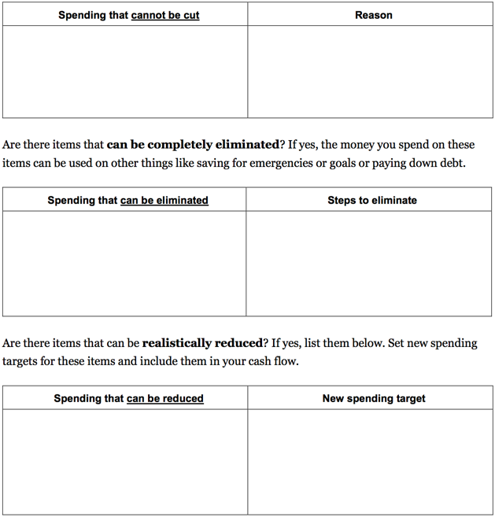
Performing Spending Analyses
Define what the analysis is for and what the analyses will mean for the future.
What spending can be eliminated?* What can you live without? Is that a sustainable loss?
What spending can be reduced?* Where is there wiggle room? What can we live without for x amount of time?
What spending cannot be cut?* What do we “need” to live? What bills are we responsible for?
*Reminder: needs and wants are a sensitive subject and should always be approached with empathy

Slide 21
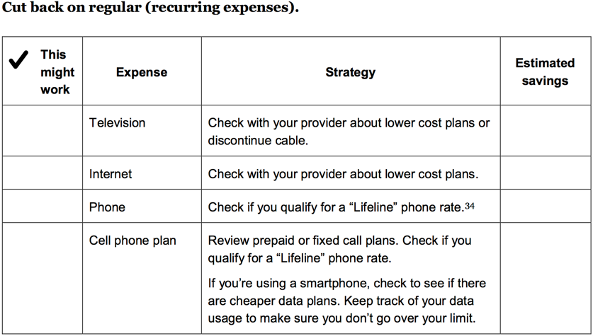
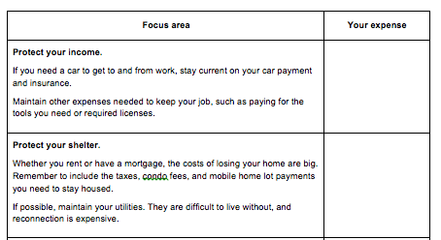
$
Responding to Spending Analyses
Create a plan to respond to a spending analyses.
Let client decide which may work and work together to create an approximate estimated savings.
Start with one and revisit after ”results” are available.
Consider a system or reward for success.
Reframe priorities; use positive words, ‘protecting income’, ‘maintain security’, etc.,

Slide 22
Financial Planning Sessions with Clients
What can I work on with clients when I have …
Spending Tracker
Bill Pay Plan
Strategies for Expense
Prioritizing Bills
All Tools
10
30
Multiple
Sessions
minutes
minutes

Slide 23
Thank You!
Next Week - Session 3: Finance Planning

