Slide 1
Housing & Resilience
Session 2: Renter’s Rights, Disaster Opportunism & Advocating for Clients

Slide 2
“Thousands of our neighbors in rental agreements were devastated by the recent flooding.”
“From deposits to leases, maintenance to repairs – it is critical for tenants and landlords understand their responsibilities and obligations as they work to pick up the pieces.”
Attorney General Jeff Landry 2017

Slide 3
Renter’s Rights & Disaster: Key Terms and Concepts
Deposit: Sum of money given to landlord to secure housing.
Lease / Rent Agreement: Legally binding agreement between both the landlord and the tenant:
Should be in writing; keep multiple copies
Fixed Term: Agreed upon by landlord and the tenant for a set amount of time.; usually 1-year.
Renewal Clauses: Some leases contain automatic renewal clauses
Month-to-Month Lease: If not otherwise stated in the agreement, lease is month-to month
Disaster Opportunism: conscious policies and practices that take advantage of people and situations within a disaster context.

Slide 4
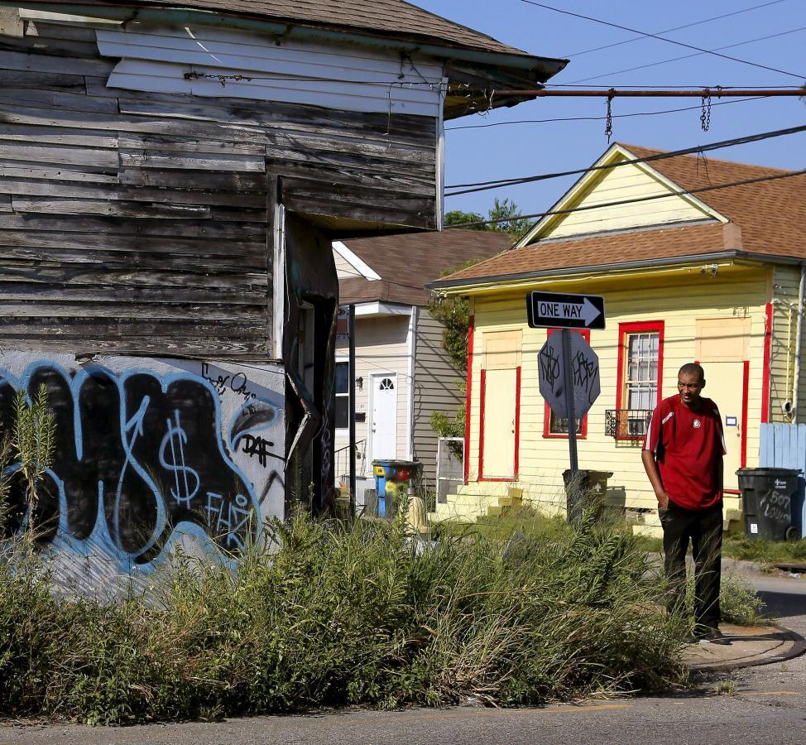
Renter’s Rights & Disaster: Notable Louisiana Civil Code Sections
Different depending on state; Louisiana does not adhere to certain laws that are common in other states, notably:
No limit on deposit amount
Does not prohibit landlord retaliation for exercising renter rights
No governance around circumstances for landlord entry of home
Louisiana Civil Code Sections 2676, 2703, 2704, 2720, 2728

Slide 5
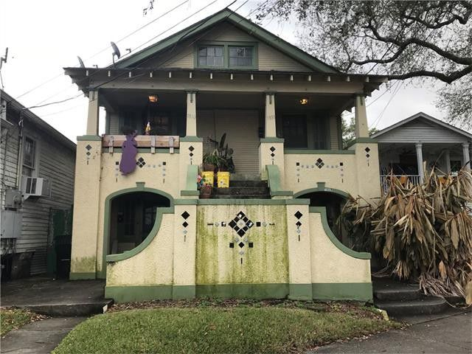
Renter’s Rights & Disaster: Key Terms and Concepts
Landlord Obligations
Deliver property to tenant at agreed time and in good condition
Maintain the property
Protect the tenant’s right of peaceful possession
Refrain from making changes to the property.
Pay taxes, assessments, and other charges to the property
If the landlord sells the property during the term of the lease, new owner may change the lease terms or evict the tenant.
To prevent this, the lease must be recorded in the parish where the property is located.
The tenant may have an action against the landlord for loss sustained as a result of the sale.

Slide 6
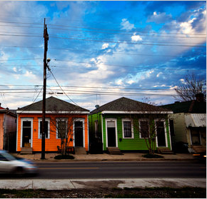
Renter’s Rights & Disaster: Key Terms and Concepts
Tenant Obligations
Pay the rent within the time frame stated on the Lease Agreement
Return the property in the same condition
Normal “wear and tear” is OK
Not alter the premises without written consent from the landlord
Allow the landlord to make all necessary repairs
Use the property for the purpose for which was leased
Misuse can lead to lease being void
Inform the landlord promptly when the property has been damaged or needs repair
Do not sublease the property

Slide 7
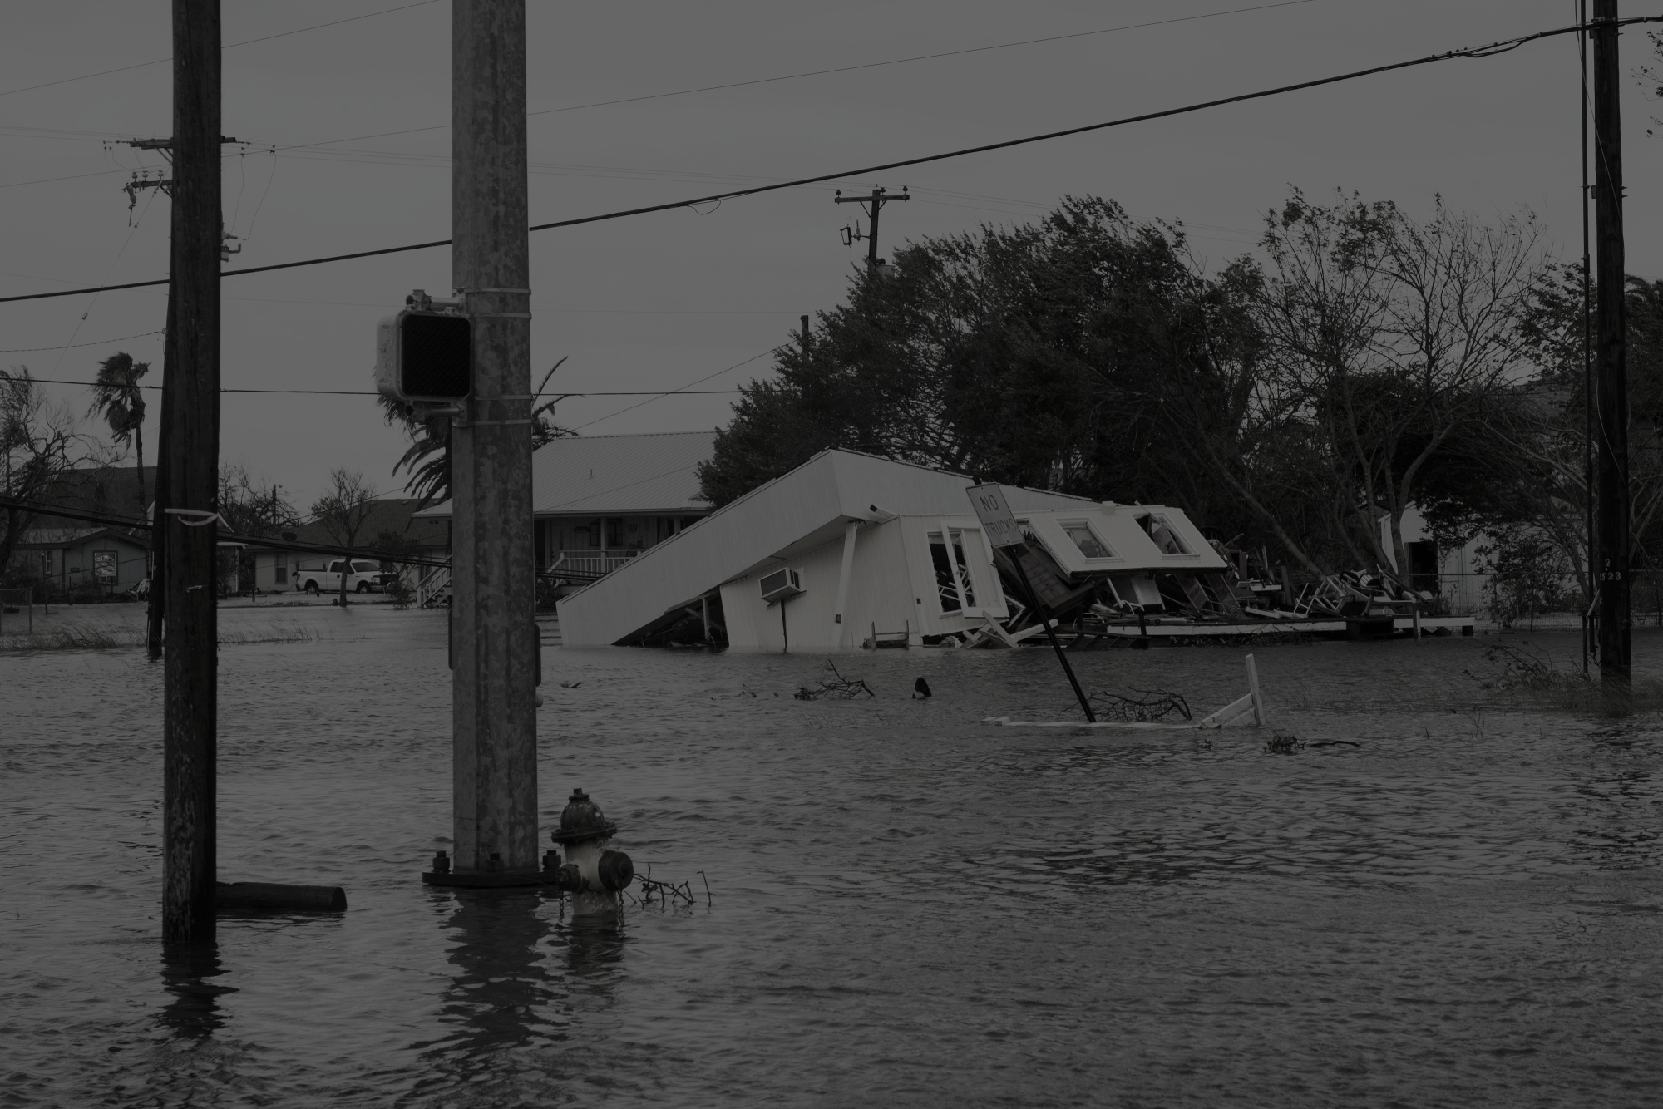
How do these obligations and rights look or change in times of crisis, such as a disaster?

Slide 8
According to the Louisiana Attorney General, if a natural disaster damages a property to the point that it is completely unusable, the lease is terminated automatically.
Louisiana Department of Justice (2018) https://www.ag.state.la.us/Article.aspx/2208?catID=3

Slide 9
Renter’s Rights & Disaster: Disaster Clauses
Some leases will include a disaster clause, especially in disaster prone areas.
Sometimes called a ‘Force Majeure’ clause:
“the court may find that, although a force majeure event occurs with frequency, in any given instance the event was “beyond the reasonable control of the parties.””
More often pertains to businesses

Slide 10
Renter’s Rights & Disaster: Louisiana Context
Historical infrastructural and social discrimination
Unique disaster history
History of poor risk communication or incorrect information
“The post-disaster relationship between landlord and tenant deserves special attention after a mass catastrophe … Unlike a contained event affecting leased premises where the landlord could rebuild at a reasonably foreseeable cost, unknown or escalating rebuild­ing costs after Katrina continue to prevent some lessors from fulfilling their obligations. - Force Majeure Clauses; American Bar Association (2018)

Slide 11
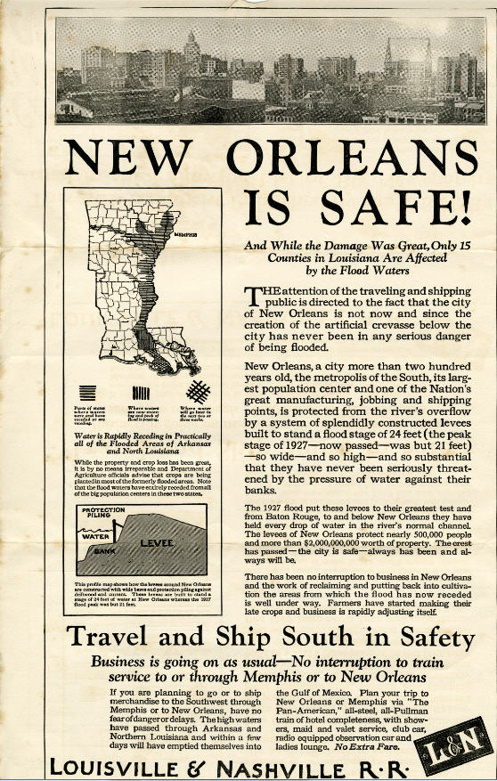
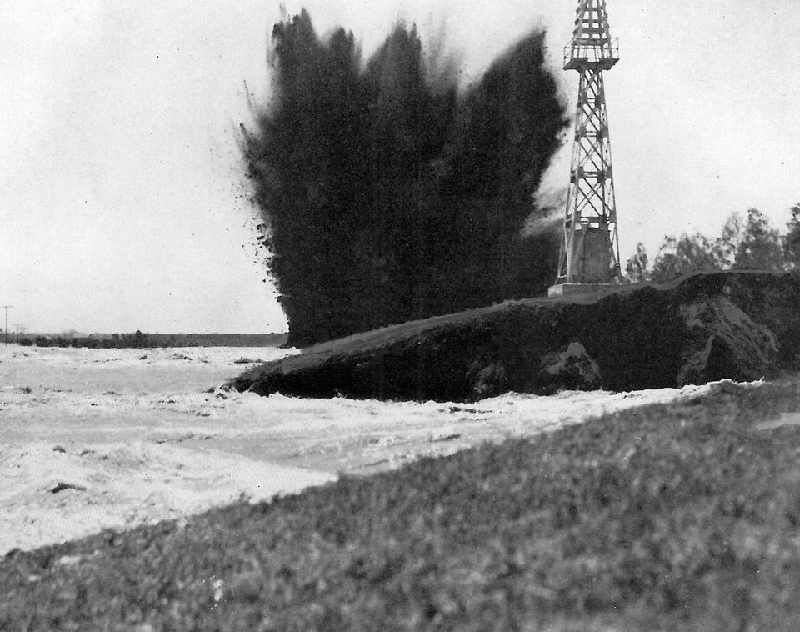
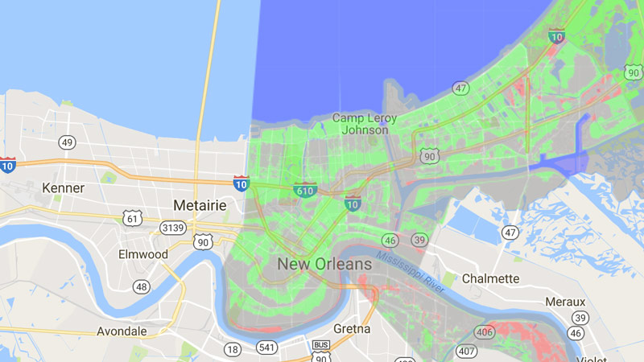
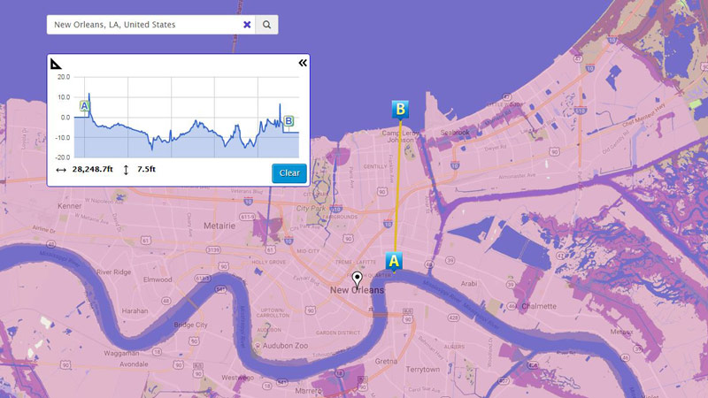
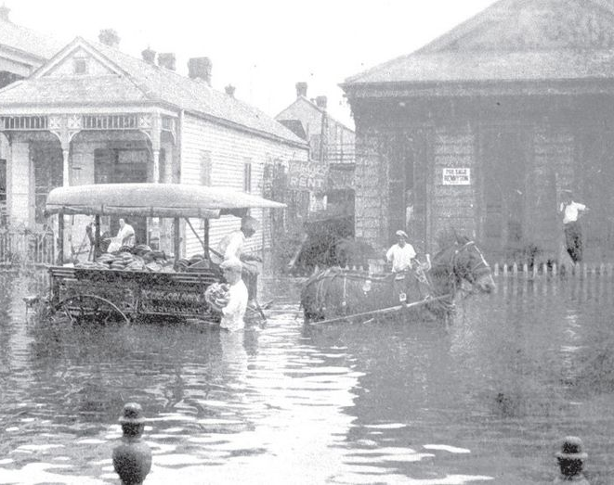
“The new [flood] maps are like a bureaucratic magic trick. At the stroke of midnight, the federal government waved its wand, and Friday morning more than half of New Orleans woke up in a land safe from storms and flooding.” – NPR (2016)
In Louisiana, the lines blur between landowner, tenant, renter, local and federal government.
Notes:
Dynamiting Caernarvon levee

Slide 12
“Even buildings that were damaged but not destroyed are expensive to repair because of increases in the cost of building materials, transportation of such materials, and labor short­ ages. If a lessor is obligated to repair a damaged building but is locked in at the same rental rates, the lease becomes less economically desirable.
Therefore, the lessor may seek to ter­minate a pre-storm lease by claiming an excuse for performance under a force majeure clause to attempt to sign a new tenant at the new rental rates.”
Force Majeure Clauses; American Bar Association (201 https://www.americanbar.org/content/dam/aba/publishing/probate_property_magazine/rppt_publications_magazine_2007_ma_Hoppe_Wright.authcheckdam.pdf

Slide 13
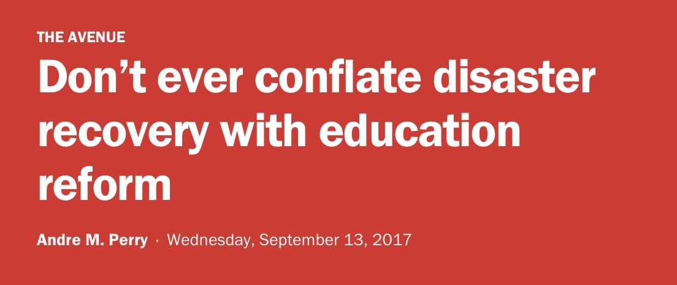
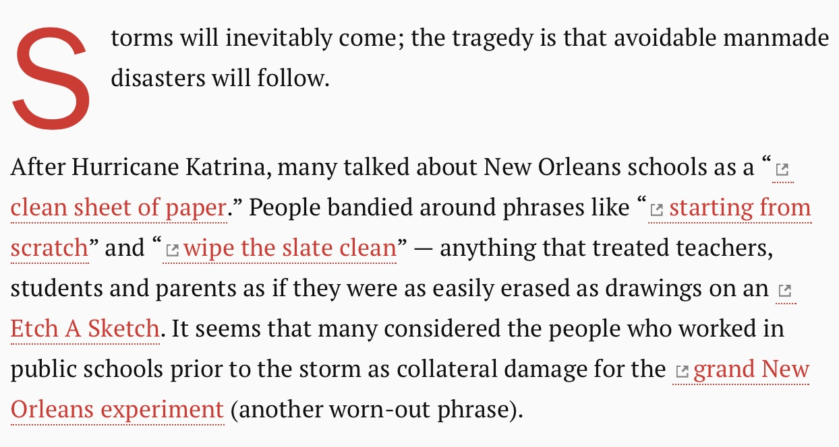
Disaster Opportunism: Why does it matter?
Takes advantage of those in dire circumstances
Can affect recovery efforts negatively
Can subject communities an infrastructural overhaul ill-fitting for context
Shifts focus from the most emergent issues
Can support cultures of neglect

Slide 14
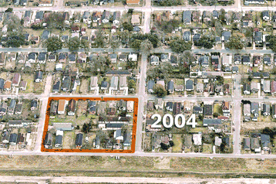
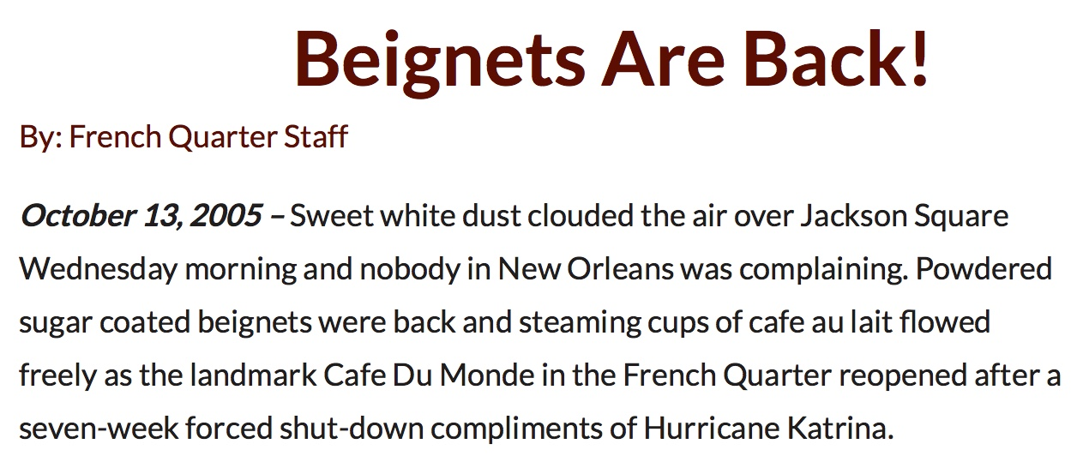
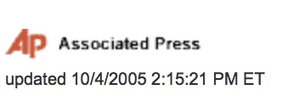
Disaster Opportunism: the opportunity to forget
Notes:
Post Katrina saw very little civilian re-entry control; this can be attributed to multiple geographies of re-entrance, lack of ground hierarchy and control, lack of communication, and a general atmosphere of chaos.
Post-Hurricane Mathew saw “re-entry riots” at check points as citizens tried to return home to coastal areas of the Carolinas.

Slide 15
Post Harvey 19 zip codes saw median rent increases of 10% or greater after the hurricane. The largest changes were in Bellaire, Downtown Houston, and Dickinson, all zip codes that experienced extensive flooding and damage.
Rent Hop Data Project https://www.renthop.com/studies/houston-tx/houston-we-have-a-problem-with-rents

Slide 16
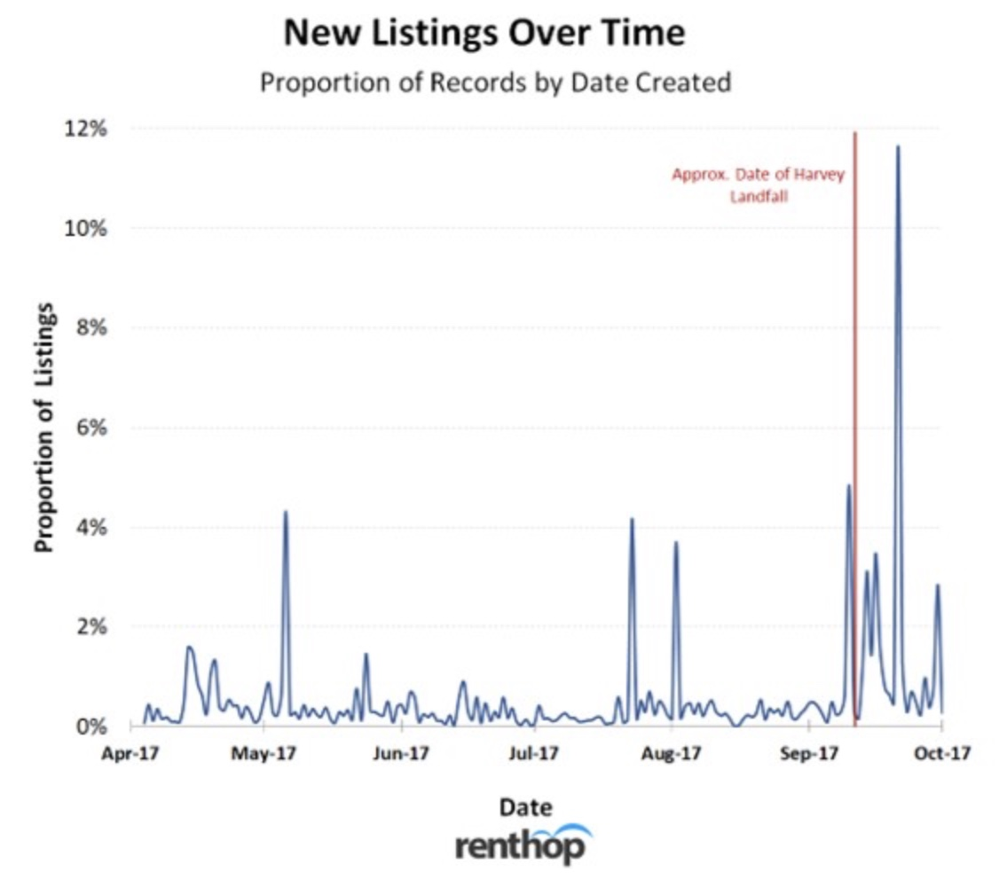
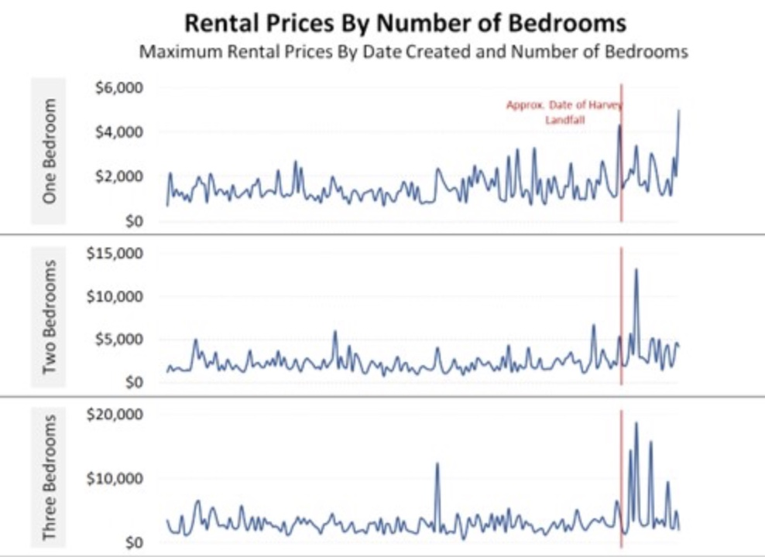
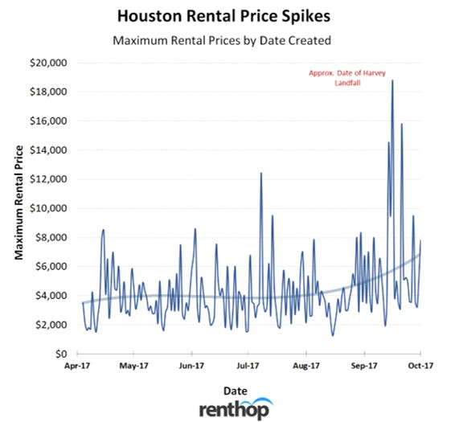
Disaster Opportunism: Rent Hiking & Renter Vulnerability
Houston rentals, post-Harvey, increased by +10%; this was consistent across all sq. ft. and bedroom categories.
Opportunism or Economic Force?
Limited supply?
Limited demand?
Analysts suspect both with high likelihood of price gouging to accommodate losses.

Slide 17
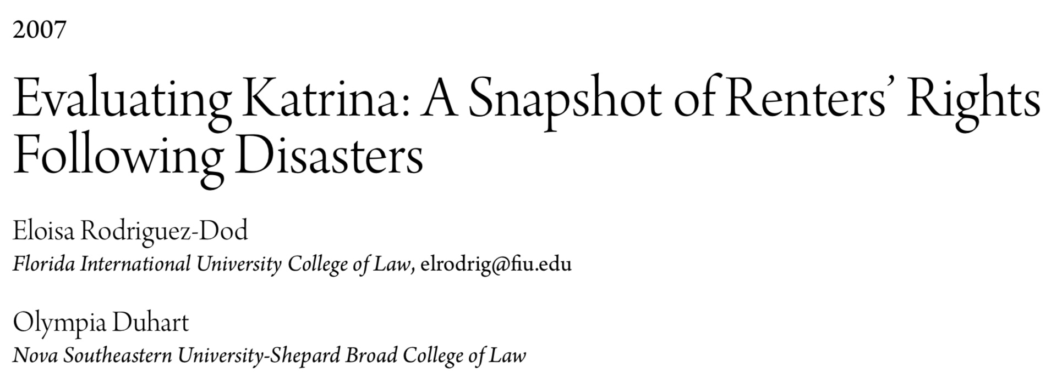

Slide 18
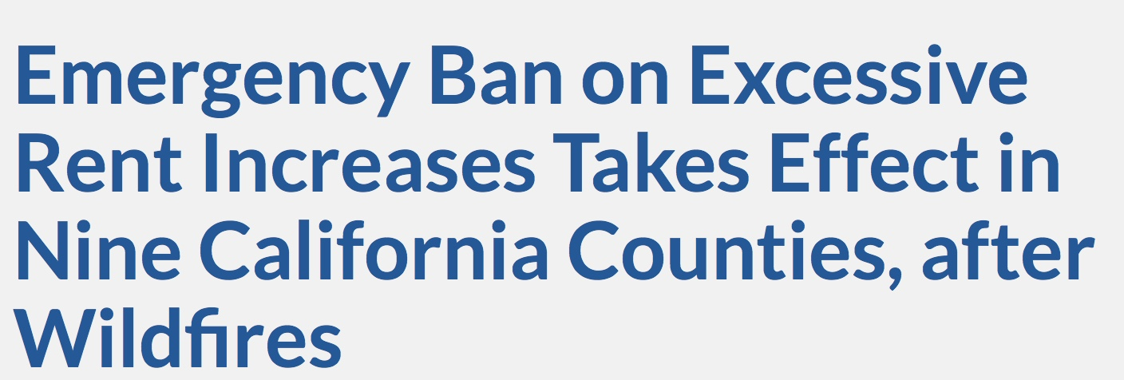

Slide 19
Tools for Counseling for Renter’s Rights: Interim Housing
HUD is currently the only large scale interim housing resource: https://www.hud.gov/states/louisiana/renting
FEMA ended its interim housing resource this year, 2018

Slide 20
Tools for Counseling for Renter’s Rights: HUD Counseling
https://www.hudexchange.info/programs/housing-counseling/housing-counseling-disaster-recovery-toolkit/operating/
HUD Checklist for Recovery: step-by-step counseling for clients who have lost their home in a disaster; or who are struggling with rent.
Scam and Fraud Protection: how to spot and avoid scams and fraud related to housing development, recovery and renting
Rental and Housing Insurance Claims

Slide 21
Next Week: Low–Income Housing

