Slide 1



Session 3: Cognitive Behavioral Therapy (CBT) for Depression
C-LEARN
Mental Health and Resilience

Slide 2

Introduction
Speaker: Wayne Bentham, MD
Review of Session 1 & Session 2:
  The Collaborative Care Model
  Models of Depression
  Problem Solving Therapy

Slide 3









The Collaborative Care Model-Overview
PRIMARY CARE MANAGMENT OF BEHAVIORAL HEALTH
“Make sure NO ONE falls through the cracks”
Registry
Consulting Psychiatrist
Care Coordinator
Home Health Giver
Case Manager
AODA
Therapist

Slide 4
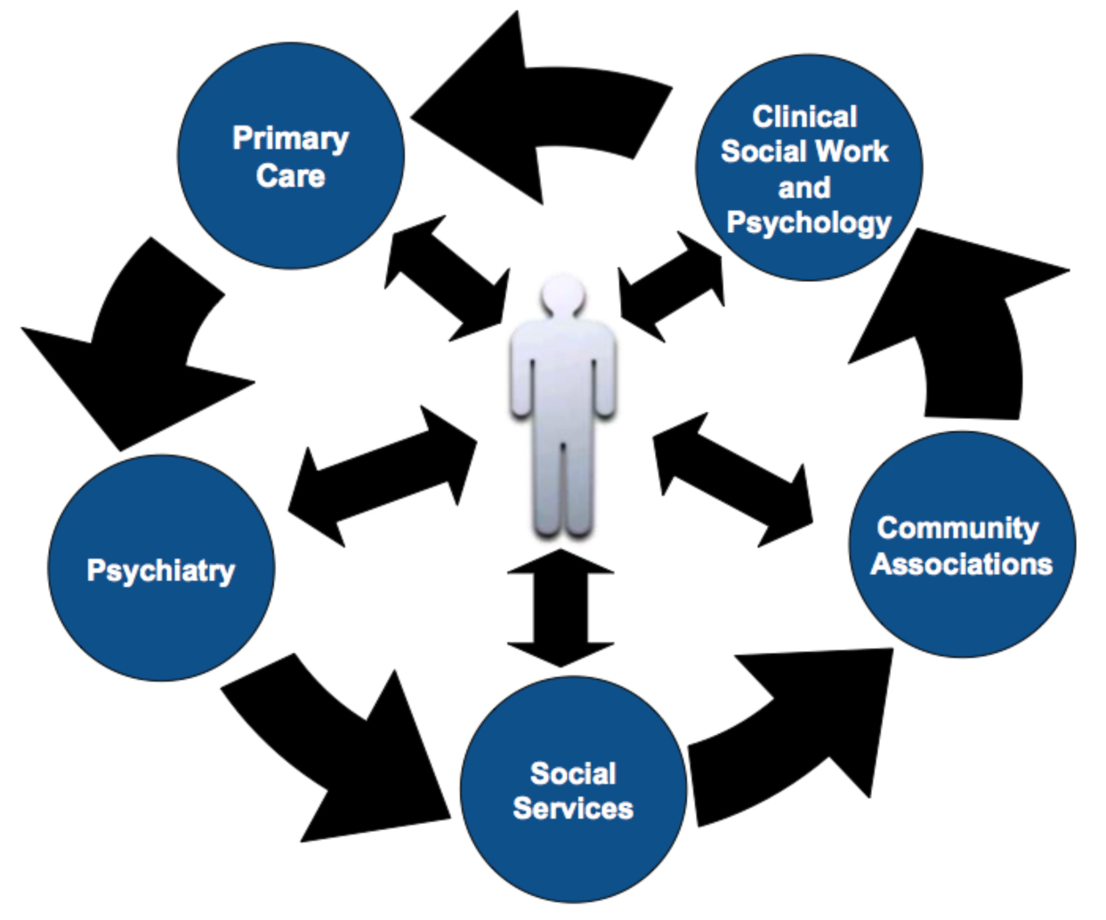
The Collaborative Care Model- Overview

Slide 5
Screening for Depression

Slide 6
Symptoms of Depression
Cognitive
Emotional
Physical
Significant or Severe
Change in Function
Or Behavior

Slide 7
It’s never “just depression”
Depression
Anxiety
??
Alcohol
PTSD

Slide 8
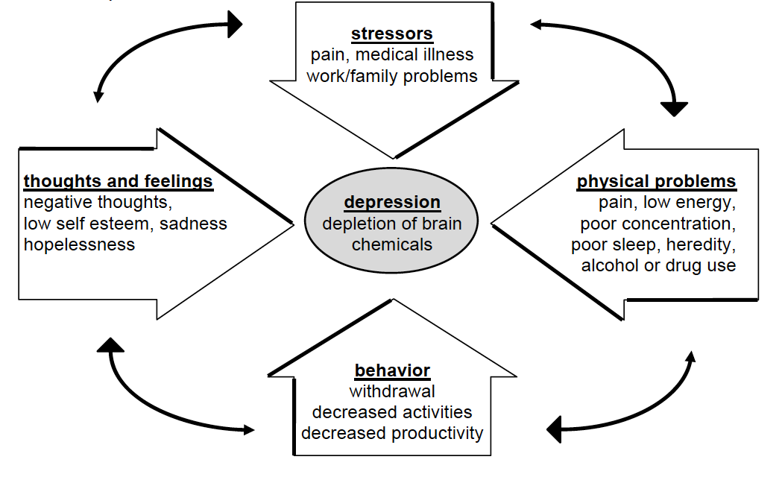
Cycle of Depression

Slide 9







Seven Steps of PST for Primacy Care
1. Clarify and Define the Problem
2. Set Realistic/Achievable Goal
3. Generate Multiple Solutions
4. Evaluate and Compare Solutions
5. Select a Feasible Solution
6. Implement the Solution
7. Evaluate the Outcome

Slide 10
Overview of
Cognitive Behavioral Therapy
CBT is the most researched form of psychotherapy
  325 published outcome studies
  Adapted for many disorders
  Generally structured and short-term
More difficult to learn than many psychotherapies (requires training and supervised case with feedback)

Slide 11
Symptoms of Depression
Cognitive
Emotional
Physical
Significant or Severe
Change in Function
Or Behavior

Slide 12
Main Ideas of CBT
THOUGHTS
EMOTIONS
BEHAVIOR
Significant Improvement
In & Recovery From
Depression

Slide 13
Main Ideas of CBT
Thoughts
Behaviors

Slide 14
Main Ideas of CBT
Dysfunctional thinking may predispose to depression.
Thinking is highly related to mood.
Thinking is highly related to activities one engages in.
Activities are highly related to mood.
Thinking is highly related to how one interacts with others.
Social support is related to mood.

Slide 15

The power of thoughts is in how they make you feel and act.
You can CHOOSE the manner in which you think.

Slide 16
Main Ideas of CBT
AWARENESS
ACTION
CHANGE
Thoughts
Emotions
Actions
Improvement
In Symptoms

Slide 17
Main Ideas of CBT
AWARENESS
ACTION
CHANGE
-Present Focused
-Behavior Focused
-Requires Practice
-Homework

Slide 18
Main Ideas of CBT
Depression
Generalized Anxiety
PTSD
Panic Disorder
Specific Phobias
Substance Use & Gambling

Slide 19
Main Ideas of CBT
Techniques and Processes
Problem Solving Therapy
Progressive Muscle Relaxation
Exposure & Response Prevention
Pleasant Events Scheduling

Slide 20
How CBT works
Improving interactions with people improves mood.
Negative thinking interferes with good interactions.
Improve social network.
Improve assertiveness.
Improve problem-solving with others.
Learn to build trust slowly.

Slide 21
CBT for Depression
Over 75 clinical trials since 1977
Meta-analyses show CBT superior to:
  Wait list control
  Placebo control
  Psychodynamic therapy
CBT equal to:
  Behavior therapy
  Medications for all but most severely depressed
Combined CBT and medications:
  May be superior to only one in severely depressed.
CBT may help prevent relapse
  30% of CBT treated versus 60% of medication treated relapse at 1 year

Slide 22
Treating Depression with CBT
Changing dysfunctional thinking can improve mood.
  Help patient to identify the accuracy of their thinking.
  Help patient develop alternatives to negative thinking
    If I’m too ill to work, I’m useless → Although I’m unable to work, I’m a good friend and good member of the community.
Engaging in pleasant activities improves mood.
  Negative thinking can decrease pleasant activities.
  Losses of work, life partners, etc. can lead to low levels of pleasant activities.
  Increasing pleasant activities increases mood.

Slide 23
Harmful Thoughts are not
Accurate, Complete, and Balanced

Slide 24
Mood Scale

Slide 25
Pleasant Activities Can Increase Resilience
When you do one activity, you often start a chain – one activity could lead to another activity, other thoughts, other feelings, and contacts with other people.
In general, more helpful activities lead to more helpful thoughts and feelings. So it is important to keep in mind that you have some choice in the thoughts and activities you engage in.
Activities are linked to mood. When you feel down, it may be hard to find the energy to do healthy activities. But when you do activities you are more likely to:

Slide 26
Types of Pleasant Activities
Think about activities that you can do:
Alone
For free
With other people
Quickly and simply
It is good to have activities that you can do alone.
You can control when you do them and you are not dependent on anyone else.
It is important to have time alone to think and enjoy your own thoughts.
It is also good to have activities you can do with other people.
Pleasant contacts with people often make us feel better.
Other people may increase your motivation to do the activity.
Doing fun stuff together helps people enjoy each other more, and can build and improve relationships.

Slide 27
Types of Pleasant Activities (continued)
Activities that are inexpensive or free are important.
You can do more of them.
You won’t feel stressed because you are spending money.
You can do them at any time, whether you have extra money or not.
Activities that don’t take too much time are important.
You can do more of them.
They are useful when you are busy and can’t find a lot of time.
Brief activities give you a glimpse of the beauty of the world.

Slide 28
Types of Healthy Activities
It may be helpful to think about healthy activities in four general categories:
Self care activities are the things you do to take care of yourself and the business of your life. For example:
Exercising at least 30 minutes a day
Planning your meals
Drinking plenty of water
Fun activities are simple, health things you can do to bring you pleasure. For example:
Pleasant contacts with people often make us feel better.
Other people may increase your motivation to do the activity.
Doing fun stuff together helps people enjoy each other more, and can build and improve relationships.

Slide 29
Healthy Activities (continued)
Learning activities give you a sense of accomplishment or of having learned to do something well. For example:
Starting an exercise program
Practicing the mood management skills
Meaningful activities fit with your values. Meaningful activities boost your health self-image and bring purpose to your life. For example:
Being a good parent or friend
Working
Letting somebody else go first in line
Participating in church, social, political, or community activities

Slide 30
Problem Solving
Be a detective. Try using this problem-solving method to figure out what is making it hard for you to do activities, be resilient, and feel better.

Slide 31
The Importance of Healthy Relationships
The contacts you have with other people can have a positive effect on your mood, thoughts, and behaviors. Other people can help you handle problems, and they can share life’s pleasant moments.
How does low mood affect the way you relate to other people and your resilience?
When your mood is low, you might:
Have less contact with others and avoid others
Be more irritable
Have more conflict or tension with others
Feel more uncomfortable around people
Act quieter and less talkative
Be more sensitive to being ignored, criticized,
or rejected
Trust others less
Low mood
Lowered resilience
Fewer positive
interactions
with people

Slide 32
The Importance of Healthy Relationships
(continued)
When you have less contact with other people you might feel:
Alone
Sad
Angry
Like no one cares
More depressed
But when your interactions with others are positive, you will feel more resilient and your mood will improve.
Increased mood
Increased resilience
More positive
interactions
with people

Slide 33
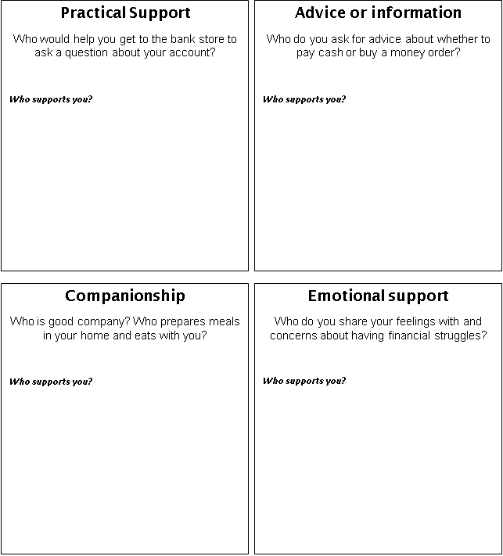
Mapping Your Social/Resiliency Support Network

Slide 34
The Collaborative Care Model- Overview

Slide 35
Listening Well
Active listening is the key in any relationship. Active listening means to give your full attention to the conversation and hear everything the other person says. Try doing some active listening:
Get together with another person.
Take turns talking about what kind of person you are trying to become. Each person should have about five minutes to talk.
The other person will not interrupt you.
If you are the speaker, think about the following:
Is your partner listening to you? How do you know?
What did your partner do that helped you know he or she was listening?
What was not so helpful about what your partner did?
How do you feel? Did it improve your mood to share your thoughts and feelings with somebody who was really listening?

Slide 36
Next Week - Session 4: Medication Management for Depression Care
Thank You!

